Slide 1
One University Development Partners, LLC
Braddock District Land Use Committee Presentation
March 19, 2019

Slide 2
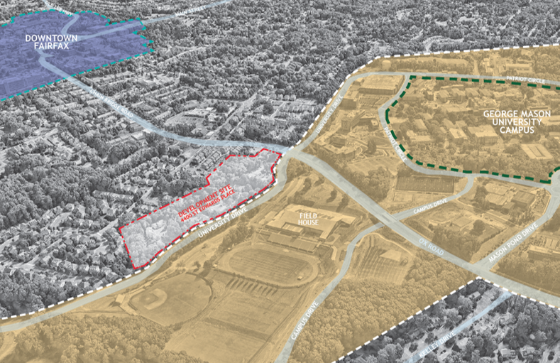
Review of Application
Plan amendment and rezoning application
10.84 acres
Proposal for Affordable (Family and Senior) and Student housing
Review of Schedule
Oct. ‘18 - Community meeting
Dec. ‘18 – Braddock Dist. LU Committee
Jan. ‘19 – Community meeting
Feb. ‘19 – Resubmitted rezoning application
March‘19 – Braddock Dist. LU Committee
April 3 – Staff report published for plan amendment
April 5 – Resubmit rezoning application to staff
April 8 – Community meeting
April 16 – Braddock District LU Committee on plan amendment
April 24 – Planning Commission hearing on plan amendment
May 21 – Board of Supervisors hearing on plan amendment
July 10 – Planning Commission hearing on rezoning

Slide 3
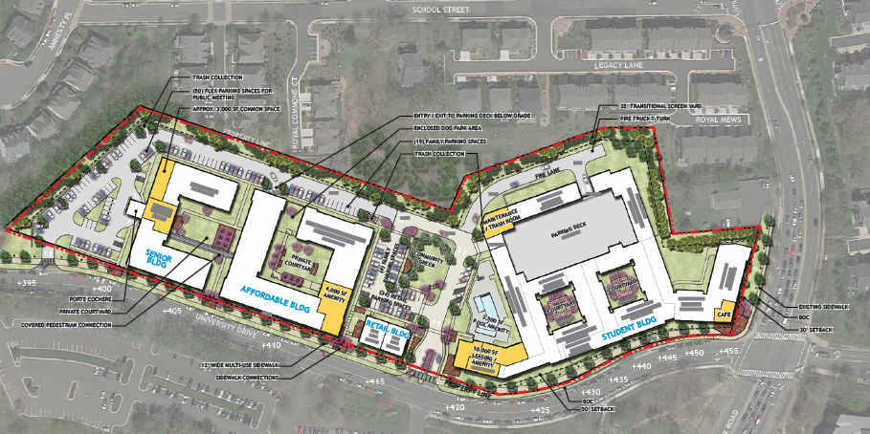
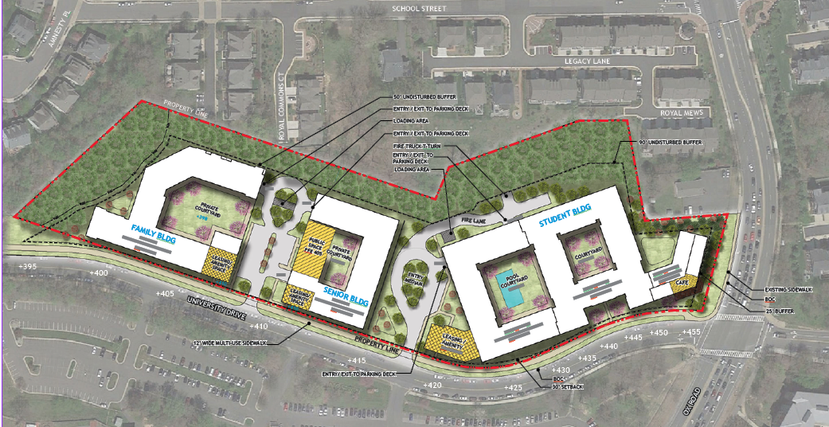
October 2018 Site Design
General Site Design Revisions
Complete redesign of parking layout
Increased setbacks and undisturbed buffers
Redesign and re-orientate buildings
Reduce number of units
Change site entrance locations
April 2019 Site Design

Slide 4
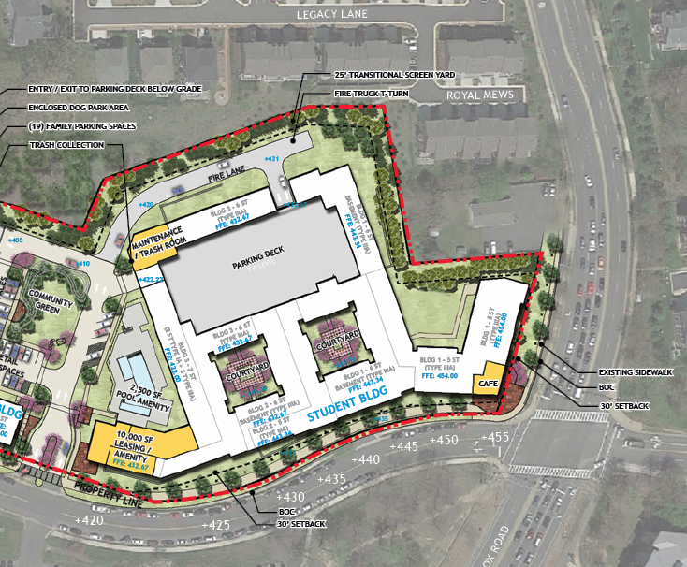
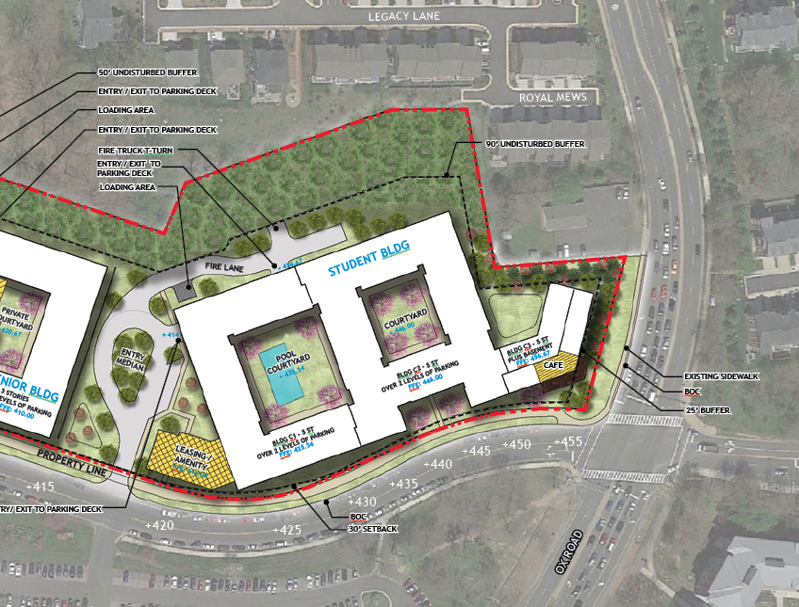
October 2018 Student Building Design
83’ Building Setback from North Lot Line
25’ Planted Buffer along North Lot Line
Up to 84’ Building Height from Average Grade Plane
10’ Ox Road Building Setback
April 2019 Student Building Design
153’ Building Setback from North Lot Line
90’ Undisturbed Tree Preservation Buffer along North Lot Line
Up to 75’ Building Height from Average Grade Plane
25’ Building Setback with Planted buffer along Ox Road

Slide 5
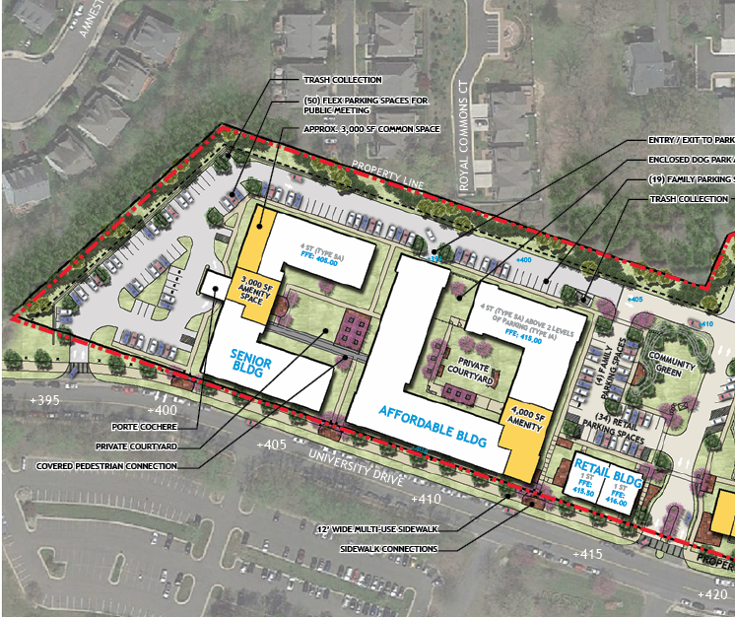
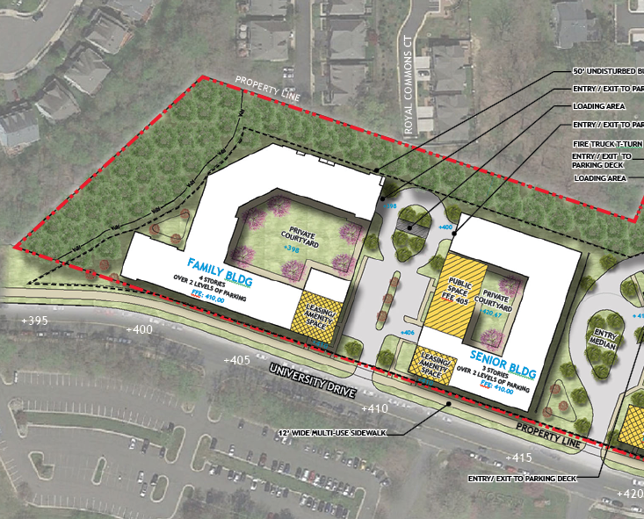
October 2018 Affordable Buildings Design
Parking and drive aisles located behind buildings
25’ Planted Buffer along North Lot Line
4 Story Senior Building
Family Building located in center of site
Disturbance of RPA zone
April 2019 Affordable Buildings Design
Parking and drive aisles removed from behind buildings
50’ Undisturbed Buffer along North Lot Line
3 Story Senior Building
Family Building flipped location with Senior Building
No disturbance in RPA zone; Restoration proposed

Slide 6
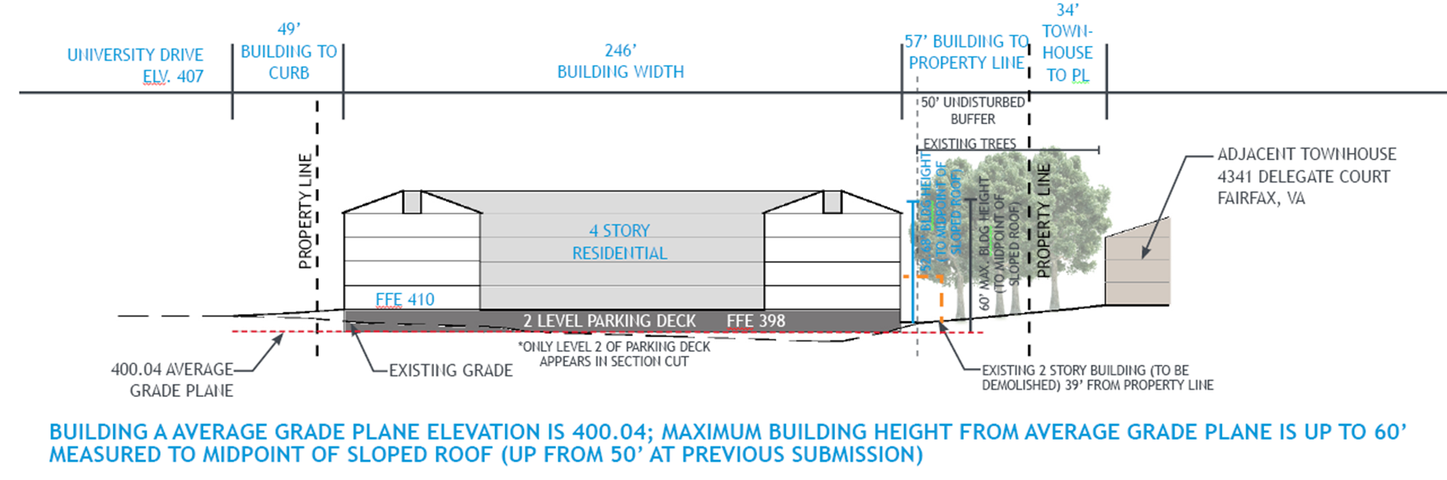
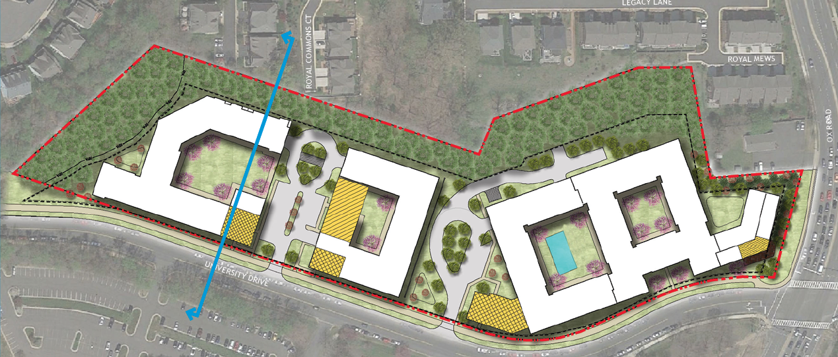
Family Building – Section AA

Slide 7
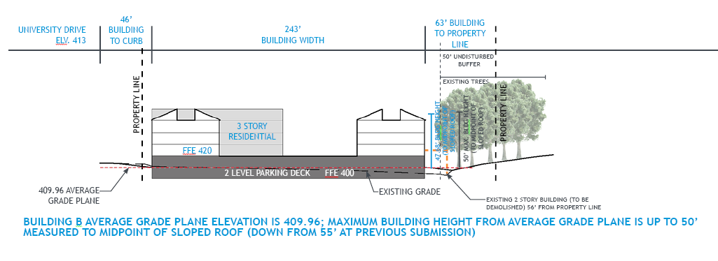
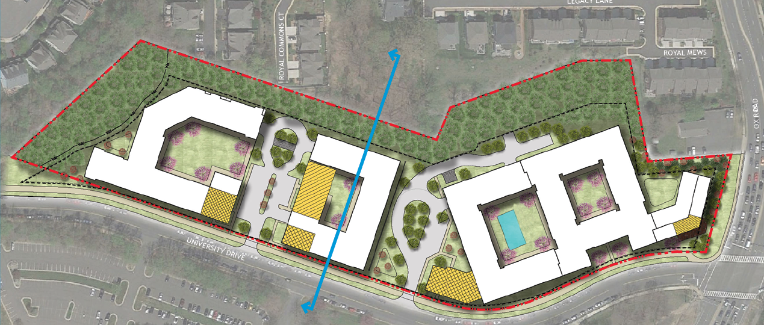
Senior Building – Section BB

Slide 8
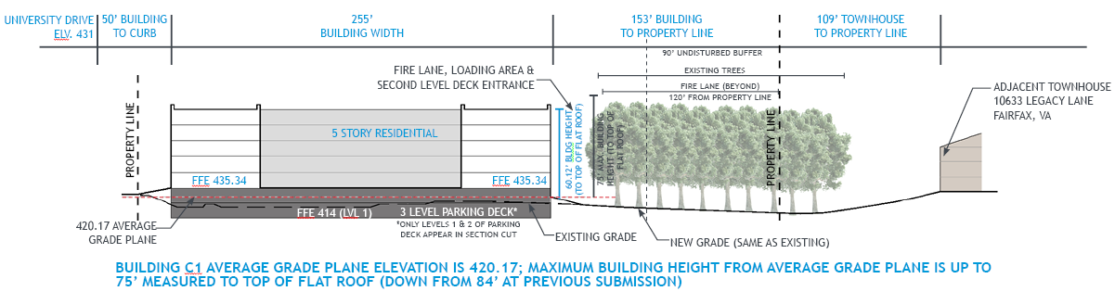
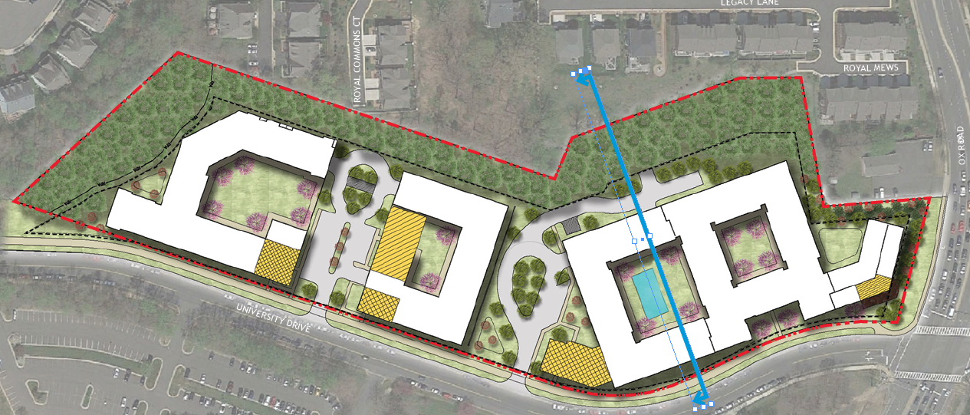
Student Building – Section C1

Slide 9
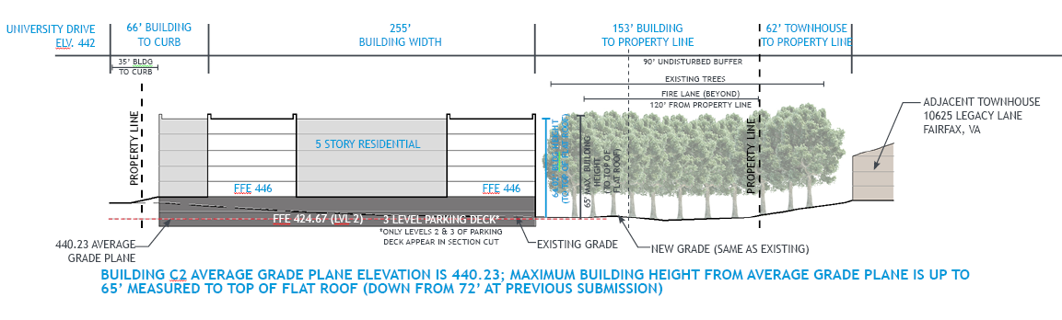
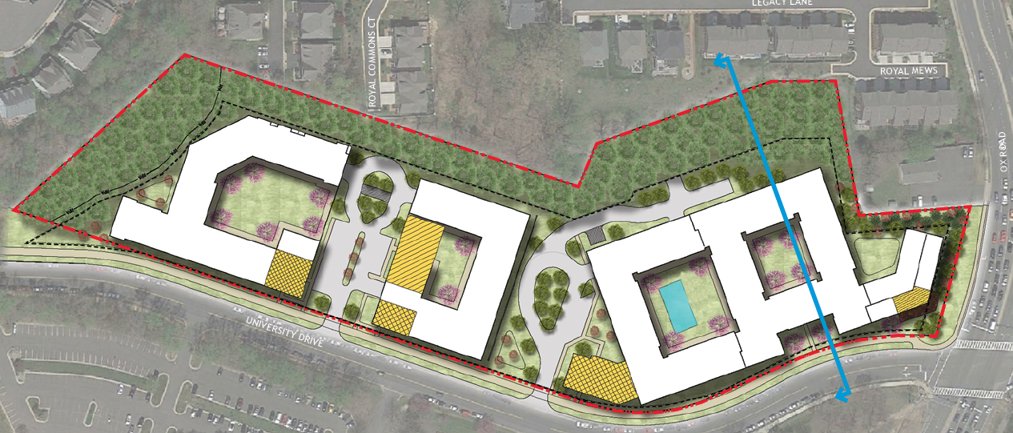
Student Building – Section C2

Slide 10
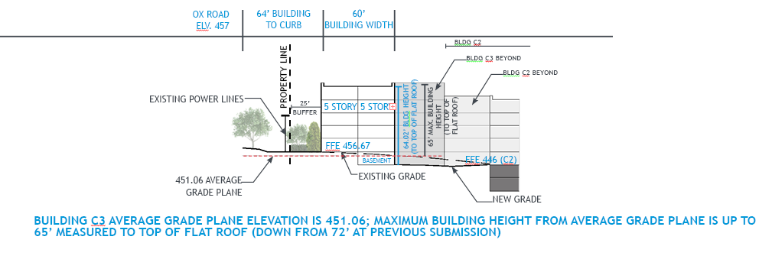
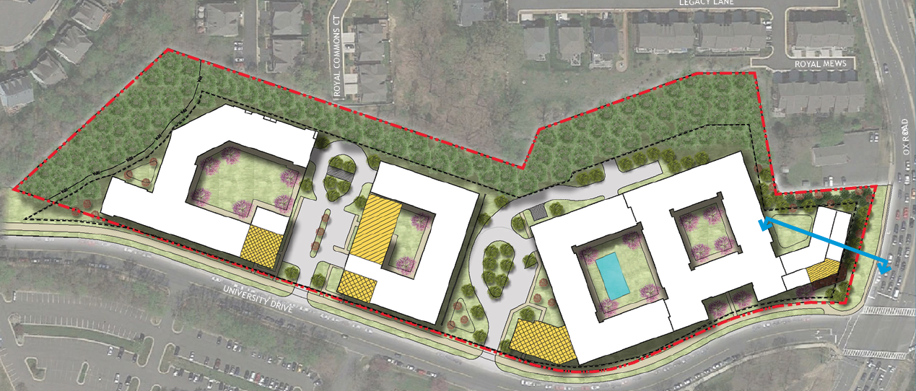
Student Building – Section C3

Slide 11
Recap of Proposed Vehicular Improvements
Remove part of parking along southern side of University Drive
Restripe EB approach to provide a dedicated right turn lane
Modify signal timing: right turn arrow in dedicated lane timed with NB and SB lefts on 123
Lengthen NB left turn lane on 123
Results
Decrease in overall delay at intersection during the AM and PM peaks over future condition without the development
Decrease in eastbound University Drive delay queues during the AM and PM peak over future condition without the development
Traffic study assumes all units are multifamily.

Slide 14
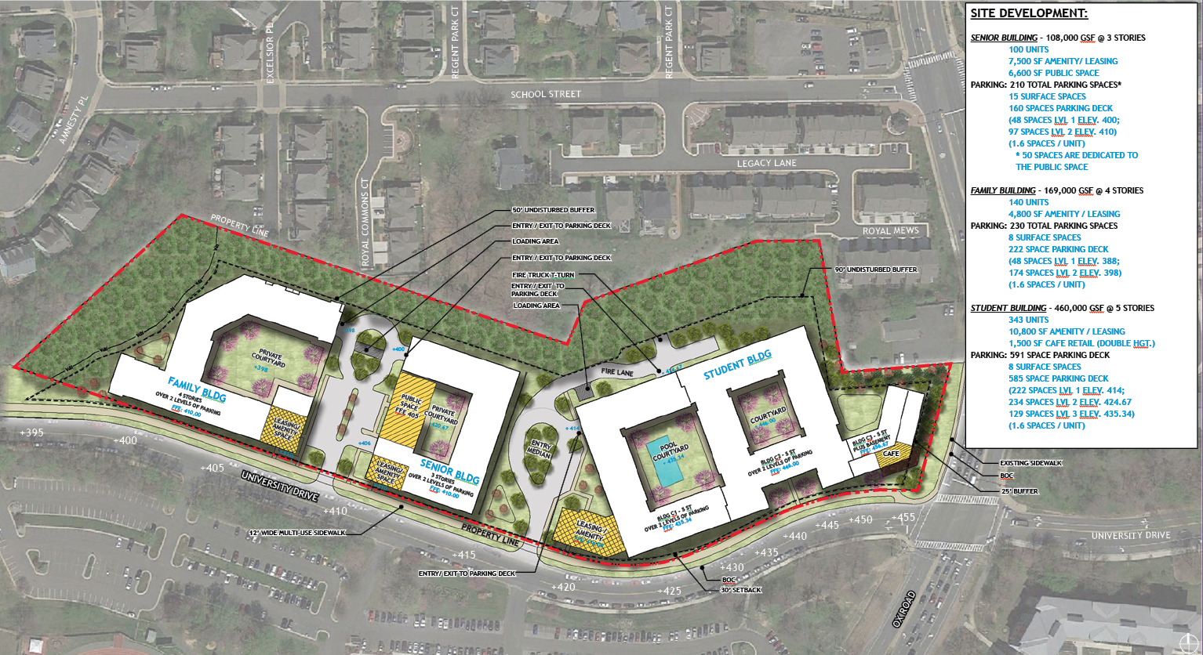
QUESTIONS?

