Slide 1
ROBERTS ROAD RZ/FDP 2017-BR-030
Community Meeting
February 12, 2019, 7:30 p.m.

Slide 2
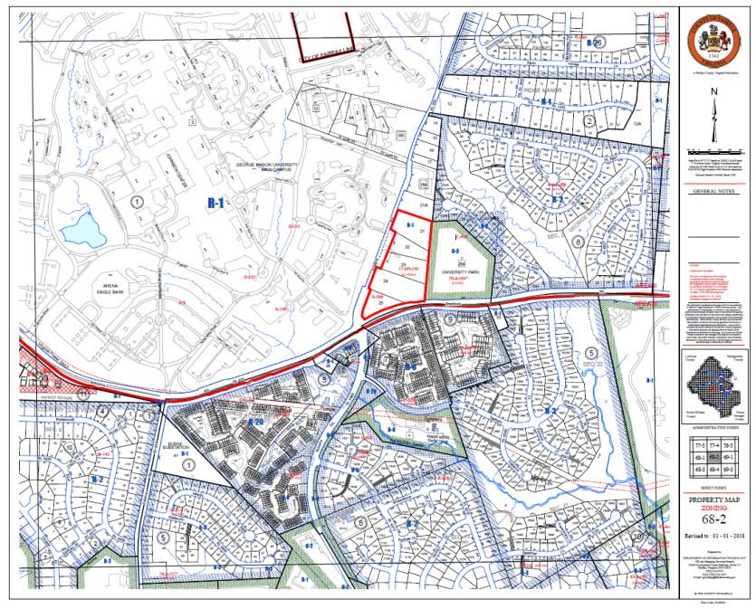

Slide 3
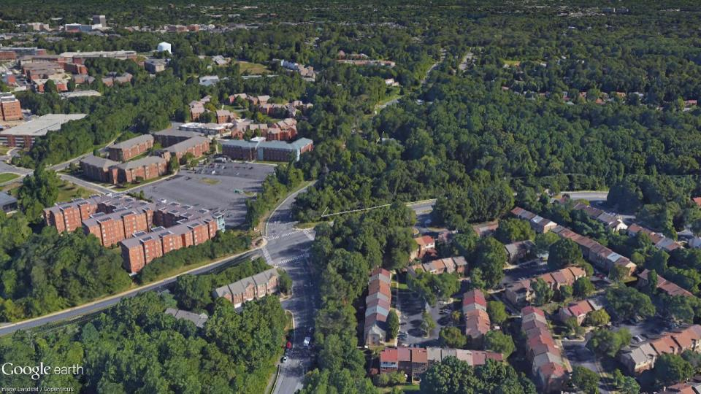

Slide 4
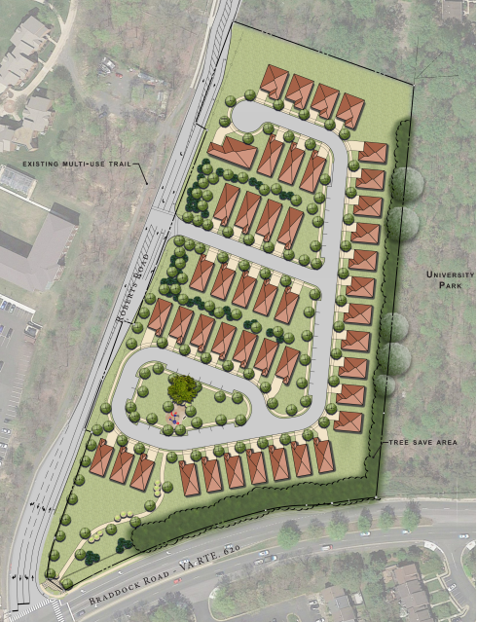
ILLUSTRATIVE PLAN
SITE TABULATION
LAND AREA: | ±9.567 AC
PROPOSED ROW DEDICATION: | ±1.99 AC
NET SITE AREA: | ±7.577 AC
DENSITY CREDIT: | ±0.922 AC
PROPOSED DENSITY: | 4.29 DU/AC
PARKING SPACES REQUIRED: | 90 SPACES
PARKING SPACES PROVIDED: | ±208 SPACES
OPEN SPACE PROVIDED: | ± 2.60 AC
ACTIVE OPEN SPACE: | ± 1.06 AC
BUILDING HEIGHT: | 60' MAX.
TOTAL UNITS: 45

Slide 5
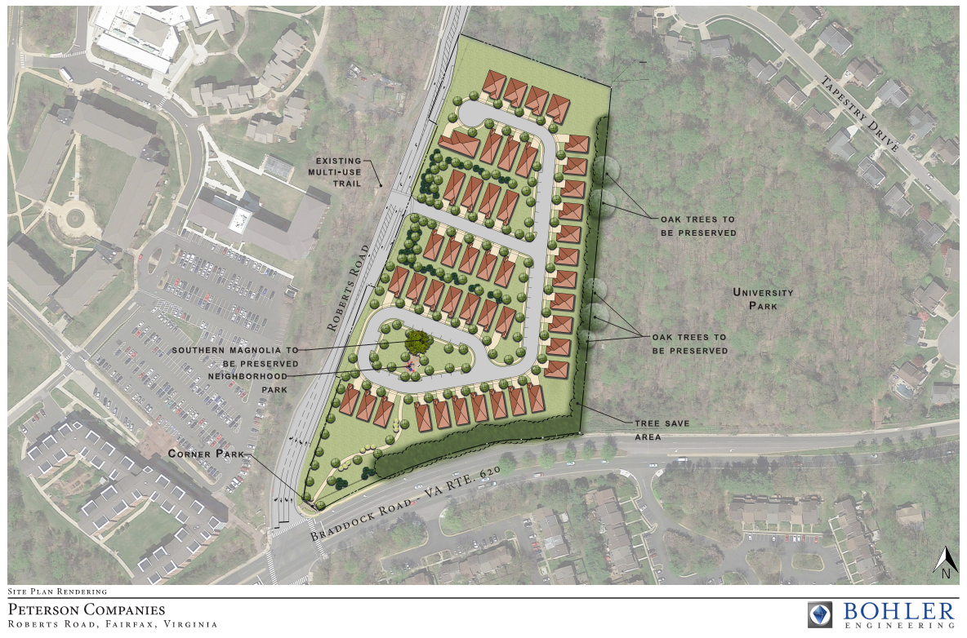

Slide 6
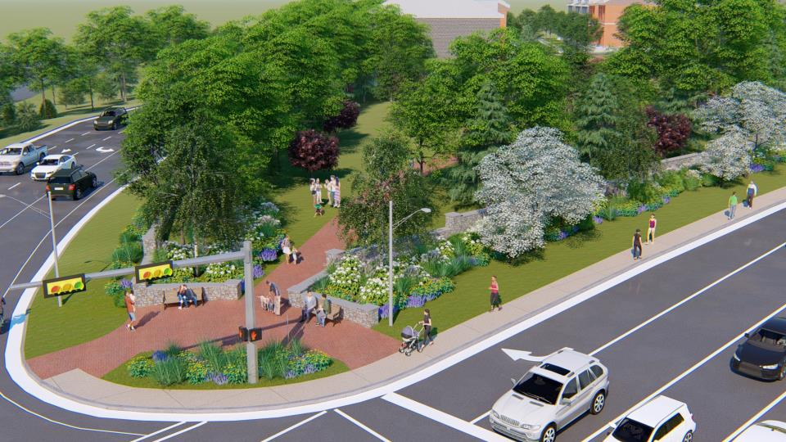

Slide 7
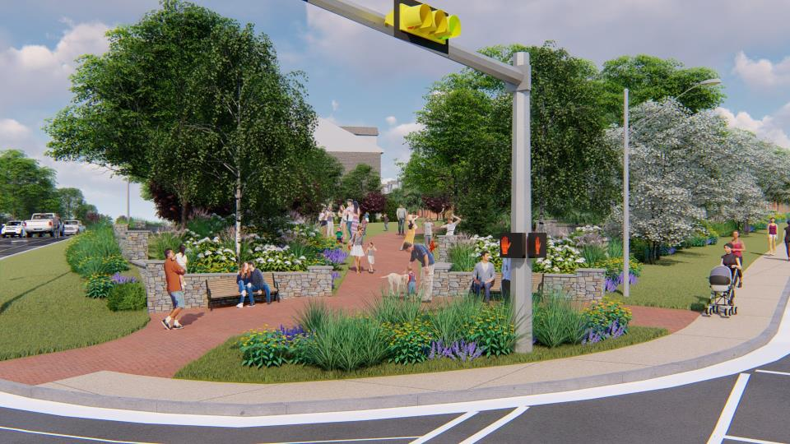

Slide 9
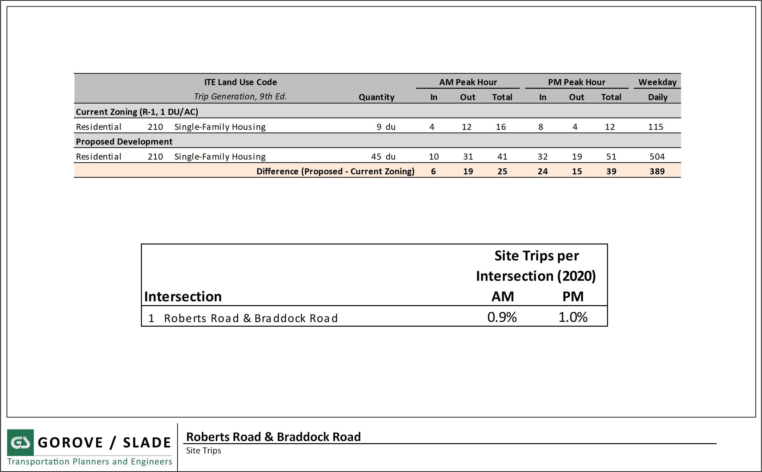

Slide 10
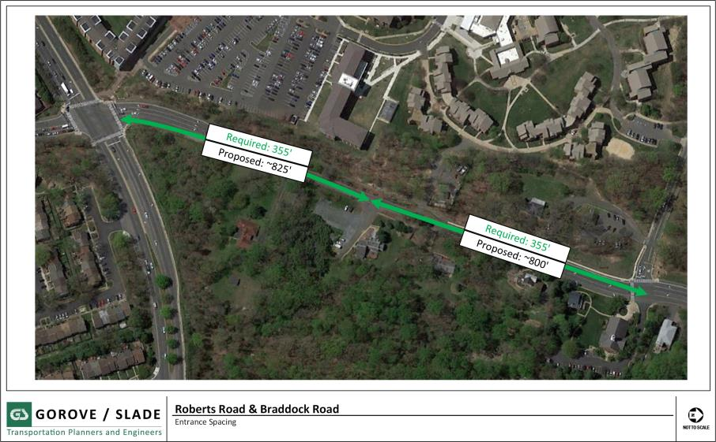

Slide 11
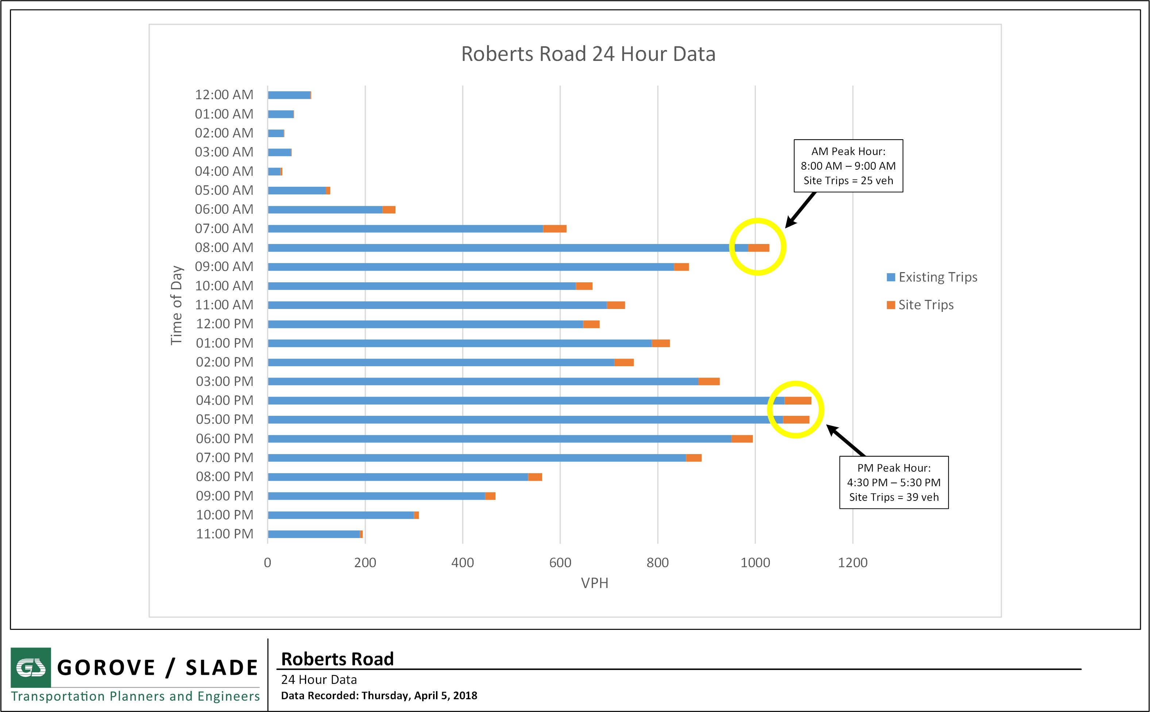

Slide 12
