Slide 1
FAIRFAX-FALLS CHURCH COMMUNITY
Partnership to Prevent and End Homelessness
Bi-Annual CoC Meeting
June 13th 2019 | 1:30 – 3:30 PM
Pennino, Room 206

Slide 2
AGENDA
1) System Performance Measures
2) Introductions & Agency Updates
3) Partnership Updates & Initiatives

Slide 3
SYSTEM PERFORMANCE MEASURES
Marcy Thompson | Principal, Homeless Services
ICF | 9300 Lee Highway Fairfax VA 22931

Slide 4
System Performance Measures: Why they Matter
icf.com
Marcy Thompson, Principal, Homeless Services
marcy.thompson@icf.com
June 13, 2019

Slide 5
What is a System?
Many parts
Doing different things
Working together
Toward a common goal

Slide 6
Purpose of System Performance Measures
Ensure common understanding of system intent and goals, along with the projects that make up the CoC’s system
Focus on measuring the cumulative impact of programs, not just their individual impact
Help CoCs gauge their progress toward preventing and ending homelessness
Identify areas for improvement
Meet HEARTH requirements

Slide 7
Setting Local Performance Targets
HUD will use the system performance data to establish national targets
Communities should use national targets as benchmarks for setting local targets
Local targets should take into account
The nature of the local homeless population (e.g., prevalence of youth)
Local priorities as CoCs implement system change
Other unique local circumstances
HUD is not setting targets for subpopulations but communities should account for subpopulation types when setting targets
National
Targets
HUD
CoCs

Slide 8
Measures and Desired Outcomes
Measure 1: Length of Time Persons Remain Homeless
Measure 2: The Extent to which Persons who Exit Homelessness to Permanent Housing
Destinations Return to Homelessness within 6, 12, and 24 Months
Measure 3: Number of Homeless Persons
Measure 4: Employment and Income Growth for Homeless Persons in
CoC Program-funded Projects
Measure 5: Number of Persons who Homeless for the First Time
Measure 6: Homelessness Prevention and Housing Placement of Persons Defined by
Category 3 of HUD’s Homeless Definition in CoC Program-funded Projects
Measure 7a: Successful Placement from Street Outreach
Measure 7b: Successful Placement in or Retention of PH

Slide 9
System Performance in Context
The performance measures are interrelated and, when analyzed relative to each other, provide a more complete picture of system performance
Communities must begin to understand the full impact of decisions
Some decisions are “bandaid” decisions that appear to fix a short-term issue but create other issues, whereas other decisions create overall better impacts – the measures are intended to highlight some of this

Slide 10
Where to Start?
System Performance Improvement Briefs
Data Quality and Analysis for System Performance Improvement
Strategies for System Performance Improvement
Stella!
Focus on Data Quality
The more you use data, the quality improves
Use data for all decision-making
Start Peeling the Onion!

Slide 11
RARE
BRIEF
ONE TIME
System performance measure #3
Number of persons experiencing homelessness
METRIC 3.1 — CHANGE IN PIT COUNTS | METRIC 3.2 — CHANGE IN Annual Counts
PIT Count
7% decrease between
2016 & 2018
ANNUAL Count
10% decrease between
2016 & 2018
PIT & ANNUAL COUNTS
Point-in-Time Count
(Street Outreach, Emergency Shelter,
& Transitional Housing)
Annual Count
(Emergency Shelter & Transitional Housing)
Federal fiscal year: 10/01 – 09/30

Slide 12
RARE
BRIEF
ONE TIME
System performance measure #5
First time homelessness
METRIC 5.1 — CHANGE IN THE # OF PERSONS IN ES+TH WITH NO PRIOR ENROLLMENTS IN HMIS
FIRST TIME HOMELESS
7% decrease between
2016 & 2018
10% decrease between
2017 & 2018
FIRST TIME HOMELESSS
Emergency Shelter & Transitional Housing
Federal fiscal year: 10/01 – 09/30

Slide 13
RARE
BRIEF
ONE TIME
System performance measure #1
Length of time persons remain homeless
METRIC 1.1 — Emergency Shelter
Average length of stay
14% increase between
2016 & 2018
Number of persons served
9% decrease between
2016 & 2018
Average length of stay
(days)
Number of Persons Served
Includes Hypothermia
Federal fiscal year: 10/01 – 09/30

Slide 14
RARE
BRIEF
ONE TIME
System performance measure #7
Exits to permanent housing
METRIC 7b.1 — CHANGE IN PERSONS EXITING TO PERMANENT HOUSING
Percent exiting to permanent housinG
Permanent housing retention
5% increase between
2017 & 2018
ES + TH + RRH To Permanent
2% decrease between
2017 & 2018
Street Outreach To Permanent
no change between
2017 & 2018
Exiting from Permanent Housing (excluding Rapid Rehousing) OR retaining permanent housing
Exiting from Emergency Shelter, Transitional Housing, & Rapid Rehousing
Exiting from Street Outreach
Federal fiscal year: 10/01 – 09/30

Slide 15
INTRODUCTIONS & AGENCY UPDATES

Slide 16
PARTNERSHIP UPDATES & INITIATIVES
FUNDING
POLICY
DATA
NEW & UPCOMING
2019 HUD CoC Program Competition
Coordinated Entry
One Fairfax – Homeless Services Racial Equity Work
HMIS Super Users Steering Committee
Built for Zero
Bailey’s Shelter & Supportive Housing
Training Curriculum
Artemis House Expansion

Slide 17
HMIS SUPER USERS – COMMITTEE STRUCTURE
Data Analytics
SUBCOMMITTEE
Data Quality
SUBCOMMITTEE
HMIS Super User COMMITTEE
Training
(End User)
SUBCOMMITTEE
System Administration
SUBCOMMITTEE
INNOVATE - COLLABORATE - ACT

Slide 18
HMIS SUPER USERS – STEERING COMMITTEE
PURPOSE
GOALS & OBJECTIVES
MEMBERS
Liaison between Super Users and CoC
Advisory body
Give strategic direction to the subcommittees, their projects and partner agency workflows
Consider subcommittee work to comply with CoC standards
Commit to transparency
Report out to Super User community
Make recommendations, decisions and inquiries
Address questions from subcommittees
Relay updates from OPEH Team on the HMIS Product
Monitor progress
Assign Super User community projects
Communicates to CoC through Super Users
AGENCY | STAFF | SUBCOMMITTEE
FACETS | Maria Avila | Data Quality
Health Department | Karen Wood | Data Analytics
New Hope Housing | Candice Stancil | Training
PRS | Charlene Williams | Training
Shelter House | Jessamyn Ayers | System Admin
OPEH | Nikki Thomas-Campbell
 | Tammy Waitsman
 | Saffie Barrie

Slide 19
HMIS SUBCOMMITTEES – ROLES
DATA ANALYTICS
DATA QUALITY
SYSTEM ADMINISTRATION
TRAINING
Develop knowledge of existing reports & data from the past five years
Create documentation related to data analytics
Make recommendations for modifications to data collection
Design and test report enhancements
Oversee completeness and accuracy of DQ for the CoC
Encourage CoC participation in DQ
Assess current DQ process and evaluate its effectiveness
Target DQ issues for improvement and monitor CoC’s progress across all agencies
Ensure adherence to privacy and security standards
Uphold standards protecting client rights
Maintain compliance with HUD Data Standards and HMIS configuration
Evaluate and implement changes to Service Point module configuration
Assess and evaluate current training processes
Assess and determine CoC HMIS training needs
Set training objectives
Establish and maintain CoC core and user curriculum
Monitor training process

Slide 20
HMIS SUBCOMMITTEES – NEXT STEPS
DATA ANALYTICS
DATA QUALITY
SYSTEM ADMINISTRATION
TRAINING
Focus on the discovery, interpretation, and communication of meaningful statistics and patterns to facilitate informed decisions within the CoC
Drive HUD & CoC data standards to expand accuracy of community’s data quality
Introduce recertification process for all Super Users to complete by December & define project workflows to shape new HMIS product development
Unveil pre- and post-curriculum End User training by the late summer

Slide 21
BUILT FOR ZERO

Slide 22
BUILT FOR ZERO
BY-NAME LIST
Achieve comprehensive, real-time, by-name list of all singles
REDUCE TO ZERO
Drive monthly reductions in your actively homeless number
ZERO FOR ALL
Sustain your gains while expanding to new populations
WHAT MAKES A BY-NAME LIST “QUALITY?”
We’ve developed a 10-point scorecard that helps communities assess the quality and real-time nature of their by-name lists. The scorecard assesses broadly for three elements.
All agencies and programs are represented
List includes people sleeping in shelters and on the streets
List is updated monthly, at a minimum
As people’s housing status changes, those changes are reflected on the list
Each person has a file that includes their name, history, health and housing needs
Each person can be followed through the system to ensure they get the help they need
FULL COVERAGE
IMPROVED SYSTEMS
RESOURCE ADVOCACY

Slide 23
BUILT FOR ZERO
Fairfax officially signed on in October 2018 for a one-year commitment with an opportunity to renew in October 2019
3 Learning Sessions with 3 Action Cycles
Individualized coaching from Community Solutions staff on how to drive improvements and get results
First official BFZ Workgroup on 6/12 to build consensus on next steps
Partnership with Kaiser Permanente awarded to Fairfax along with select communities throughout the country

Slide 24
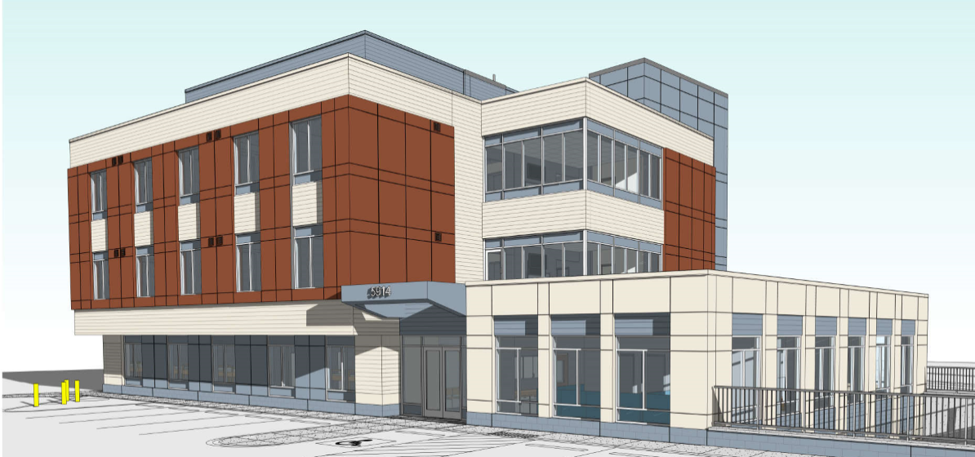
BAILEY’S SHELTER & SUPPORTIVE HOUSING

Slide 25
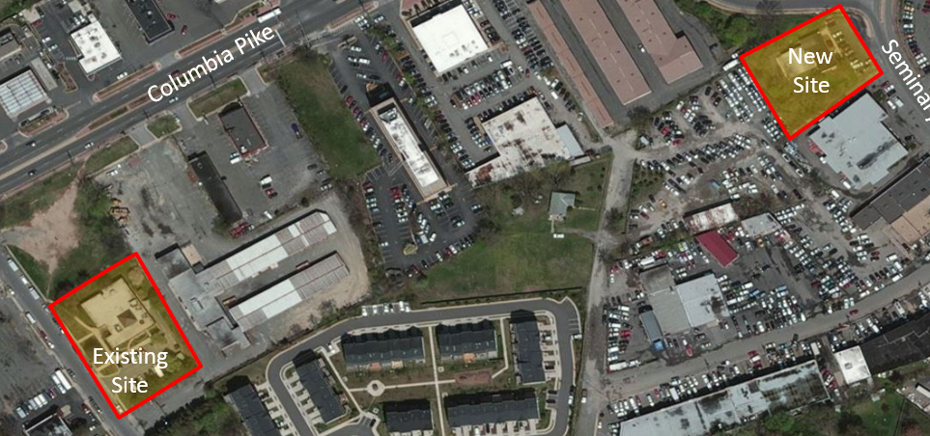
BAILEY’S SHELTER & SUPPORTIVE HOUSING

Slide 26
BAILEY’S SHELTER & SUPPORTIVE HOUSING
DEVELOPMENT PROCESS & SCHEDULE
Site Acquisition September 2016
Program/Concept Design August – January 2017
Zoning/Land Use Actions November 2016 – July 2017
Design Development March – May 2017
Construction Document/Permits Summer – Fall 2017
Bidding /Contract Award Fall 2017
Construction Spring 2018 – Summer 2019
Occupancy Late Fall 2019

Slide 27
BAILEY’S SHELTER & SUPPORTIVE HOUSING
BUILDING PROGRAM AND FUNDING
PROGRAM
Approximately 21,000 SF, 3 story building including a full cellar
Replacement facility for the existing Bailey’s Crossroads Community Shelter
52 emergency shelter beds including 4 medical respite beds
18 Permanent Supportive Housing units
Outdoor areas including parking and a sunken plaza/courtyard
FUNDING
Project funding approved as part of the 2016 Bond Referendum
First of four emergency shelters to be replaced/renovated through the bond, the others being the Eleanor Kennedy Community Shelter in South County, the Embry Rucker Community Shelter in North County, and the Patrick Henry Family Shelter in Falls Church

Slide 28
BAILEY’S SHELTER & SUPPORTIVE HOUSING
MORE DETAILS
Currently operated by New Hope Housing
Each shelter room will have its own private bathroom/shower and there will be communal bathroom/shower space on the cellar level
Increased meeting and gathering space for shelter clients, including a large Activity Room and an outdoor sunken plaza on the cellar level, a Multi-Purpose Room on the first floor, and private Interview Rooms on both
New Medical Respite Program beds, nearly doubling the current program size
Dedicated space for the Community Services Board and Health Department
18 Personal Living Quarters (PLQ) on the second and third floors, with two ADA accessible units
Common space available on both PLQ floors with access to internet and cable, as well as outdoor balcony space

Slide 29
PARTNERSHIP UPDATES & INITIATIVES
FUNDING
POLICY
DATA
NEW & UPCOMING
2019 HUD CoC Program Competition
Coordinated Entry
One Fairfax – Homeless Services Racial Equity Work
HMIS Super Users Steering Committee
Built for Zero
Bailey’s Shelter & Supportive Housing
Training Curriculum
Artemis House Expansion

Slide 30
FAIRFAX-FALLS CHURCH COMMUNITY
Partnership to Prevent and End Homelessness
Thoughts, questions, or ideas
about CoC meetings?
Jamie Ergas, MSW, LSW
Continuum of Care Manager
Office to Prevent and End Homelessness
Direct: 703-324-3240
Cell: 703-223-2003
jamie.ergas@fairfaxcounty.gov

