Slide 1
FAIRFAX-FALLS CHURCH COMMUNITY
Partnership to Prevent and End Homelessness
Bi-Annual CoC Meeting
July 8th, 2021 | 10:30 – 12:00 PM
Virtual Meeting
Please turn off cameras and microphones
Use the chat for questions or comments
Notes:
Purpose of the meeting (build and strengthen common understanding of homeless services system initiatives and performance outcomes)
Introduce yourself in the chat (name, agency, pro-nouns)
Please mute when you are not speaking

Slide 2
FAIRFAX-FALLS CHURCH COMMUNITY
Agenda
Point-in-Time Count and System Performance Measure Dashboards
2) Homeless Services System Updates
Built for Zero
Emergency Housing Vouchers & Federal Funding Overview
Regional Racial Equity Initiative
CoC Committee
Forming the new CoC Governance
Questions and Updates from Partners

Slide 3
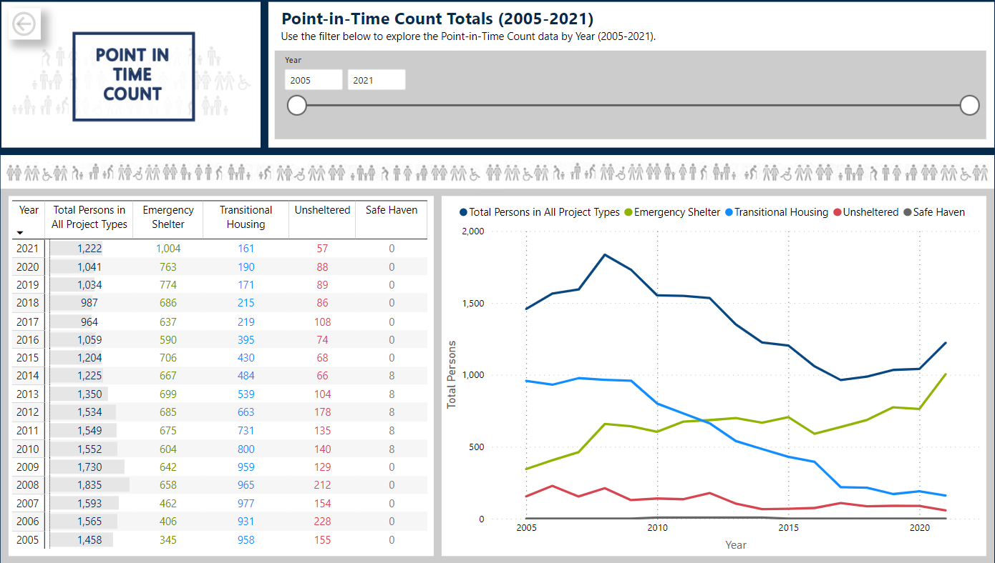
FAIRFAX-FALLS CHURCH COMMUNITY
Point-in-Time Count
Notes:
What is the PIT?
A Snapshot: a count of people experiencing homelessness on a single night in January. The Department of Housing and Urban Development (HUD) requires Continuums of Care across the country to conduct this annual count of people experiencing homelessness, which includes people in emergency shelter, transitional housing, and safe havens as well as those experiencing unsheltered homelessness. Each count is planned, coordinated, and carried out locally.
Coordinated with the 9 jurisdictions in the DC metropolitan area.
What does the Dashboard include:
The total number of people identified as experiencing homelessness between the 2005 and 2021 Point-in-Time Counts;
The Point-in-Time Count demographics between 2017 and 2021; and
The shelter and housing capacity compiled as part of the Housing Inventory Counts conducted between 2005 and 2021.
Annual Point-in-Time Count Increases: After a steady reduction of people experiencing homelessness on the night of the Point-in-Time Counts between the 2008 and 2017, a decrease of 47 percent (871 people), the number of people experiencing homelessness identified through the Point-in-Time Counts has increased over the past five consecutive years. There were 964 people experiencing homelessness on the night of the 2017 Point-in-Time Count and 1,222 people experiencing homelessness on the night of the 2021 Point-in-Time Count, an increase of 27 percent (258 people).
Impacts of the pandemic
Lowest unsheltered count
Highest emergency shelter count

Slide 4
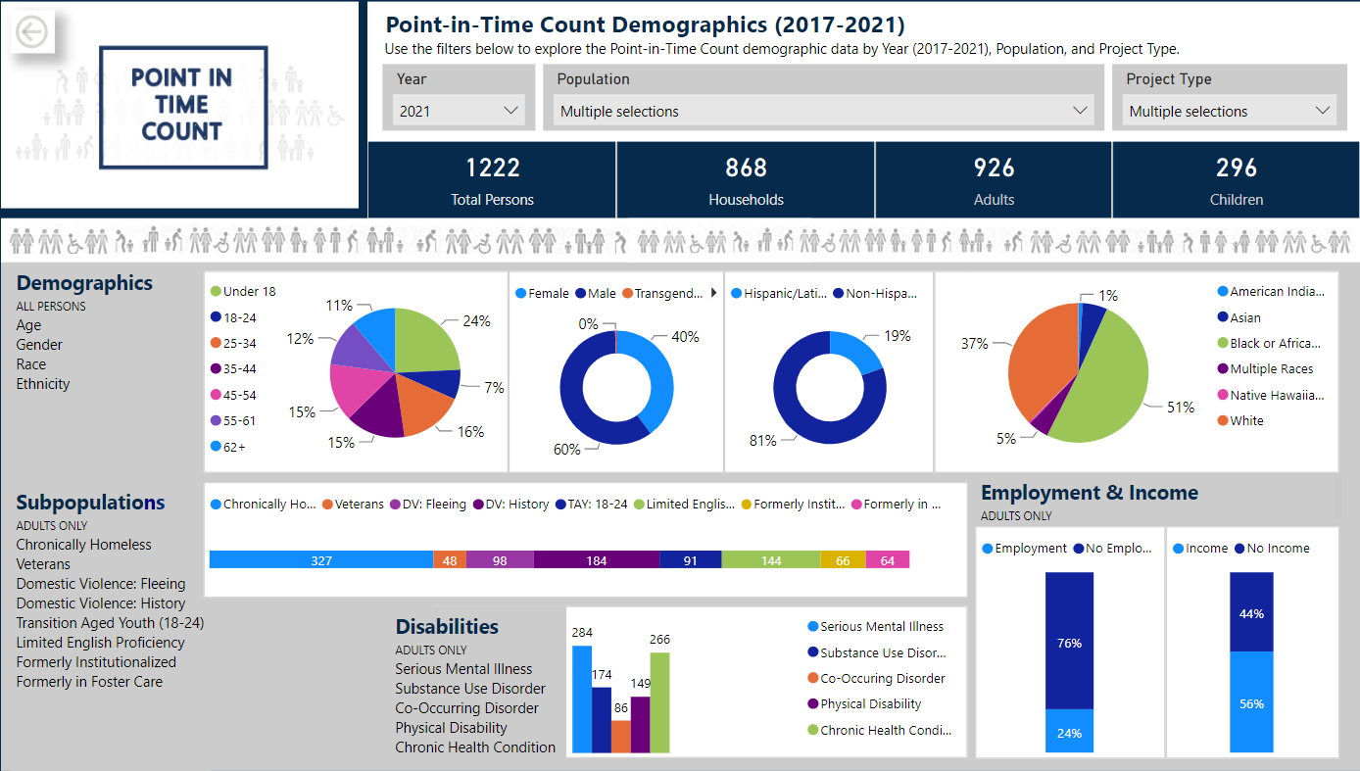
FAIRFAX-FALLS CHURCH COMMUNITY
Point-in-Time Count
Notes:
Chronic Homelessness: There were 180 people reported to be experiencing chronic homelessness during the 2020 Point-in-Time Count (25 percent of total adults counted) and 327 people reported to be experiencing chronic homelessness during the 2021 Point-in-Time Count (35 percent of the total adults counted). The increase is also reflected in increases in people experiencing substance use disorders, serious mental illness, physical disabilities, and/or chronic health problems.
Veterans: There were 33 people that identified as veterans during the 2020 Point-in-Time Count (5 percent of total adults counted) and 48 people that identified as veterans during the 2021 Point-in-Time Count (also 5 percent of the total adults counted).
Survivors of Domestic Violence: There were 95 households identified as currently fleeing domestic violence and 191 households that reported a history of domestic violence during the 2020 Point-in-Time Count (14 percent and 28 percent of total households counted). There were 97 households identified as currently fleeing domestic violence and 183 households that reported a history of domestic violence during the 2021 Point-in-Time Count (11 percent and 21 percent of total households counted).
Transition Age Youth (18-24): There were 95 transition aged youth (persons between the ages of 18 and 24) identified during the 2020 Point-in-Time Count (13 percent of total adults counted) and 91 transition aged youth identified during the 2021 Point-in-Time Count (10 percent of the total adults counted).
Race: The most significant disparity in the demographics continues to be the disproportionate representation of people identifying as Black or African American. Although only 10 percent of the general population in Fairfax County identifies as Black or African American, 51 percent of people experiencing homelessness on the night of the 2021 Point-in-Time Count identified as Black or African American.
Age: There were 34 individuals (4 percent of the total adults) over the age of 70 experiencing homelessness on the night of the 2021 Point-in-Time Count, the oldest of which was 96. This is an increase from previous Point-in-Time Counts over the past five years in which only 2 percent of the adults included in the Counts were over the age of 70.

Slide 5
FAIRFAX-FALLS CHURCH COMMUNITY
Point-in-Time Count
Notes:
What is the Housing Inventory Count: The Housing Inventory Count (HIC) is a point-in-time inventory of provider programs within a Continuum of Care that provide beds and units dedicated to serve people experiencing homelessness and, for permanent housing projects, were homeless at entry, per the HUD homeless definition. Emergency shelter, transitional housing, rapid rehousing, permanent supportive housing, and other permanent housing projects are included in the Housing Inventory Count. The Housing Inventory Count provides the Shelter and Housing Capacity. When compared to the Point-in-Time Count, it helps to tell the story of how the capacity impacts homelessness. In the most recent Housing Inventory Count, 14 agencies reported capacity data for more than 100 projects.
What data is included in this screenshot:
This screenshot includes the total counts from 2005 – 2021. The total capacity at the bottom will look different when adjusting the years included. Increasing housing capacity is key to ending homelessness.
Total Capacity:

Slide 6
FAIRFAX-FALLS CHURCH COMMUNITY
System Performance Measures
1,106
255
Notes:
Length of Homelessness – This chart is focused on emergency shelter. There has been an increase in length of stay in ES & TH between FFY2016-FFY2020.
Returns to Homelessness – This measure looks at returns to homelessness after exiting to permanent housing. The returns to homelessness in FFY20 are similar to the rate of returns in FFY19 – 11% at 6 months, 6% at 12 months, 9% at 24 months.
Number of People Experiencing Homelessness – The PIT snapshot continues to demonstrate that more people are experiencing homelessness on the night of the PIT (upward trend between 2017-2020). The annual count has not increased though, which may be due to the trend of longer lengths of stay.
Income Growth – This focuses on HUD CoC funded projects. In FFY2020, approximately 50% of those served in HUD CoC projects, which is primarily PSH, were able to increase their total income.
First Time Homeless – 60% of people are new to our system in the last two years, which means that we need to increase focus on understanding inflow. The rate of first time homeless has remained consistent for the last 5 federal fiscal years.
Prevention (not collected) – The % of exits to permanent housing has been consistent (54% from SO, 46% from ES, TH, and RRH), 98% exiting or retaining PH (excluding RRH). The consistency of exits to SO is significant, especially considering TLC changed in 2019 from a SO project to a daily shelter (i.e. less providers achieving same level of outcomes).

Slide 7
Built for Zero
“Homelessness is a big and complex problem –
but it is not one
too big
or complex
to be solved.”
Video by Eido
Notes:
What is Built for Zero

Slide 8
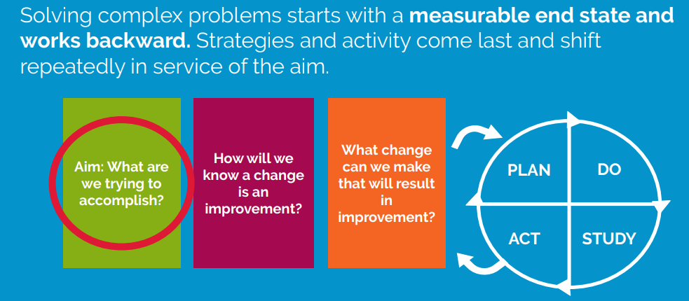
Built for Zero
Fairfax signed on in October 2018
Diversion Pilot (Kaiser)
Veteran and Chronic Improvement Cohorts
Cornerstones
Department of Veteran Affairs
Friendship Place
HCD – OPEH
HCD – Rental Assistance
New Hope Housing
Pathway Homes
Shelter House
The Lamb Center
Volunteers of America – SSVF
Notes:
How is Fairfax’s CoC implementing Built for Zero

Slide 9
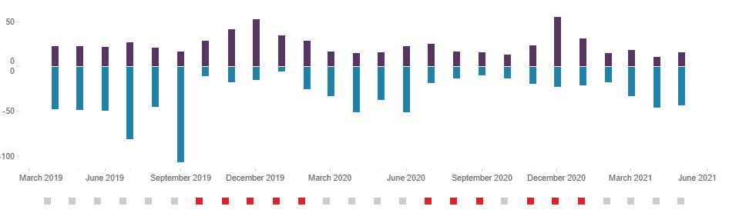
Built for Zero
Actively Homeless Population
Monthly count for Chronic subpopulation(s)
6 Datapoints submitted monthly related to Inflow/Active/Outflow
Veteran/Chronic data provided since January 2019
Single Adults and Family Data provided since February 2021
500
400
300
200
100
0
440
390
215
March 2019 June 2019 September 2019 December 2019 March 2020 June 2020 September 2020 December 200 March 2021 June 2021
Monthly Inflow & Outflow
Red squares at bottom indicates Inflow exceeded Outflow
50
0
0
50
100
INFLOW
OUTFLOW
March 2019 June 2019 September 2019 December 2019 March 2020 June 2020 September 2020 December 200 March 2021 June 2021
Notes:
Built for Zero Data

Slide 10
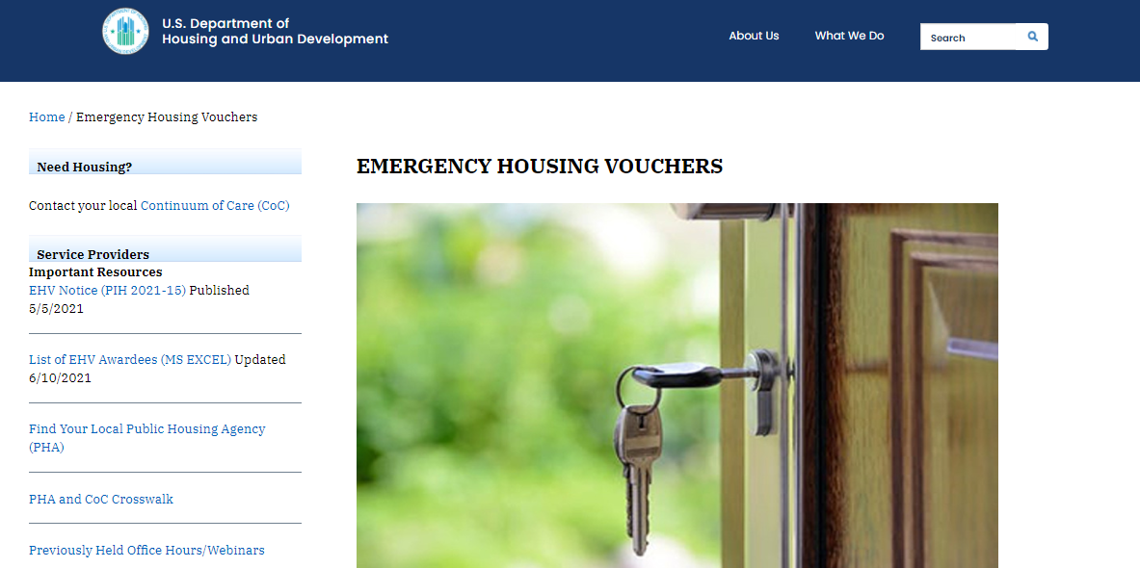
Emergency Housing Vouchers
Video by Eido

Slide 11
Emergency Housing Vouchers
BACKGROUND: On March 11, 2021, President Biden signed the American Rescue Plan Act of 2021 (P.L. 117-2, hereafter referred to in this notice as “the ARP”) into law, which provides over $1.9 trillion in relief to address the continued impact of the COVID-19 pandemic on the economy, public health, State and local governments, individuals, and businesses.
AWARD: Notice PIH 2021-15 (HA) issued May 5, 2021 describes the process HUD is using to allocate approximately 70,000 emergency housing vouchers (EHVs) to public housing agencies. 169 vouchers awarded to Fairfax County.
ELIGIBILITY: Individuals and families who are:
Homeless;
At-risk of Homelessness;
Fleeing, or attempting to flee, domestic violence, dating violence, sexual assault, stalking, or human trafficking;
Recently homeless and for whom providing rental assistance will prevent the family’s homelessness or having high risk of housing instability, including clients in rapid rehousing and permanent supportive housing programs.
PRIORITIZATION: In process of being developed.
REFFERALS: Referrals will be accepted through Coordinated Entry after July 15th.

Slide 12
Federal Funding Overview
 | Emergency Rental Assistance (ERA) | ESG-CV | Emergency Housing Vouchers (EHVs) | HOME Homelessness Assistance
Funding (National awards) | $46.6 billion | $4 billion | $5 billion | $5 billion
Expenditure Deadlines | ERA 1: 09/30/2022 ERA 2: 09/30/2027 | 09/30/2022 | 09/30/2030 (cannot be reissued after 09/23/2023) | Obligation by 2025 (4 years) Expenditure by 2030
Eligible Households | At or below 80% AMI Hardship due to COVID Risk of homelessness of housing instability | Experiencing or at high risk of homelessness | Homeless At-risk of homelessness Survivors of domestic violence Recently homeless | Experiencing or at risk of homelessness Survivors of domestic violence Veterans Other populations with greatest risk of housing instability
Video by Eido

Slide 13
Federal Funding Overview
$290 million ESG
$1.3 billion (not specific to homeless services) HOME
$2.5 billion CoC
ESG-CV $4 billion
HOME $5 billion
EHVs $5 billion
ERA $46.6 billion

Slide 14
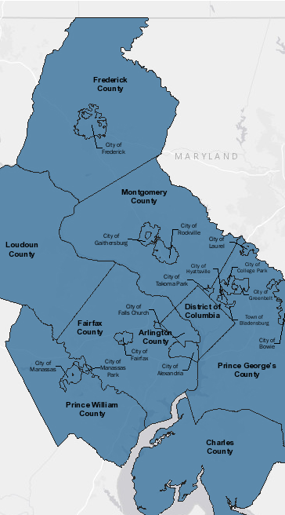
Regional Racial Equity Initiative
PHASE 1
MONTHS 1 - 4
C4 Innovations will convene CoC teams to support foundational knowledge building and discussion, racial equity assessment, and conduct quantitative and qualitative research and data consultation
Key Activities:
Planning Session(s)
CoC Racial Equity Assessment
Mapping of CoC Elements, Policies, and Procedures,
Data Collection and Consultation
Data Analysis and Interpretation
Building Foundational Knowledge
Presentation of Initial Race Equity findings

Slide 15
Regional Racial Equity Initiative
PHASE 2
MONTHS 5 - 9
Conduct a Racial Equity Results Academy, comprised of multi-stakeholder CoC teams working towards transformative action planning and systems change. C4 will arrange the nine participating CoCs into three distinct cohorts. Action planning and follow-up coaching will yield a common core of results and indicators as well as measurable improvements that are specific to each jurisdiction and their proposed recommendations.
Key Activities:
Develop Results Academy Team
Conduct the Results Academy
Deliver Coaching and TA for Action Planning
Engage Members in Deeper Learning

Slide 16
Regional Racial Equity Initiative
PHASE 3
MONTHS 10 - 12
The engagement will conclude in a synthesis of results from the initial analyses and the Racial Equity Results Academy. This will include recommendations for actionable next steps and opportunities for upstream interventions that center racial equity in the work to prevent and end homelessness across the region.
During this phase, C4 will also provide additional training and coaching to address adaptive leadership barriers, clarify pathways for accountability, and ensure that there are continuous quality improvement processes in place.
Key Activities:
Synthesis of Recommended Actions Across Nine CoCs
Sustainability Training and Coaching

Slide 17
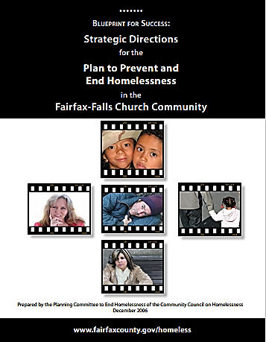
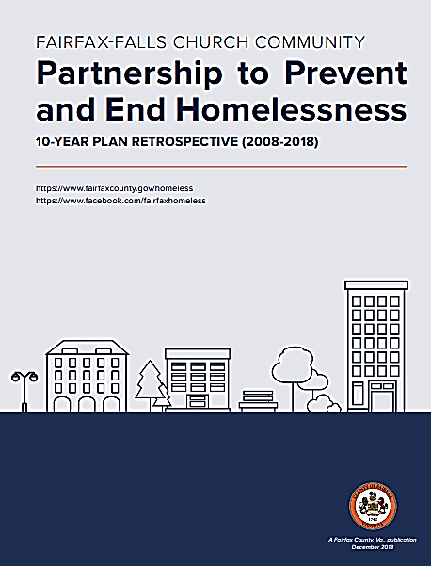
CoC Committee (CoC Governance)
10 Year Plan to Prevent and
End Homelessness
(2008 – 2018)
Post 10 Year Plan
OPEH & HCD Merger
Governing Board Transition
Affordable Housing Advisory Council
CoC Committee

Slide 18
CoC Committee (CoC Governance)
CoC Committee
STRUCTURE
Affordable Housing Advisory Council (AHAC)
Fairfax County Redevelopment and Housing Authority & Board of Supervisors
Advisory
body
AHAC Continuum of Care (CoC) Committee
Fairfax County Office to Prevent and End Homelessness
Advisory
body

Slide 19
CoC Committee (CoC Governance)
CoC Committee
RESPONSIBILITIES
Bring an Equity Lens in all work and recommendations
Promote shared responsibility and decision-making among all partners
Involve and engage all segments of the community to assure their participation in
the work of preventing and ending homelessness
Mobilize political and community will to increase the overall resources available to end
homelessness and catalyze such other actions as may be necessary to affect the community and systems change
necessary to end homelessness
Exercise executive stewardship over the pooled funding and resources
available for addressing homelessness in the Fairfax-Falls Church community
Develop, monitor, and update the Plan to prevent and end homelessness
Monitor progress towards achievement of the goal of preventing and ending homelessness
Review and monitor CoC Performance of aggregate CoC and ESG programs through HMIS data
Articulate progress toward the goal throughout the community

Slide 20
CoC Committee (CoC Governance)
CoC Committee
INITIAL MEMBERSHIP
Seat | Organization | Name | Title
1 | Cornerstones | Maura Williams | Division Director, Housing and Community Services
2 | FACETS | Carole Huell | Senior Director of Programs
3 | Family Services, Fairfax County Domestic and Sexual Violence Services | Vanessa Cullers | Housing and Economic Specialist
4 | Family Services, Fairfax County Public Assistance and Employment Services | Lisa Jones | Human Services Worker III
5 | Health Department, Fairfax County | Nathalie Washington | Homeless Healthcare Program Coordinator
6 | Lamb Center | John MacPherson | Executive Director
7 | New Hope Housing | Keiyauna Stanley | Senior Program Director
8 | Shelter House | Laura Woody | Chief Program Officer
UPCOMING PROJECTS
Emergency Housing Vouchers (EHV) MOU
Develop new by-laws

Slide 21
CoC Committee (CoC Governance)
CoC Committee
MEMBERSHIP GOAL
Seat | Type | Appointed by | Confirmed by
1 | Government – Community Services Board | Executive Director, Community Services Board | AHAC
2 | Government – Department of Family Services | Director, Department of Family Services
3 | Government – Department of Housing and Community Development | Director, Department of Housing and Community Development
4 | Government – Health Department | Director, Health Department
5 | Consumer(s)* | Nomination Sub-Committee
6 | Public and private housing and service providers, including nonprofits, healthcare, faith community, schools, criminal justice system, training and employment, etc.* (several seats) | Nomination Sub-Committee
7 | Ex-officio – Deputy Director, Office to Prevent and End Homelessness | Based on position | N/A
*One member may represent the interests of more than one homeless subpopulation, and the membership must represent all
subpopulations within the CoC to the extent that someone is available and willing to represent that subpopulation

Slide 22
FAIRFAX-FALLS CHURCH COMMUNITY
Partnership to Prevent and End Homelessness
Questions?
Updates from Partners

Slide 23
FAIRFAX-FALLS CHURCH COMMUNITY
Partnership to Prevent and End Homelessness
Thoughts, questions, or ideas
about CoC meetings?
Jamie Ergas, LMSW
Continuum of Care Manager
Office to Prevent and End Homelessness
Department of Housing & Community Development
Direct: 703-324-3240
Cell: 703-223-2003
jamie.ergas@fairfaxcounty.gov

