Slide 1
ZONE A – NORTH (181.33)
Criminal Justice Academy (2.6) - 14601 Lee Rd, Chantilly, VA 20151
Spring Vale Ave Path (0.26) – 1410 Spring Vale Ave, McLean, VA 22101
Dranesville District Government Center (5.2) -1437 Balls Hill Rd, Mclean, VA 22101
Police Driving School / Police Firearms Training (55.15) – 3725/3721 Stonecroft Blvd, Chantilly, VA 20151
Sully District Government Center (6.8) - 4900 Stonecroft Blvd, Chantilly, VA 20151
Herndon Connector Bus (.81) – 270 Spring St, Herndon, VA 20170
Dolley Madison Library (1.19) – 1244 Oak Ridge Ave, McLean, VA 22101
Great Falls Library (4.56) – 9830 Georgetown Pike, Great Falls, VA 22066
Tyson’s Pimmit Library (2.11) – 7584 Leesburg Pike, Falls Church, VA 22043
Group Home (0.35) – 1320 Ingleside Ave, McLean, VA 22101
Lot (0.11) – 1447 Woodacre Dr., McLean, VA 22101
Cut 6’ along sidewalk. (0.14) – Colshire Dr., Mclean, VA 22102
Embry Rucker Shelter (0.36) – 11975 Bowman Towne Dr., Reston, VA 20190\
North County/Hunter Mill Government Center (8.06) – 1801 Cameron Glen Dr, Reston, VA 20190
Reston Human Services (2.85) – 1850 Cameron Glen Dr., Reston, VA 20190
Reston Regional Library (1.44) – 11925 Bowman Towne Dr., Reston, VA 20190

Slide 2
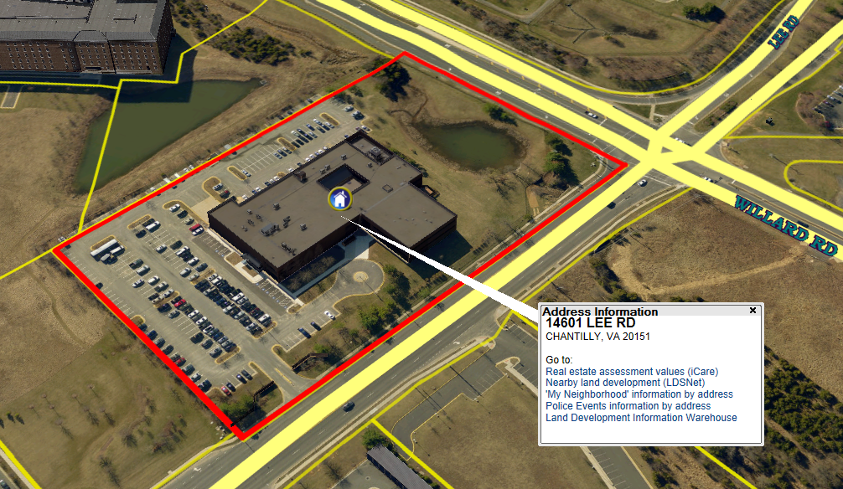
Criminal Justice Academy (2.6) - 14601 Lee Rd, Chantilly, VA 20151

Slide 3
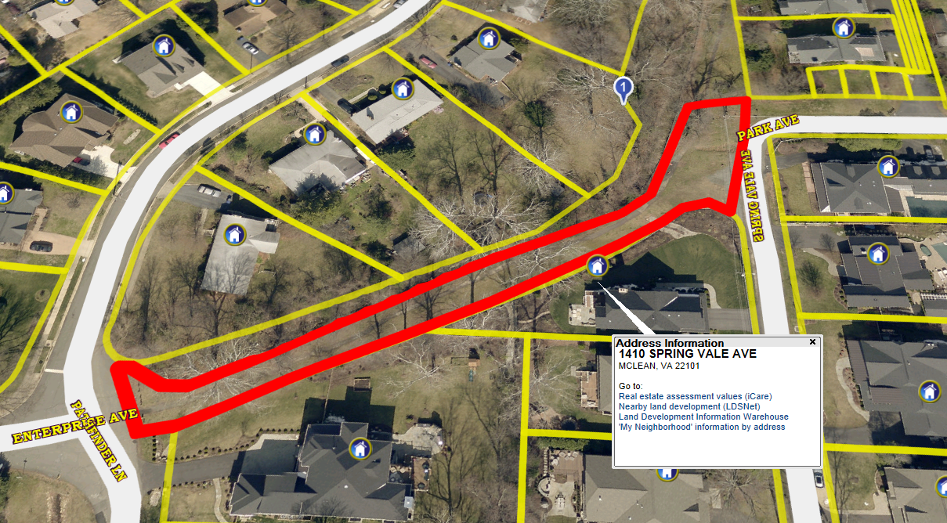
Spring Vale Ave Path (0.26) – 1410 Spring Vale Ave, McLean, VA 22101

Slide 4
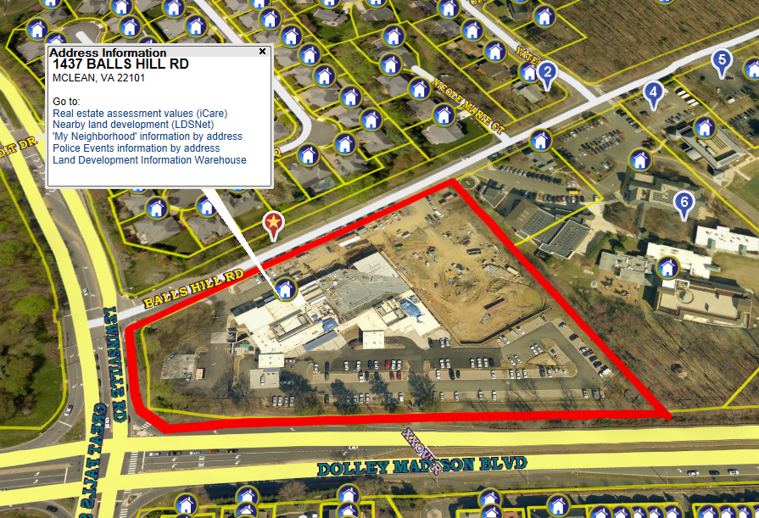
Dransville District Government Center (5.2)- 1437 Balls Hill Rd, Mclean, VA 22101

Slide 5
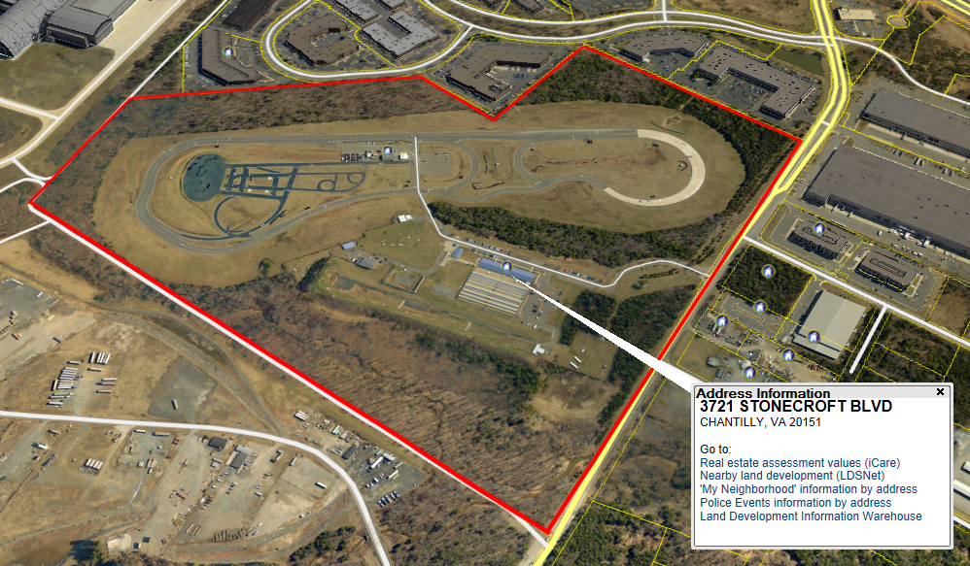
Police Driving School / Police Firearms Training (55.15) – 3725/3721 Stonecroft Blvd, Chantilly, VA 20151

Slide 6
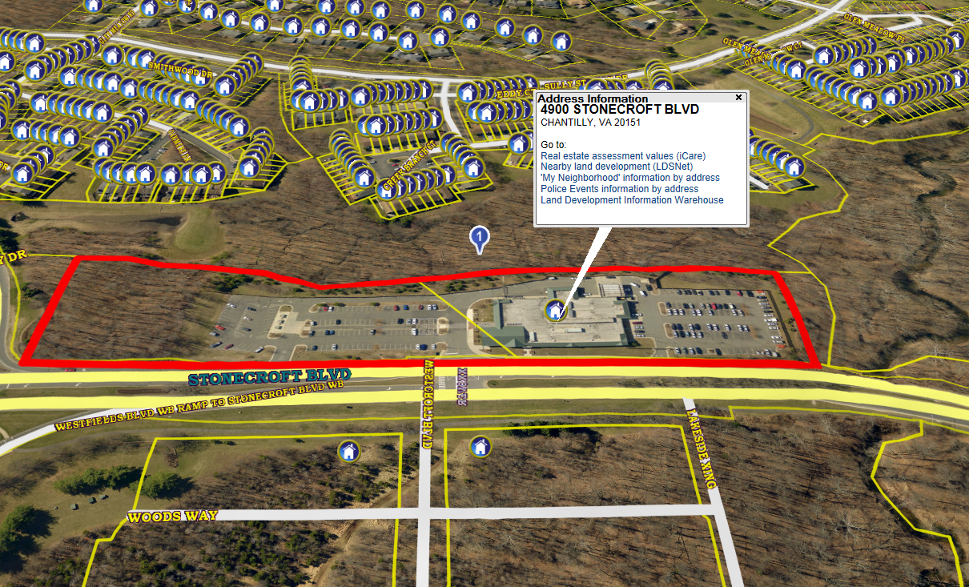
Sully District Government Center (6.8) - 4900 Stonecroft Blvd, Chantilly, VA 20151

Slide 7
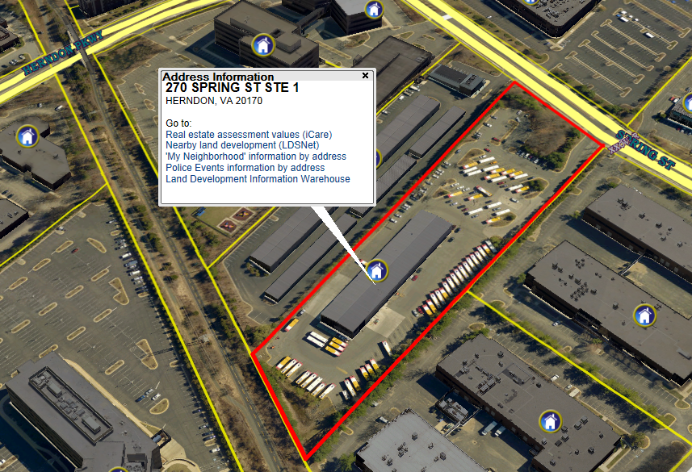
Herndon Connector Bus (.81) – 270 Spring St, Herndon, VA 20170

Slide 8
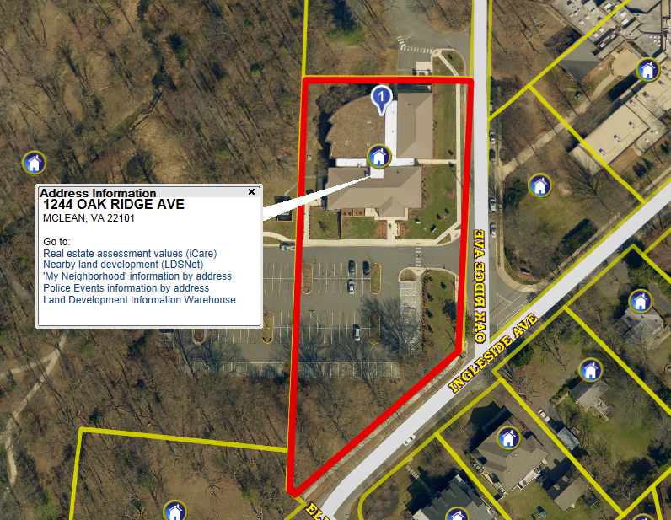
Dolley Madison Library (1.19) – 1244 Oak Ridge Ave, McLean, VA 22101

Slide 9
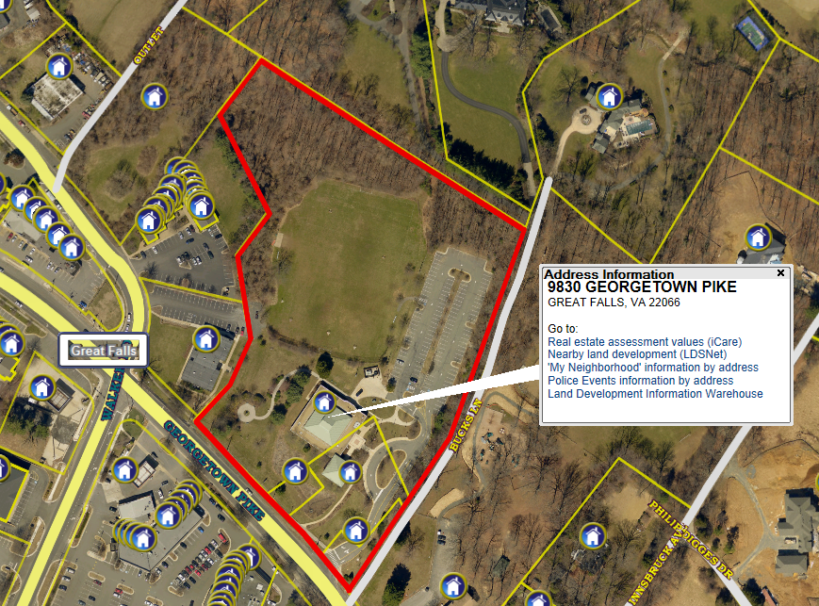
Great Falls Library (4.56) – 9830 Georgetown Pike, Great Falls, VA 22066

Slide 10
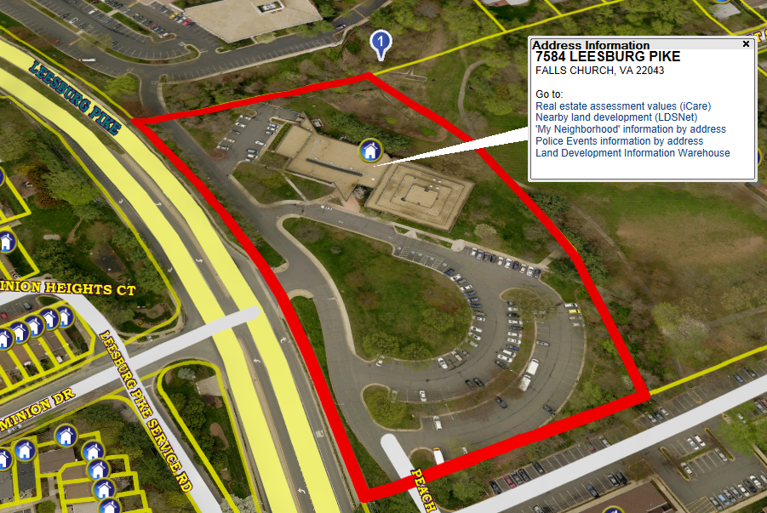
Tyson’s Pimmit Library (2.11) – 7584 Leesburg Pike, Falls Church, VA 22043

Slide 11
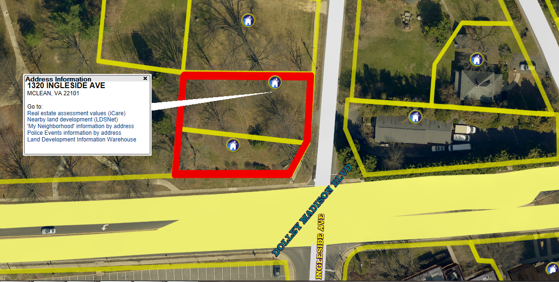
Group Home (0.35) – 1320 Ingleside Ave, McLean, VA 22101

Slide 12
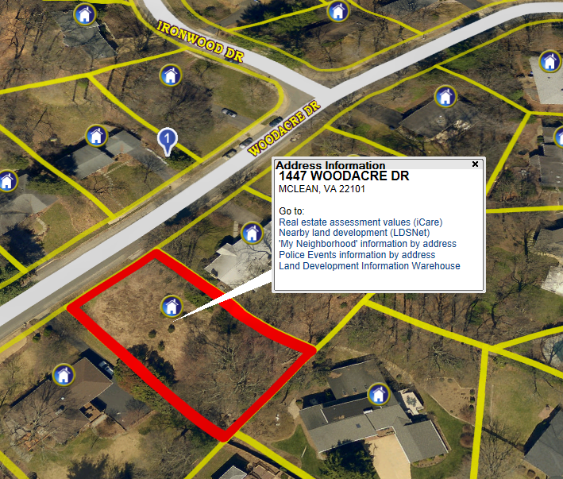
Lot (0.11) – 1447 Woodacre Dr, McLean, VA 22101

Slide 13
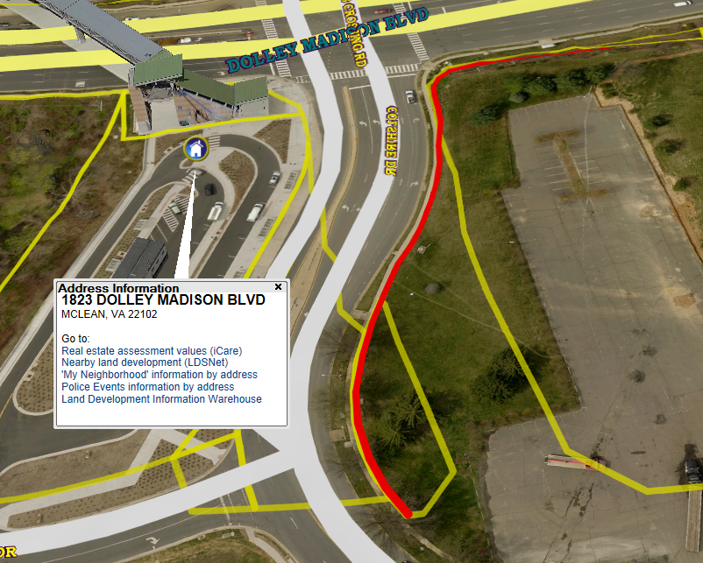
Cut 6’ along sidewalk. (0.14) – Colshire Dr, Mclean, VA 22102

Slide 14
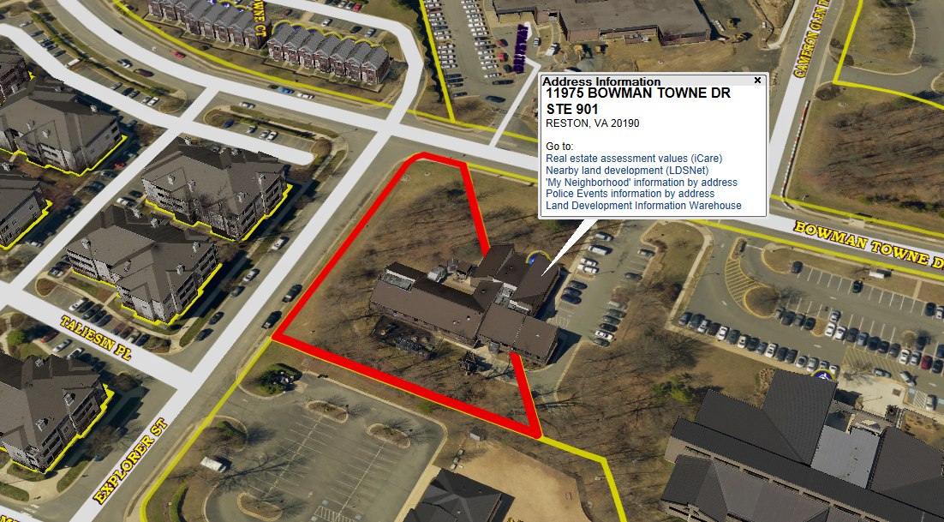
Embry Rucker Shelter (0.36) – 11975 Bowman Towne Dr, Reston, VA 20190

Slide 15
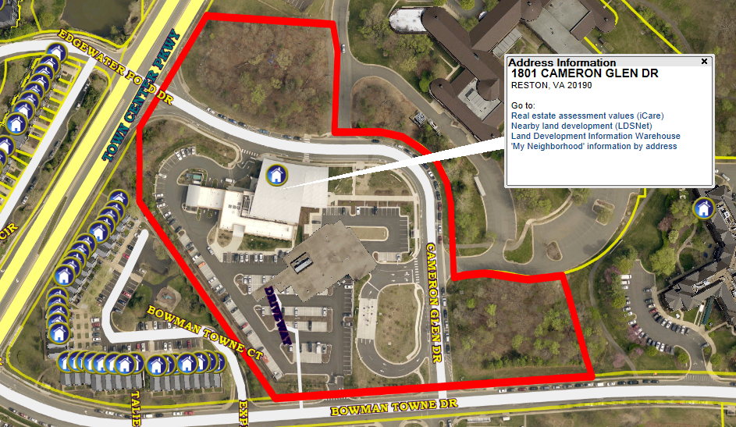
North County/Hunter Mill Government Center (8.06) – 1801 Cameron Glen Dr, Reston, VA 20190

Slide 16
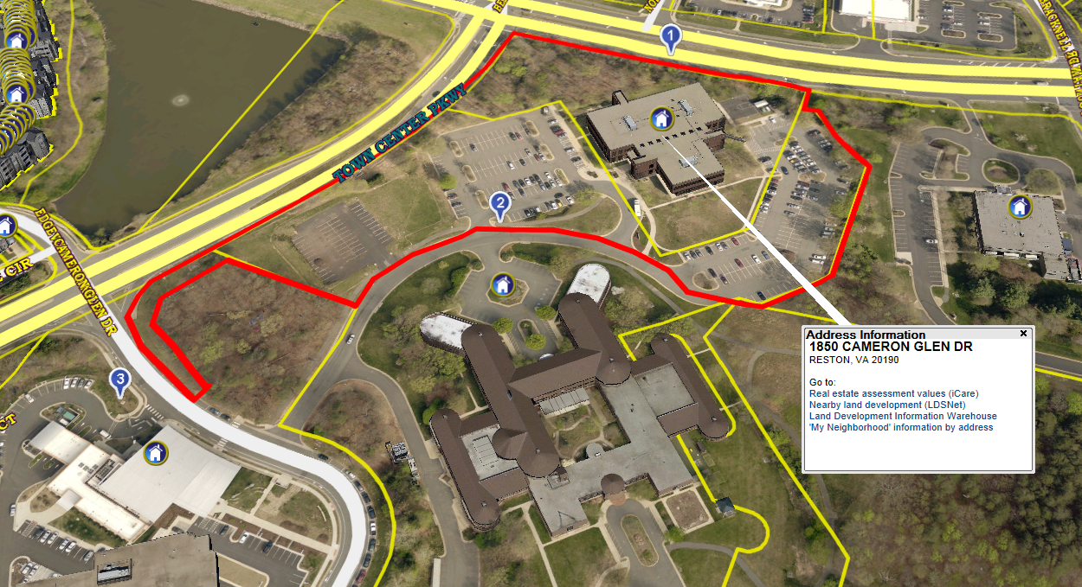
Reston Human Services (2.85) – 1850 Cameron Glen Dr, Reston, VA 20190

Slide 17
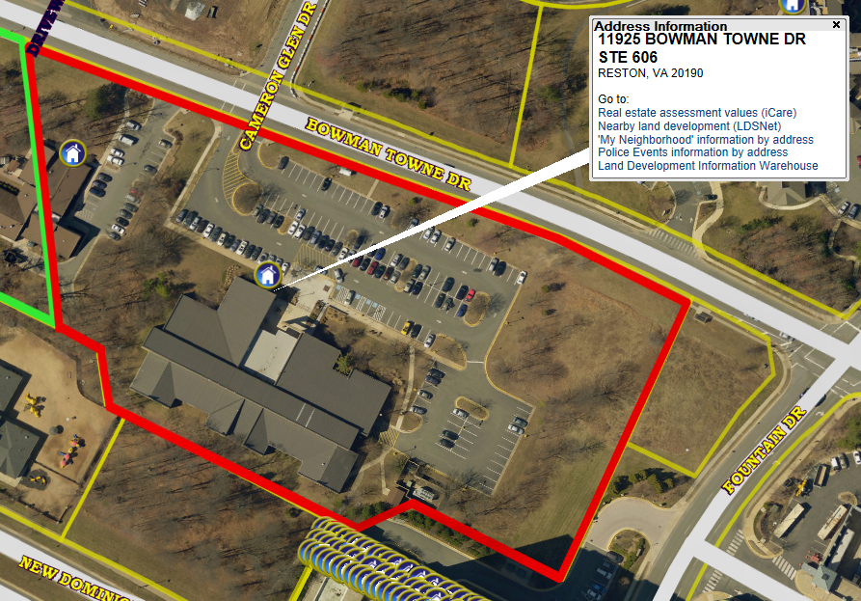
Reston Regional Library (1.44) – 11925 Bowman Towne Dr., Reston, VA 20190

Slide 18
ZONE A – NORTH (Continued)
Centreville Library (2.57) – 14200 St. Germain Dr, Centreville, VA 20121
Chantilly Library (5.85) – 4000 Stringfellow Rd, Chantilly, VA 20151
Cornerstone / New Beginnings (1.95) – 4211 Walney Rd, Chantilly, VA 20151
Fair Oaks Police & Fire (1.08) – 12300 Lee Jackson Memorial HWY, Fairfax, VA 22033
Boys Probation (0.92) - 4410 Shirley Gate Rd, Fairfax, VA 22030
Kate Hanley Shelter (2) – 12970 Katherine Hanley Ct, Fairfax, VA 22030
Fairfax City Library (0.5) – 10360 North St., Fairfax, VA 22030
Girls Probation House (0.71) – 12720 Lee HWY, Fairfax, VA 22030
Stevenson Place (0.53) – 4113 Stevenson St., Fairfax, VA 22030
Jermantown Garage (2.3) - 3609 Jermantown Rd, Fairfax, VA 22030
Joseph & Belle Willard/Gorgenson Lab (1.4) – 3750 Old Lee Highway, Fairfax, VA 22030
Providence District Government Center (2.2) – 3001 Vaden Dr, Fairfax, VA 22031

Slide 19
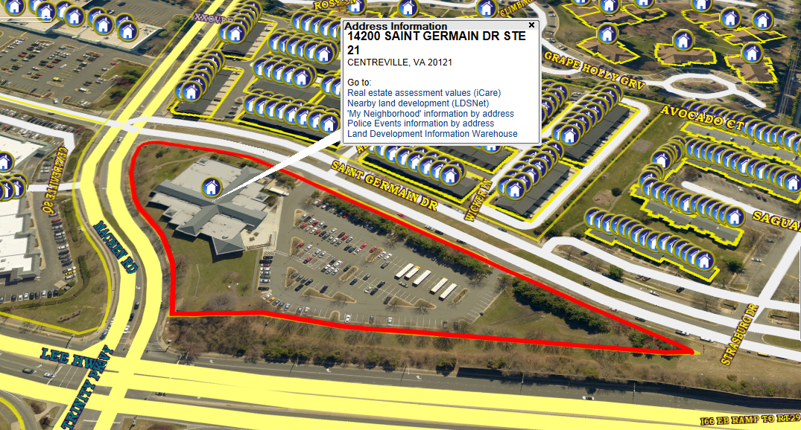
Centreville Library (2.57) -14200 St. Germain Dr, Centreville, VA 20121

Slide 20
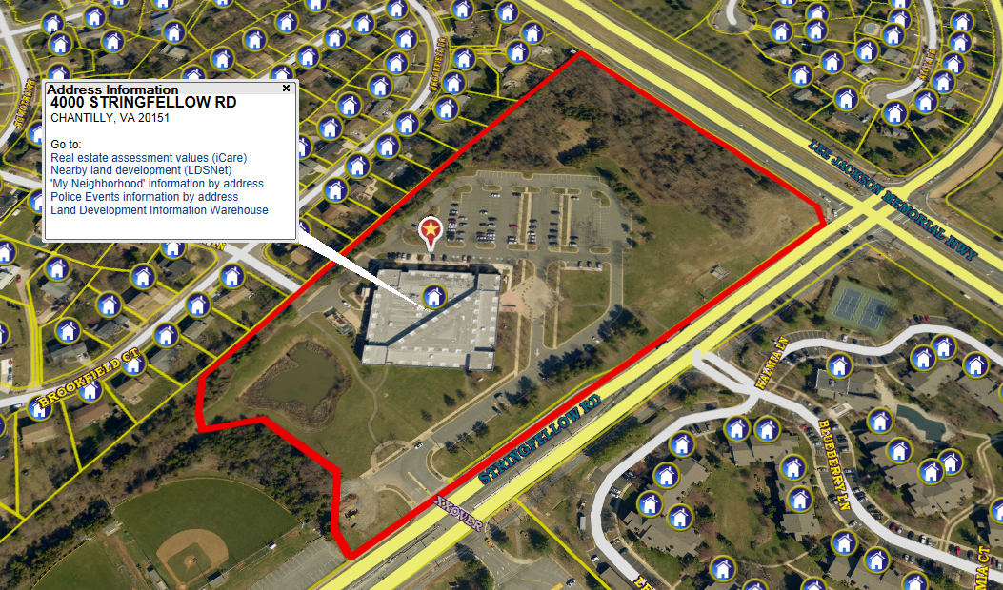
Chantilly Library (5.85) – 4000 Stringfellow Rd, Chantilly, VA 20151

Slide 21
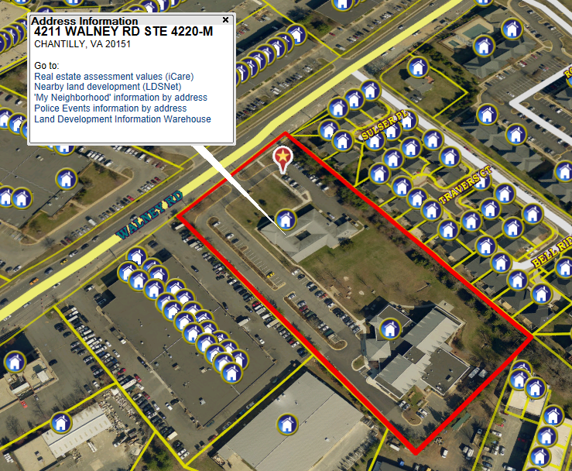
Cornerstone / New Beginnings (1.95) – 4211 Walney Rd, Chantilly, VA 20151

Slide 22
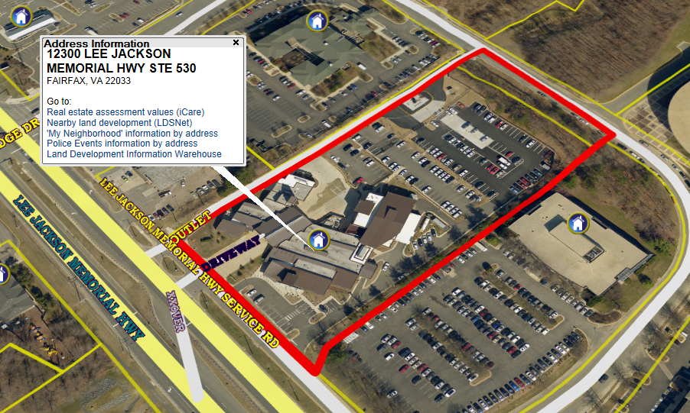
Fair Oaks Police & Fire (1.08) – 12300 Lee Jackson Memorial HWY, Fairfax, VA 22033

Slide 23
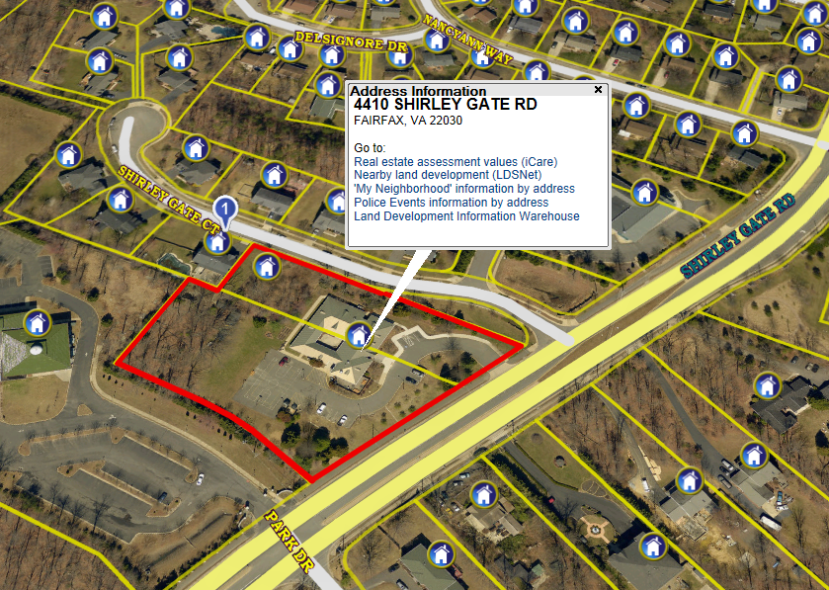
Boys Probation (.92) - 4410 Shirley Gate Rd, Fairfax, VA 22030

Slide 24
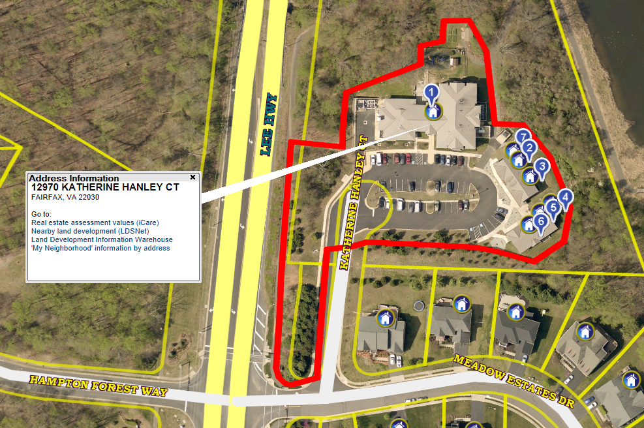
Kate Hanley Shelter (2) – 12970 Katherine Hanley Ct, Fairfax, VA 22030

Slide 25
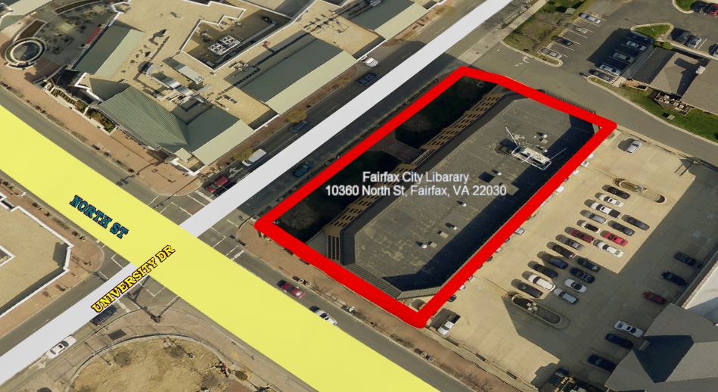
Fairfax City Library (0.5) – 10360 North St., Fairfax, VA 22030

Slide 26
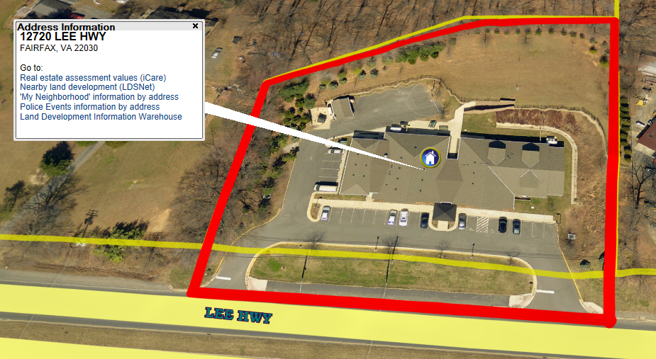
Girls Probation House (0.71) – 12720 Lee HWY, Fairfax, VA 22030

Slide 27
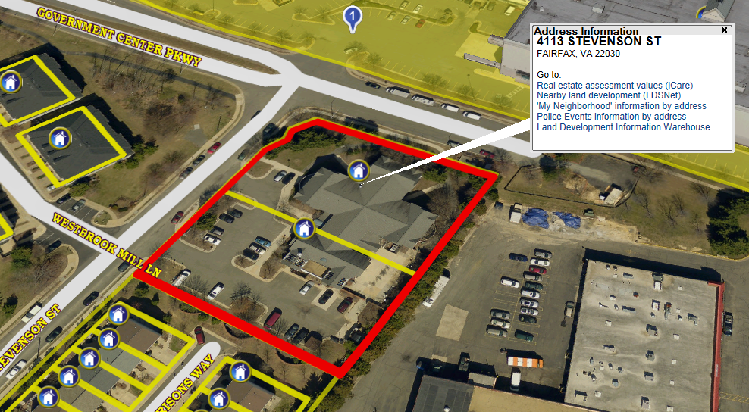
Stevenson Place (0.53) – 4113 Stevenson St., Fairfax, VA 22030

Slide 28
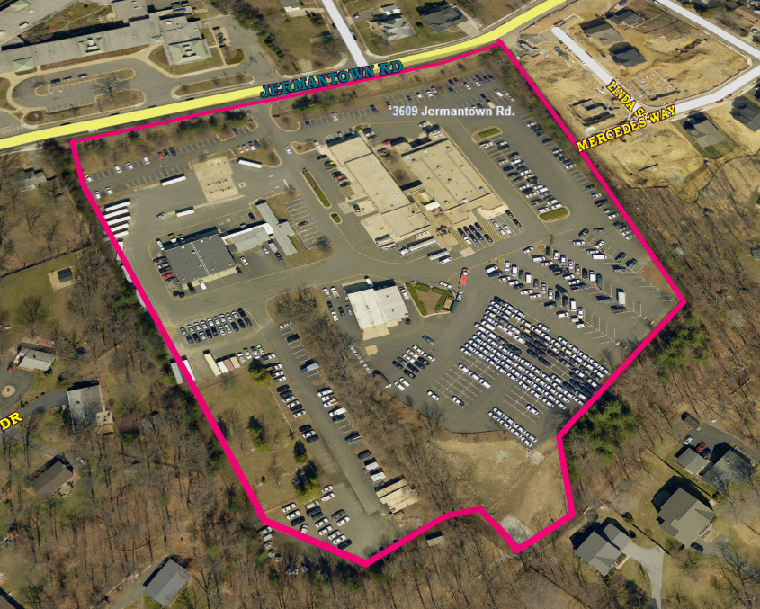
Jermantown Garage (2.3) - 3609 Jermantown Rd, Fairfax, VA 22030

Slide 29
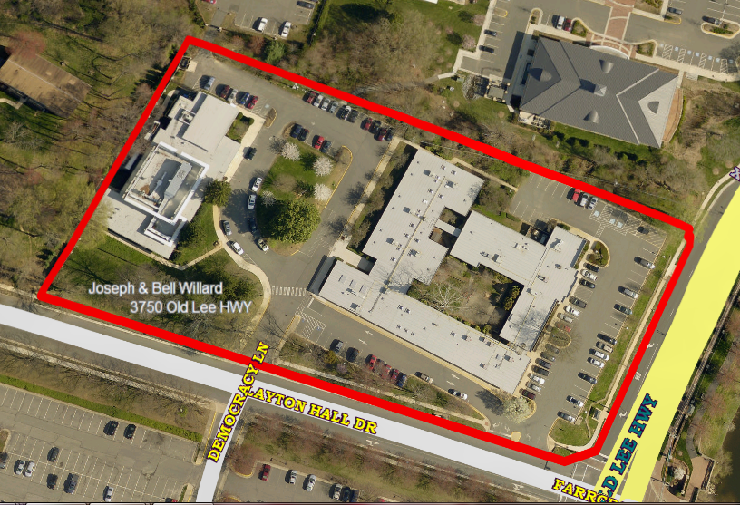
Joseph & Belle Willard/Gorgenson Lab (1.4) –
3750 Old Lee Highway, Fairfax, VA 22030

Slide 30
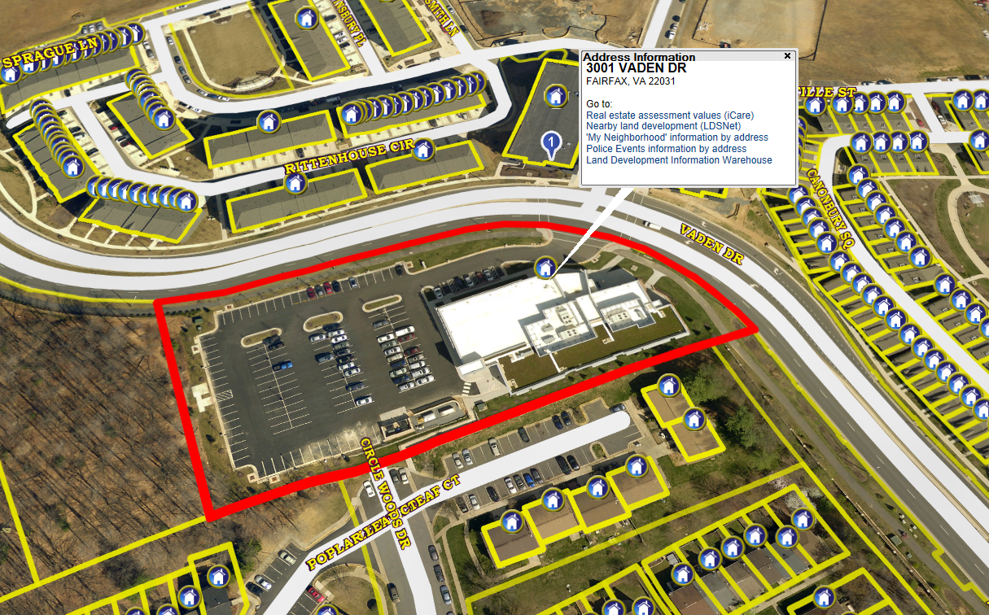
Providence District Government Center (2.2) – 3001 Vaden Dr, Fairfax, VA 22031

Slide 31
ZONE A – NORTH (Continued)
James Lee Community Center (7.25) – 2855 Annandale Rd., Falls Church, VA 22042
School Ln. Parcel (0.47) – 2901 Annandale Rd., Falls Church, VA 22042
Kings Park Library / Braddock District Supervisor (0.97) – 9000 Burke Lake Rd., Burke, VA 22015
Springfield District Government Center (8.5) – 6140 Rolling Rd, Springfield, VA 22152
Connector Trail to W&OD Trail (0.2) – (Closest Address) 20304 Jackson PKWY, Vienna, VA 22180
Patrick Henry Library (0.33) – 101 Maple Ave E, Vienna, VA 22180
Pohick Library (1.57) – 6450 Sydenstricker Road, Burke, VA 22015
Police K-9 Training (10.46) – 5755 Revercomb Ct., Fairfax, VA 22030
Thomas Jefferson Library (1.12) – 7415 Arlington Blvd, Falls Church, VA 22042
Merrifield Center (2.5) – 8221 Willow Oaks Corporate Dr., Fairfax, VA 22031
Mott Community Center (1.28) – 12111 Braddock Rd., Fairfax, VA 22030
Donegal Ln. (2.49) – Lots 1-14 & 60-66 – (Nearest Address) 7915 Donegal Ln., Springfield, VA
Burke Centre Library (6.5) - 5935 Fred Oak Rd, Burke, VA 22015
Oakton Library (2.5) – 10304 Lynnhaven Pl., Oakton, VA 22124
South Gate Community Center (2.4) – 12125 Pinecrest Rd., Reston, VA 20191

Slide 32
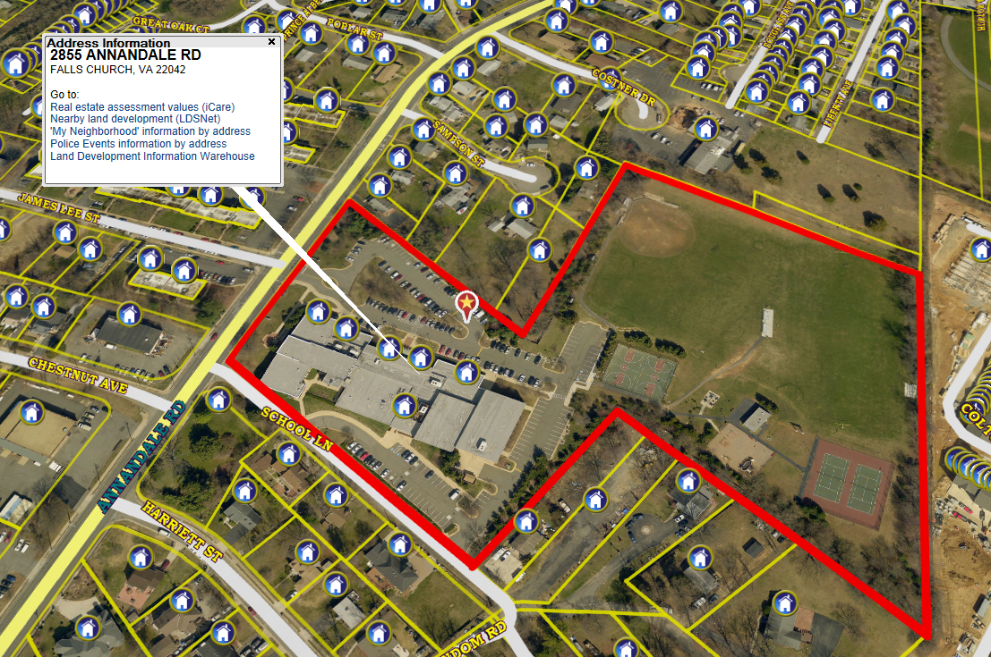
James Lee Community Center (7.25) – 2855 Annandale Rd., Falls Church, VA 22042

Slide 33
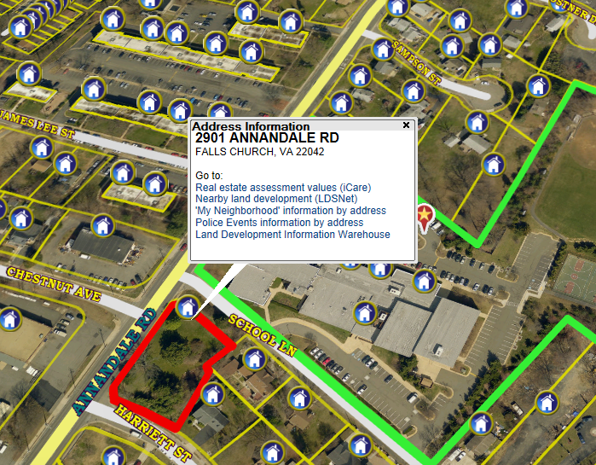
School Ln. Parcel (0.47) – 2901 Annandale Rd., Falls Church, VA 22042

Slide 34
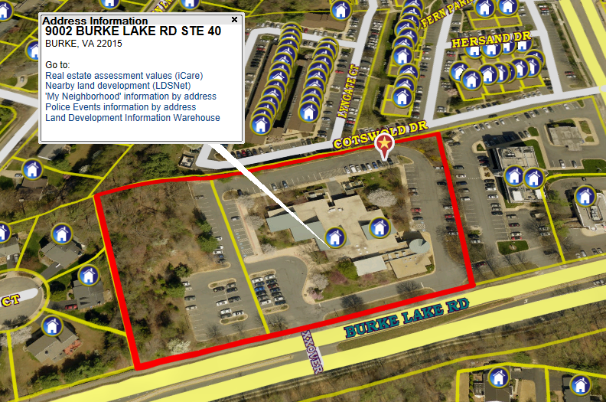
Kings Park Library / Braddock District Supervisor (0.97) – 9000 Burke Lake Rd., Burke, VA 22015

Slide 35
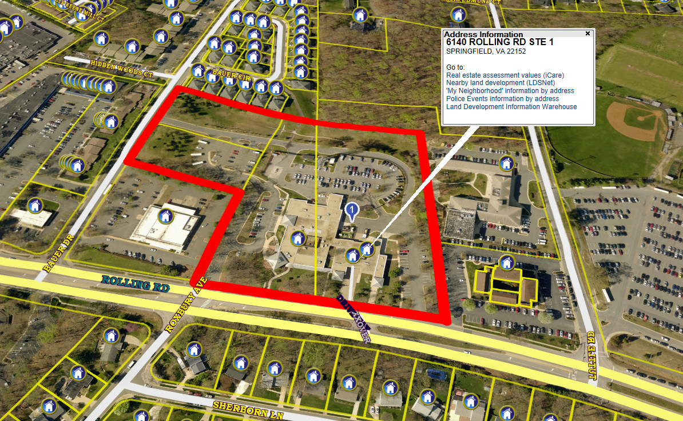
Springfield District Government Center (8.5) – 6140 Rolling Rd, Springfield, VA 22152

Slide 36
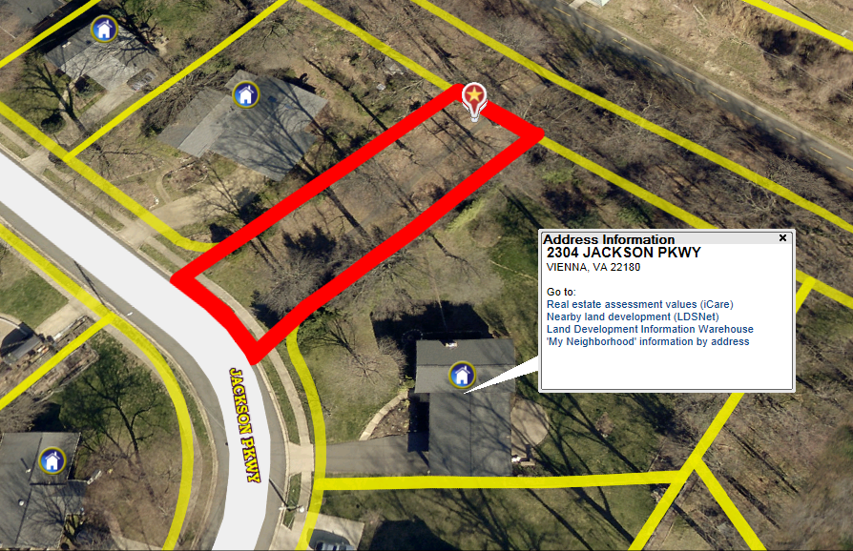
Connector Trail to W&OD Trail (0.2) – (Closest Address) 20304 Jackson PKWY, Vienna, VA 22180

Slide 37
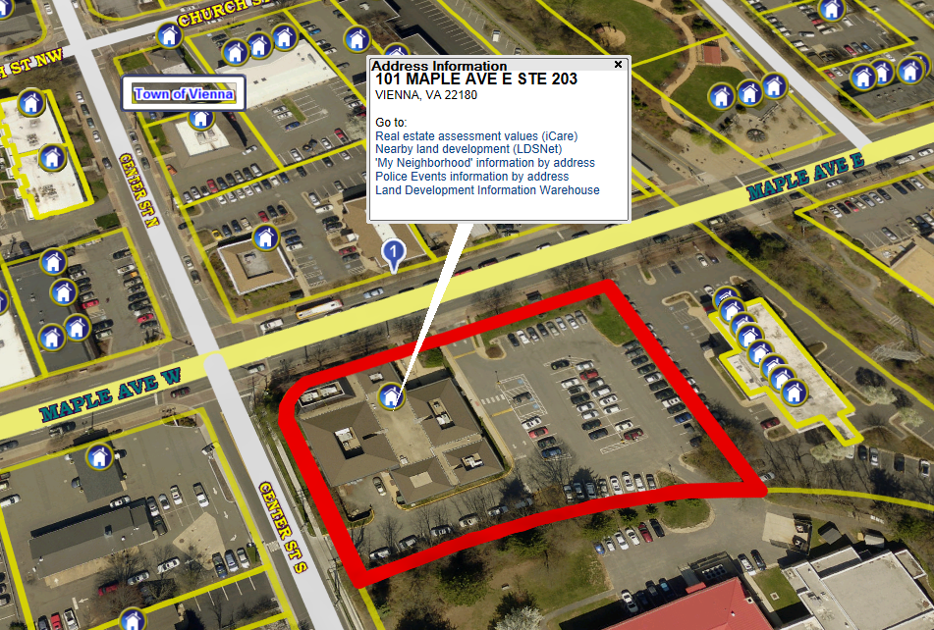
Patrick Henry Library (0.33) – 101 Maple Ave E, Vienna, VA 22180

Slide 38
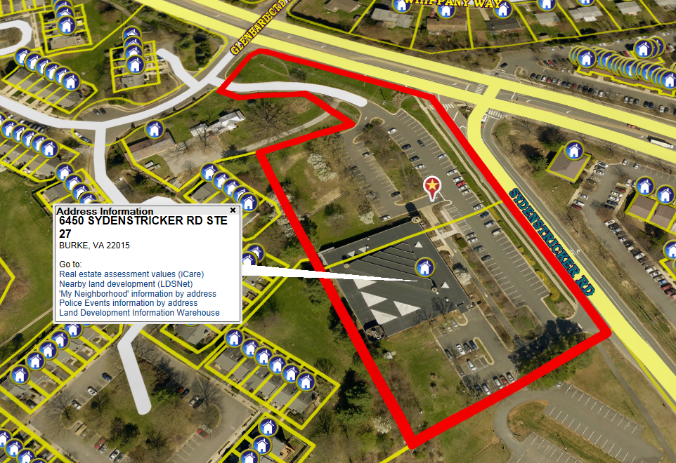
Pohick Library (1.57) – 6450 Sydenstricker Road, Burke, VA 22015

Slide 39
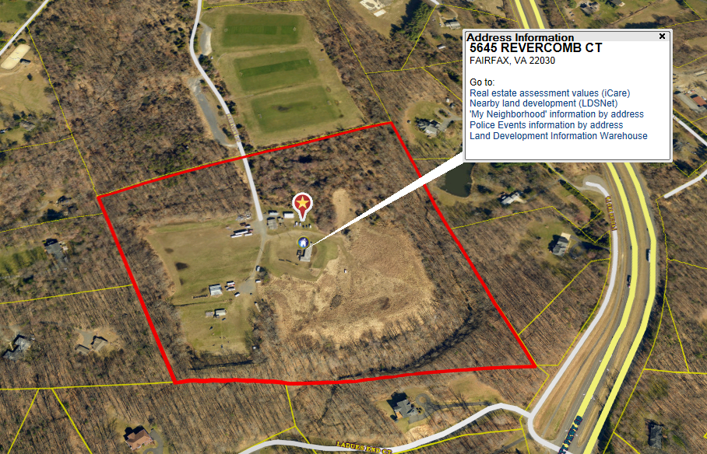
Police K-9 Training (10.46) – 5755 Revercomb Ct., Fairfax, VA 22030

Slide 40
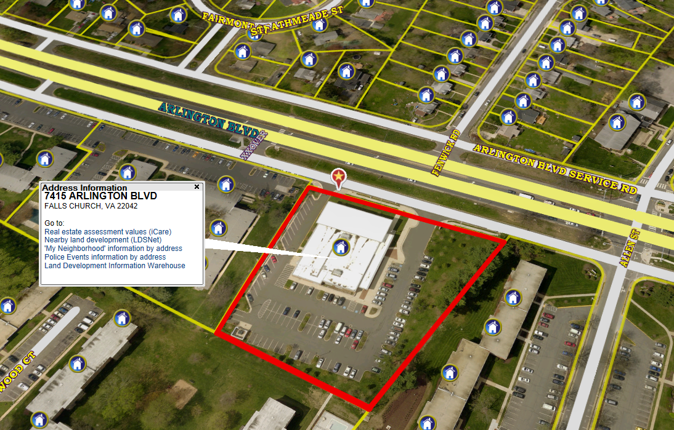
Thomas Jefferson Library (1.12) – 7415 Arlington Blvd, Falls Church, VA 22042

Slide 41
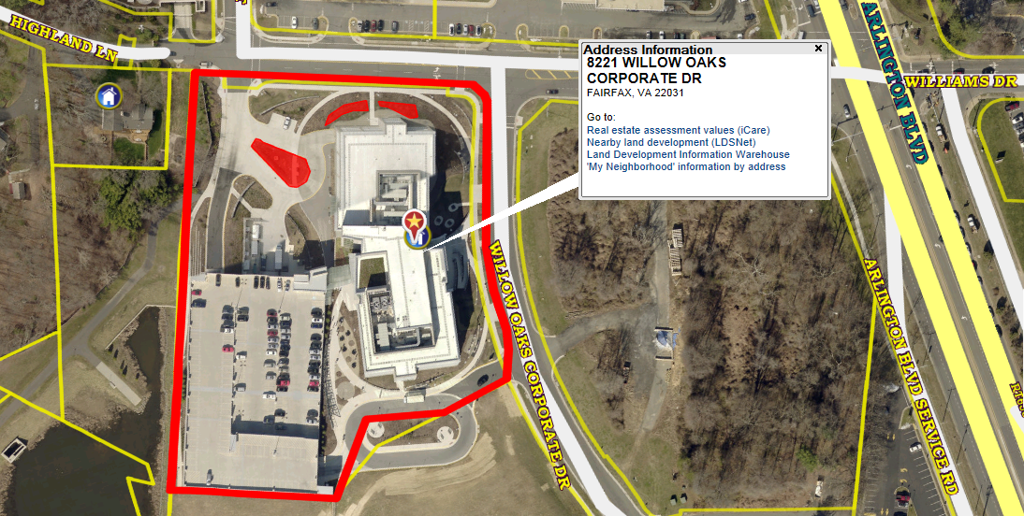
Merrifield Center (2.5) – 8221 Willow Oaks Corporate Dr., Fairfax, VA 22031

Slide 42
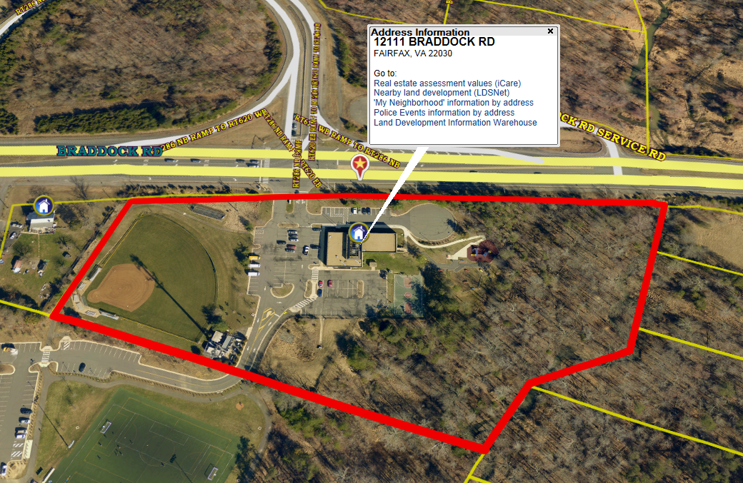
Mott Community Center (1.28) – 12111 Braddock Rd., Fairfax, VA 22030

Slide 43
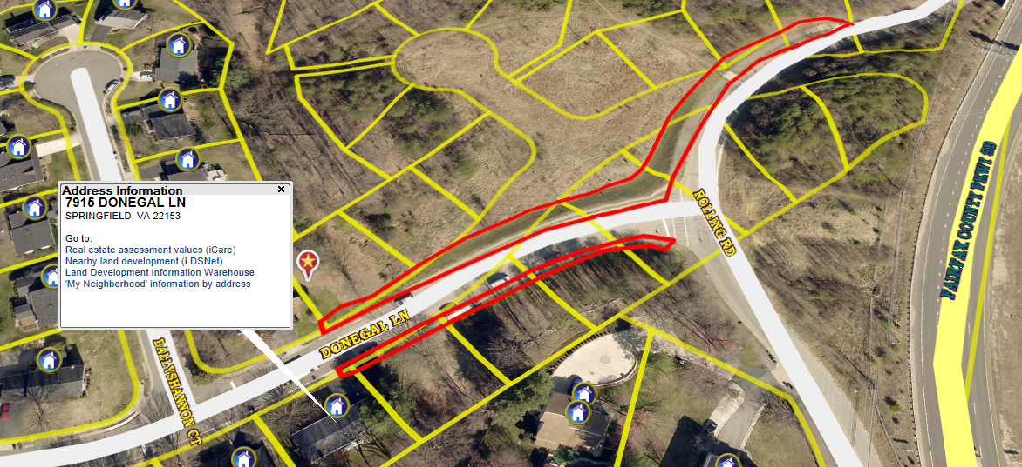
Donegal Ln. (0.52) – Lots 1-14 & 60-66 – (Nearest Address) 7915 Donegal Ln., Springfield, VA

Slide 44
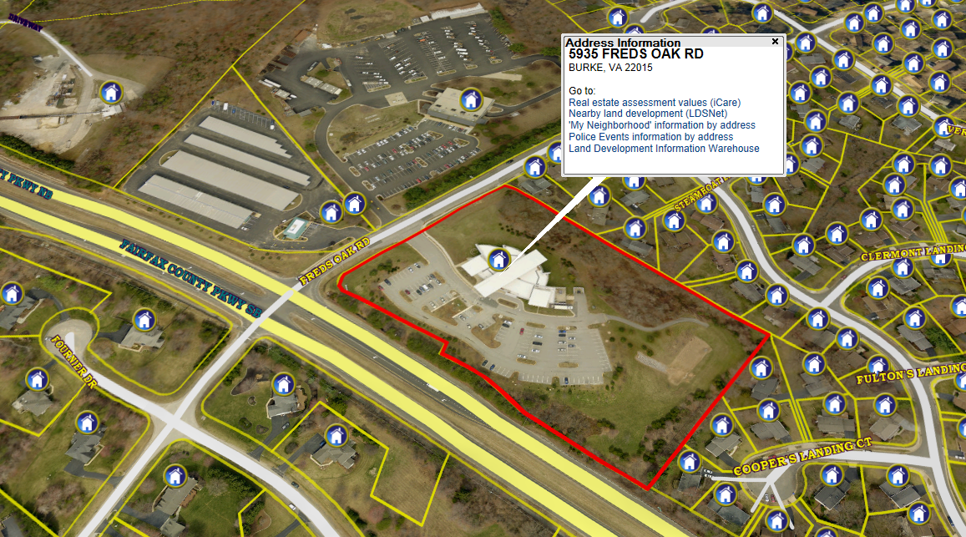
Burke Centre Library (6.5) - 5935 Fred Oak Rd, Burke, VA 22015

Slide 45
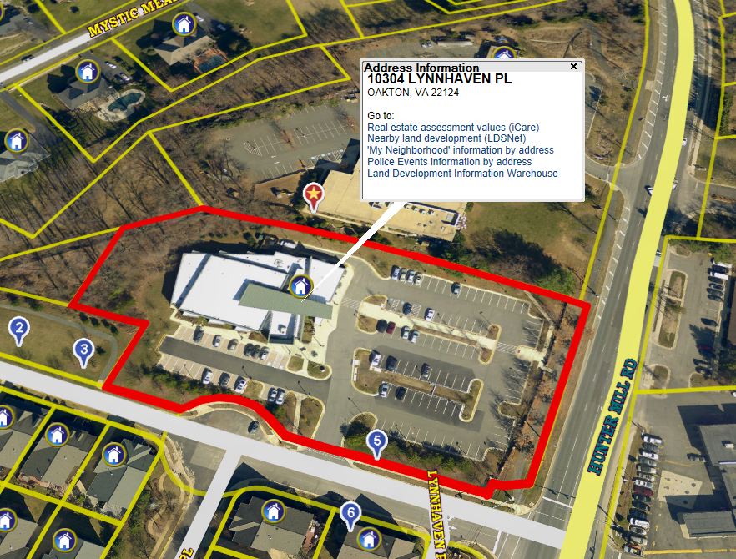
Oakton Library (2.5) – 10304 Lynnhaven Pl., Oakton, VA 22124

Slide 46
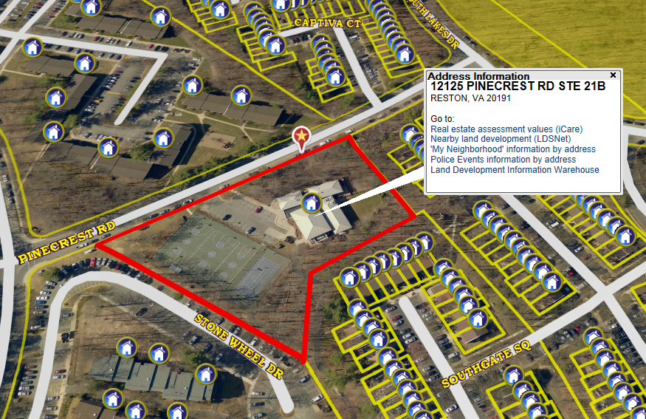
South Gate Community Center (2.4) – 12125 Pinecrest Rd., Reston, VA 20191

