Slide 1
ZONE B – CENTRAL (98.85)
PSC Headquarters (4.3) – 12099 Government Center Pkwy, Fairfax VA 22035
Herrity Building (3.1)- 12055 Government Center Pkwy, Fairfax VA 22035
Pennino Building (6.8) – 12011 Government Center Pkwy, Fairfax VA 22035
Fairfax County Government Center (22) –12000 Government Center Pkwy, Fairfax, VA 22035
PSTOC (20.43) – 4890 Alliance Drive, Fairfax, VA 22030
Fire and Rescue Academy (11.7) – 4600 West Ox Rd., Fairfax, VA 22030
Animal Shelter (3.7) – 4500 West Ox Rd., Fairfax, VA 22030
Public Safety Center Complex (23.8) – 4110 Chain Bridge Rd, Fairfax, VA 22030
Burkholder Center (.89) – 10700 Page Ave, Fairfax, VA 22030
Burke Station Road Shop (2.13) – 4001 Burke Station Rd, Fairfax, VA 22032

Slide 2
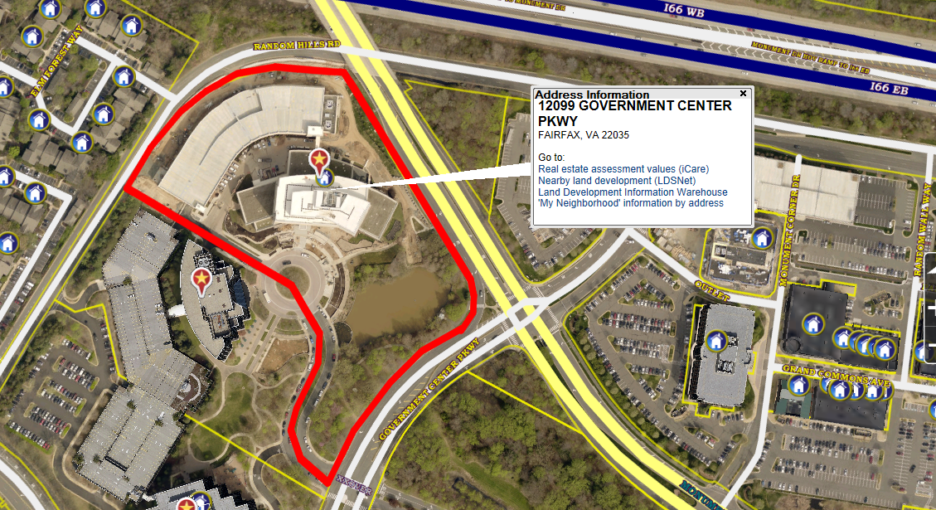
PSC Headquarters (4.3) – 12099 Government Center Pkwy, Fairfax VA 22035

Slide 3
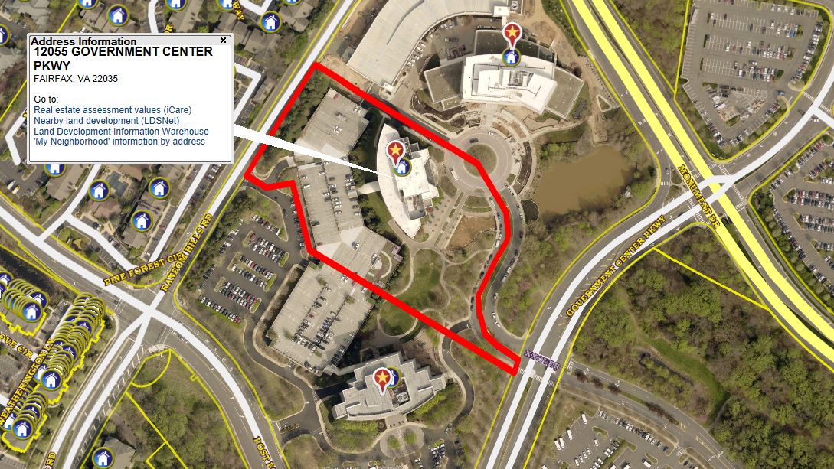
Herrity Building (3.1)- 12055 Government Center Pkwy, Fairfax VA 22035

Slide 4
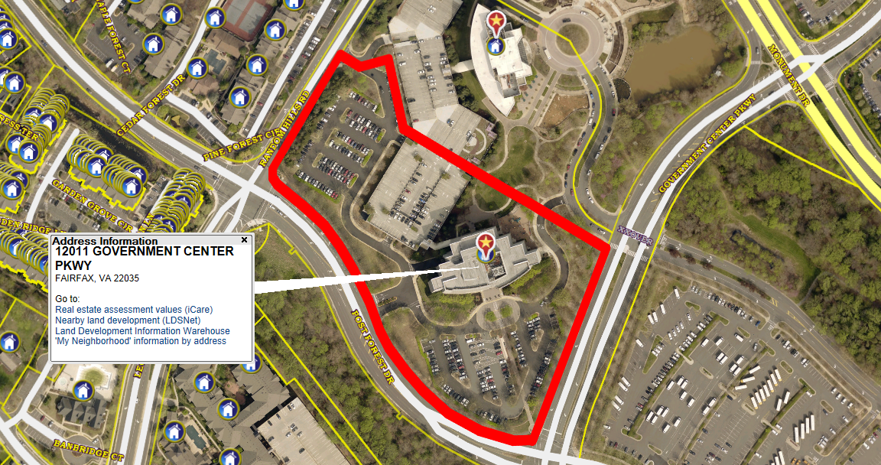
Pennino Building (6.8) – 12011 Government Center Pkwy, Fairfax VA 22035

Slide 5
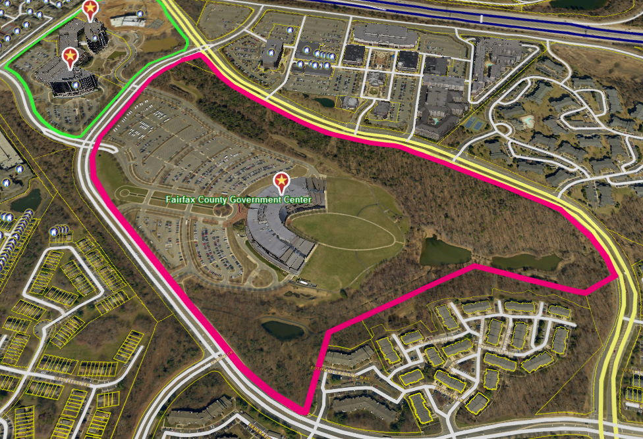
Fairfax County Government Center (22) – 12000 Government Center Pkwy, Fairfax, VA 22035

Slide 6
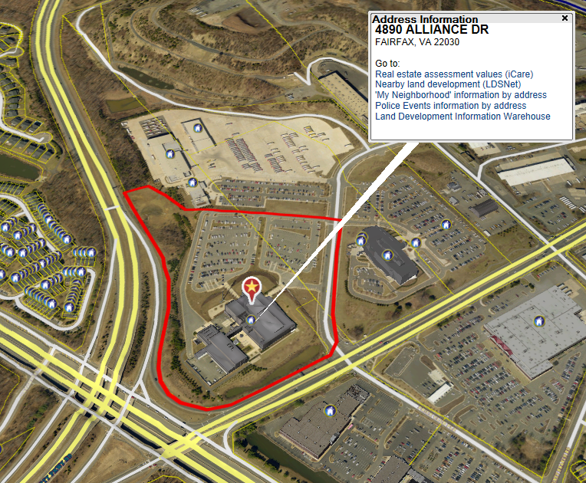
PSTOC (20.43) – 4890 Alliance Drive, Fairfax, VA 22030

Slide 7
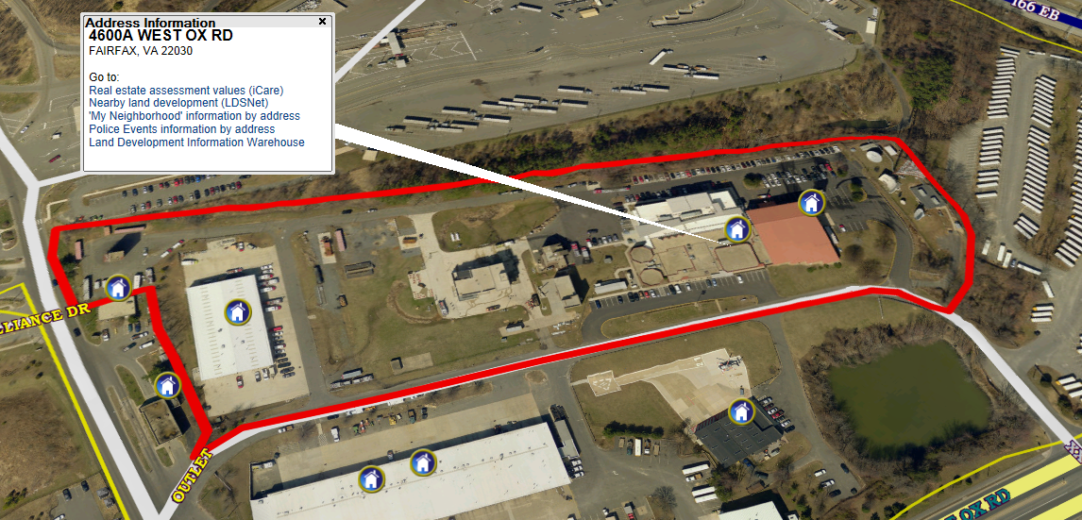
Fire and Rescue Academy (11.7) – 4600 West Ox Rd., Fairfax, VA 22030

Slide 8
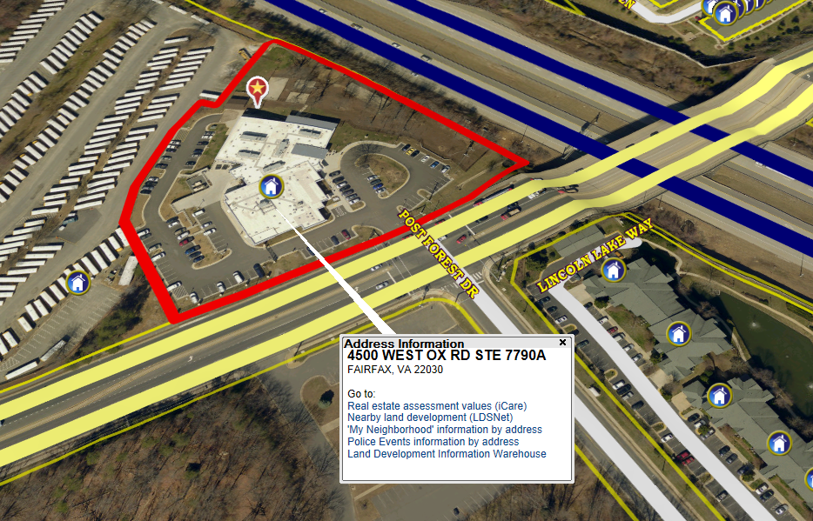
Animal Shelter (3.7) – 4500 West Ox Rd., Fairfax, VA 22030

Slide 9
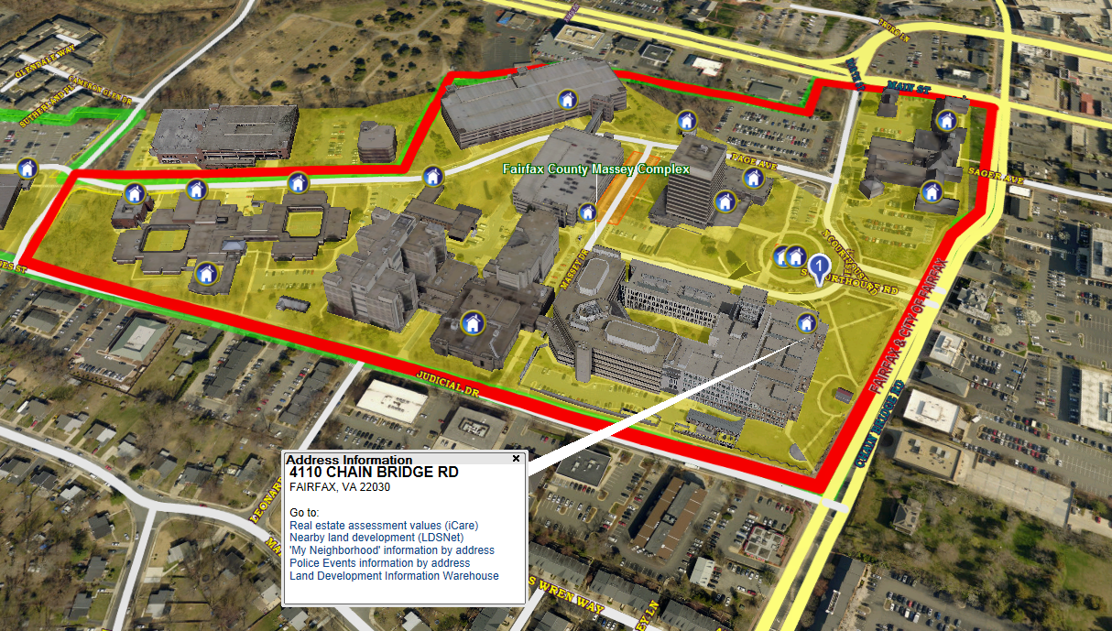
Public Safety Center Complex (23.8) – 4110 Chain Bridge Rd, Fairfax, VA 22030

Slide 10
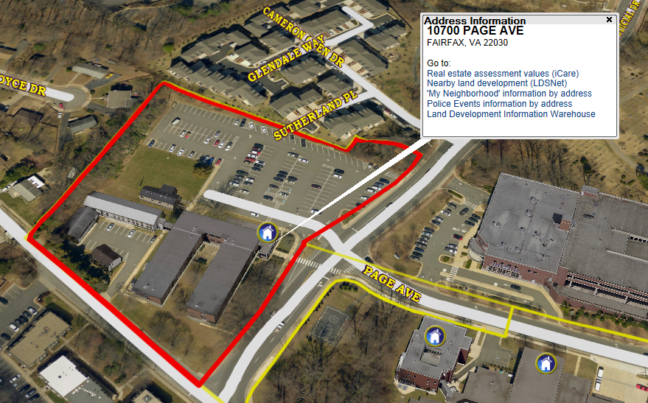
Burkholder Center (.89) – 10700 Page Ave, Fairfax, VA 22030

Slide 11
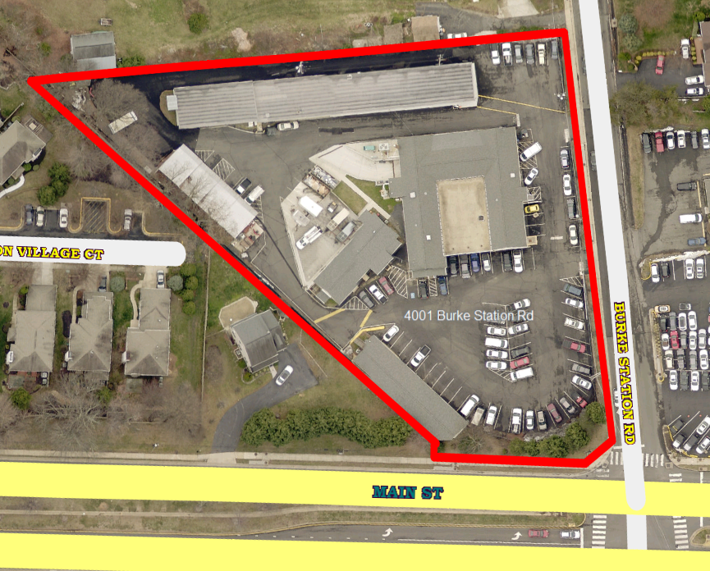
Burke Station Road Shop (2.13) – 4001 Burke Station Rd, Fairfax, VA 22032

