Slide 1
ZONE C - SOUTH (103.47)
Annandale EDC/daycare + 4175 Daniels Ave (3.6) – 7200 Columbia Pike, Annandale, VA 22003
Bailey’s Homeless Shelter (0.7) – 3525 Moncure Ave, Falls Church, VA 22041
Bailey’s Community Center (2.3) – 5920 Summers Lane, Falls Church, VA 22041
Future Bailey’s Fire Shelter (0.42) – 5914 Seminary Rd, Falls Church, VA 22041
Woodburn Place (1.16) – 3300 Woodburn Rd., Annandale, VA 22003
Mason District Government Center (7.7) – 6507 Columbia Pike, Annandale, VA 22003
George Mason Library (1.27) – 7001 Little River Tpke, Annandale, VA 22003
Pine Ridge (6.1) – 3911 Woodburn Rd., Annandale, VA 22003
Willston Center 7 Corners Daycare (3.15) – 6131 Willston Dr., Falls Church, VA 220044
Woodrow Wilson Library (0.42) – 6101 Knollwood Dr., Falls Church VA 22041
Luton Place (0.38) – 7624 Luton Place, Alexandria, VA 22315
Crossroads Drug Abuse (0.06) – 6901 Van Dorn St., Alexandria, VA 22315
Lincolnia Senior Center (1.27) – 4710 N. Chambliss St., Alexandria, VA 22310
Alban Garage (0.82) – 7940 Alban Road, Springfield, VA 22150
Lee District Government Center (2.0) - 6121 Franconia Rd, Franconia, VA 22310

Slide 2
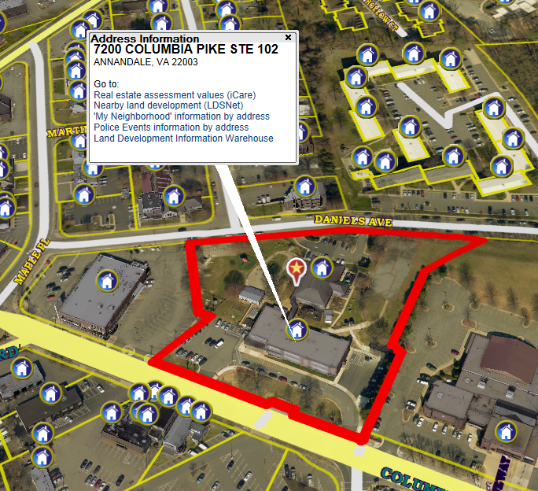
Annandale EDC/daycare (3.6) – 720 Columbia Pike, Annandale, VA 22003

Slide 3
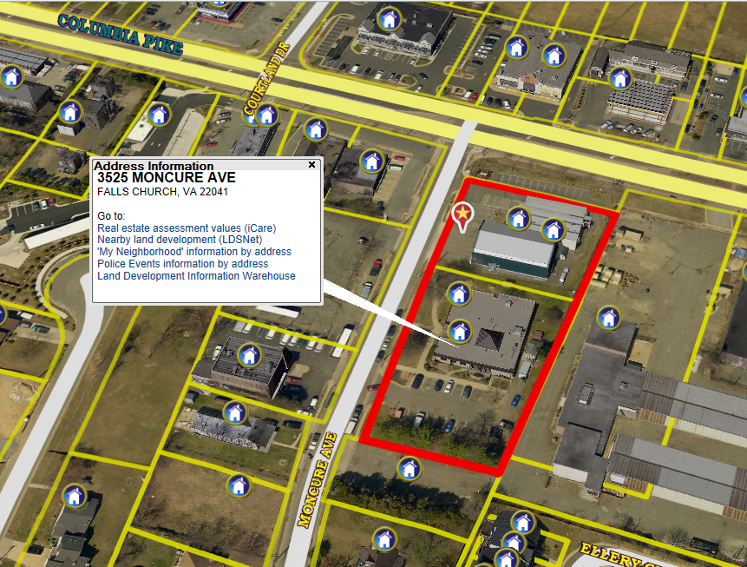
Bailey’s Homeless Shelter (0.7) – 3525 Moncure Ave, Falls Church, VA 22041

Slide 4
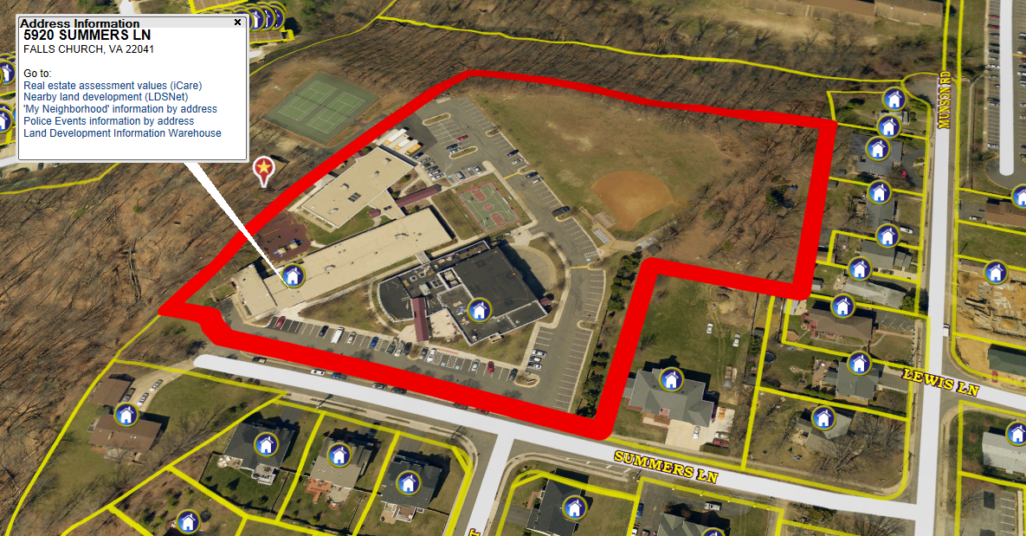
Bailey’s Community Center (2.3) – 5920 Summers Lane, Falls Church, VA 22041

Slide 5
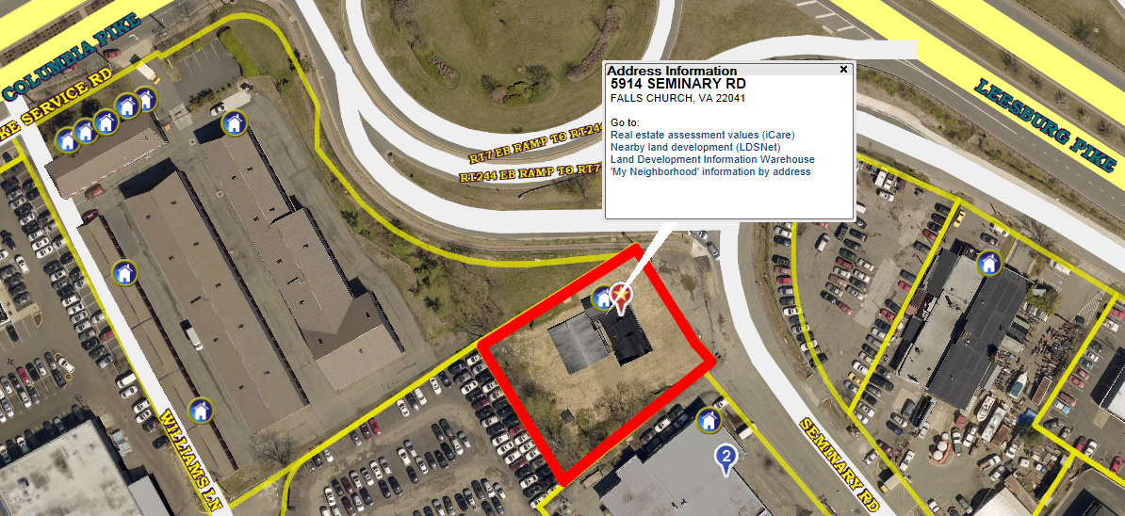
Future Bailey’s Fire Shelter (0.42) –
5914 Seminary Rd, Falls Church, VA 22041

Slide 6
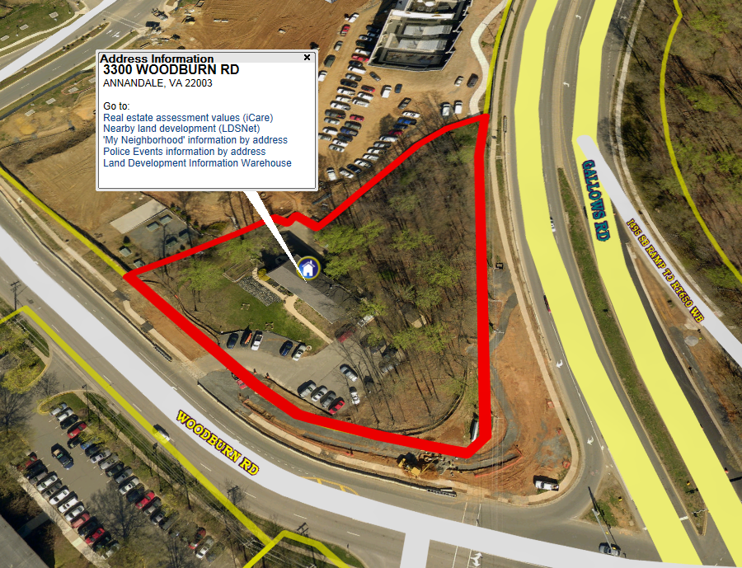
Woodburn Place (1.16) – 3300 Woodburn Rd., Annandale, VA 22003

Slide 7
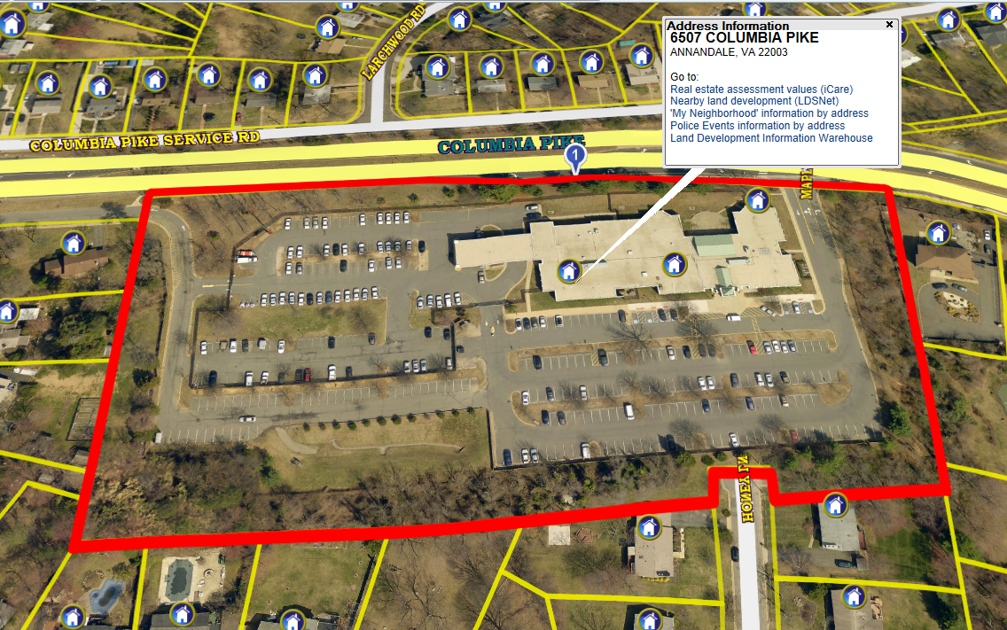
Mason District Government Center (7.7) – 6507 Columbia Pike, Annandale, VA 22003

Slide 8
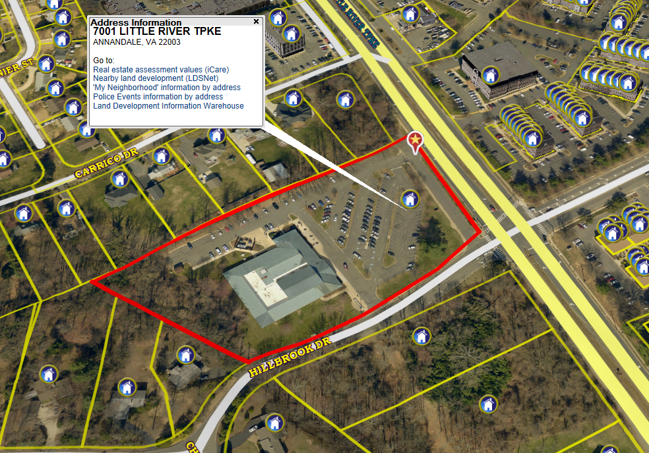
George Mason Library (1.27) – 7001 Little River Tpke, Annandale, VA 22003

Slide 9
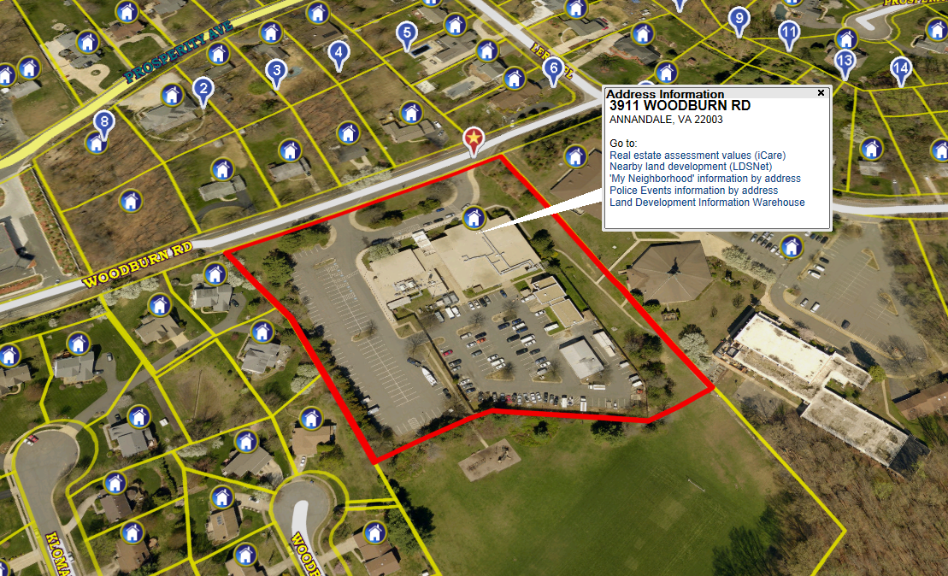
Pine Ridge (6.1) – 3911 Woodburn Rd., Annandale, VA 22003

Slide 10
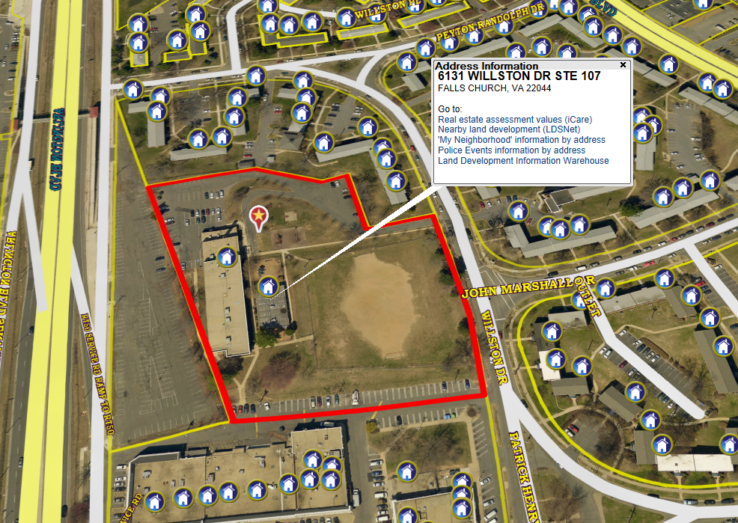
Willston Center 7 Corners Daycare (3.15) – 6131 Willston Dr., Falls Church, VA 220044

Slide 11
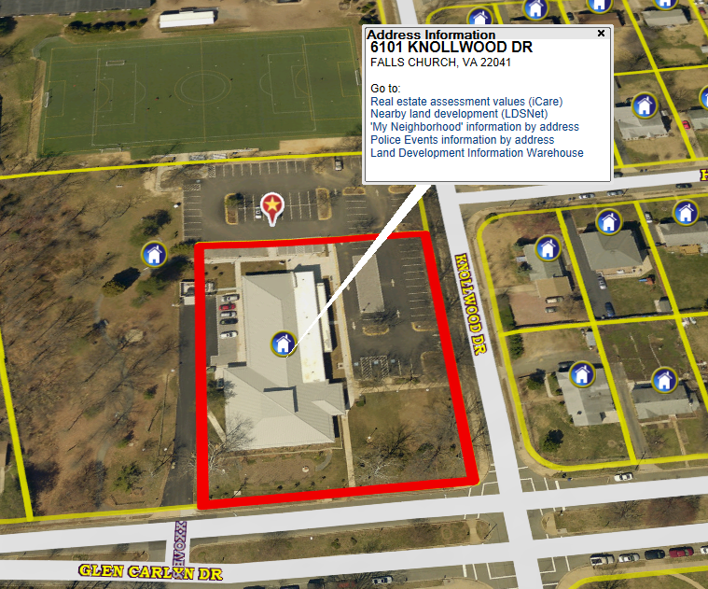
Woodrow Wilson Library (0.42) – 6101 Knollwood Dr., Falls Church VA 22041

Slide 12
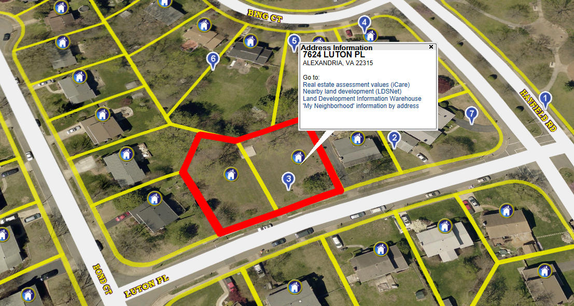
Luton Place (.38) – 7624 Luton Place, Alexandria, VA 22315

Slide 13
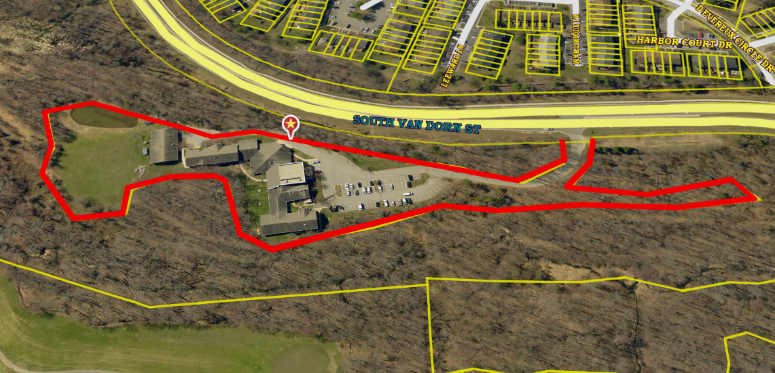
Crossroads Drug Abuse (0.06) – 6901 Van Dorn St., Alexandria, VA 22315

Slide 14
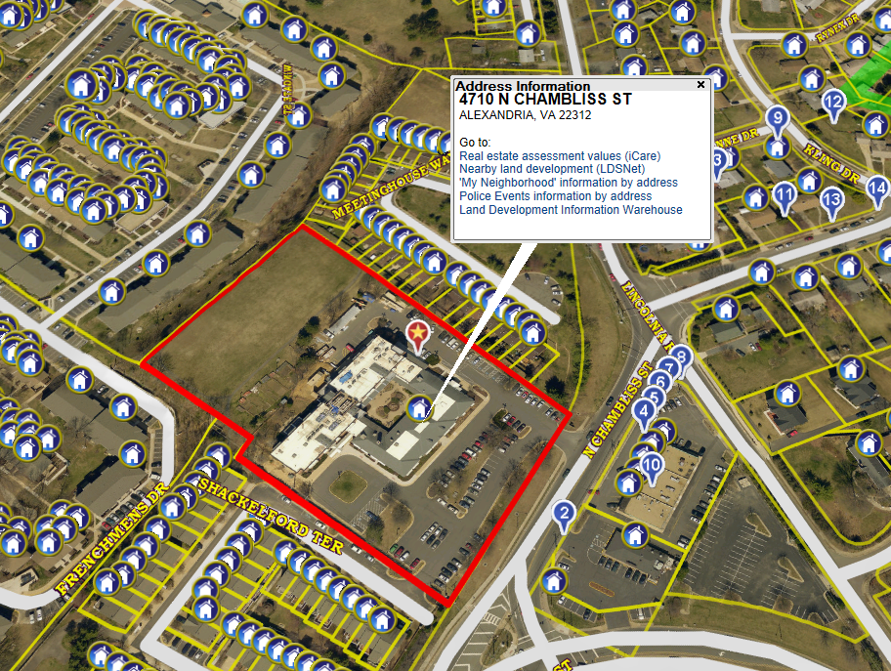
Lincolnia Senior Center (1.27) – 4710 N. Chambliss St., Alexandria, VA 22310

Slide 15
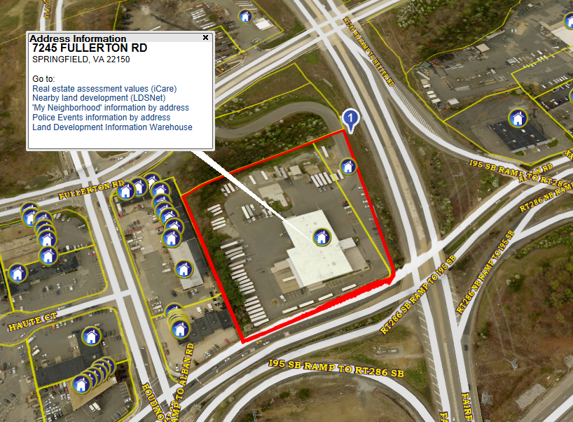
Alban Garage (0.82) – 7940 Alban Road, Springfield, VA 22150

Slide 16
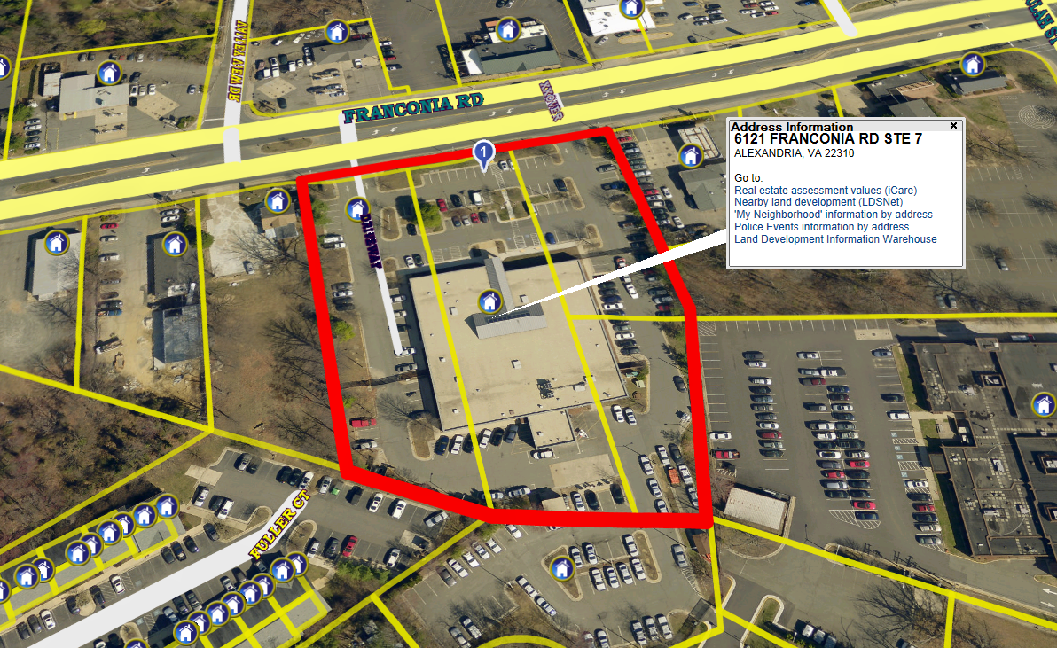
Lee District Government Center (2.0) - 6121 Franconia Rd, Franconia, VA 22310

Slide 17
ZONE C – SOUTH (Continued)
Burgundy Community Ctr. (0.41) – 5516 Norton Rd., Alexandria, VA 22303
Eleanor Kennedy Shelter (1.0) – 9155 Richmond HWY, Fort Belvoir, VA 22060
New Horizons (0.57) – 8243 Gregory Dr., Alexandria, VA 22309
Gum Springs Community Ctr. (4.95) – 8100 Fordson Rd., Alexandria, VA 22306
Hollin Hall Center (5.34) – 1500 Shenandoah Rd., Alexandria, VA 22308
Huntington Community Center (0.25) – 5751 Liberty Dr., Alexandria, VA 22303
Huntington Feeder Bus (1.39) – 8101 Cinder Bed Rd., Lorton, VA 22079
John Marshall Library (0.51) - 6209 Rose Hill Dr., Alexandria, VA 22310
Lorton Library / Murphy Tract House (4.61) – 9520 Richmond HWY, Lorton, VA 22079
Martha Washington Library (0.64) – 6614 Fort Hunt Rd., Alexandria, VA 22307
Quander Rd (2.01) – 6318 Quander Rd, Alexandria, VA 22307
Mt Vernon Government Center (4.1) – 2511 Parkers Lane, Mt. Vernon, VA 22306
Mt. Vernon Mental Health (2.28) – 8119 Holland Rd., Alexandria, VA 22306
Richard Byrd Library (0.96) – 7250 Commerce St., Springfield, VA 22150
Sherwood Library (1.21) – 2501 Sherwood Hall Ln., Alexandria, VA 22306
South County Center (2.13) – 8350 Richmond HWY, Alexandria, VA 22309

Slide 18
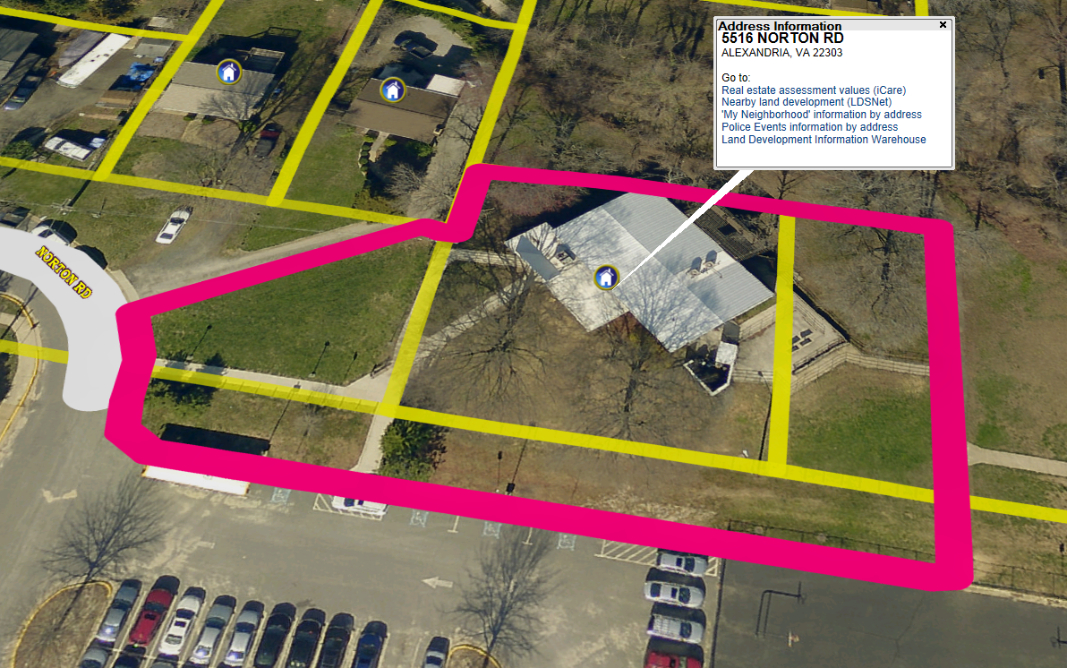
Burgundy Community Ctr. (0.41) – 5516 Norton Rd., Alexandria, VA 22303

Slide 19
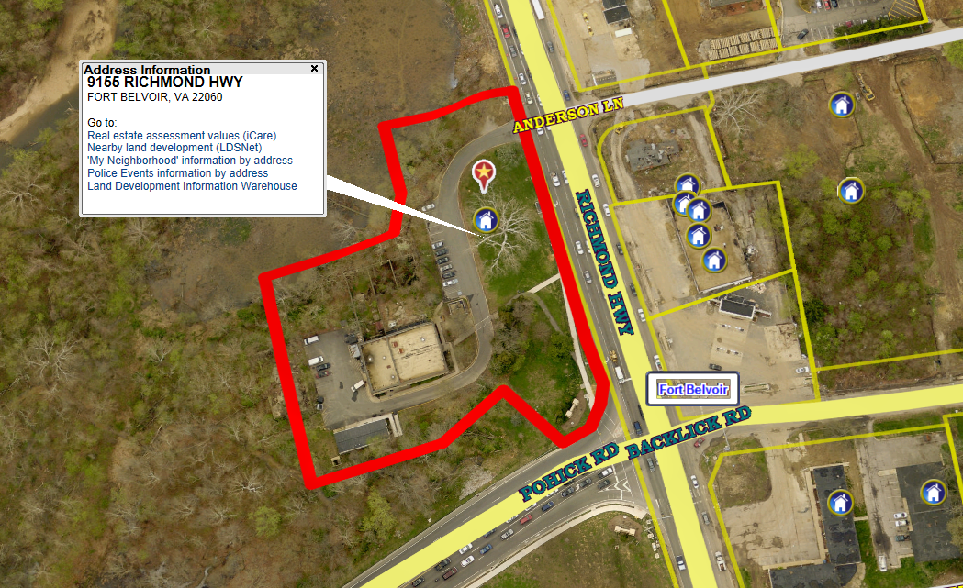
Eleanor Kennedy Shelter (1) – 9155 Richmond HWY, Fort Belvoir, VA 22060

Slide 20
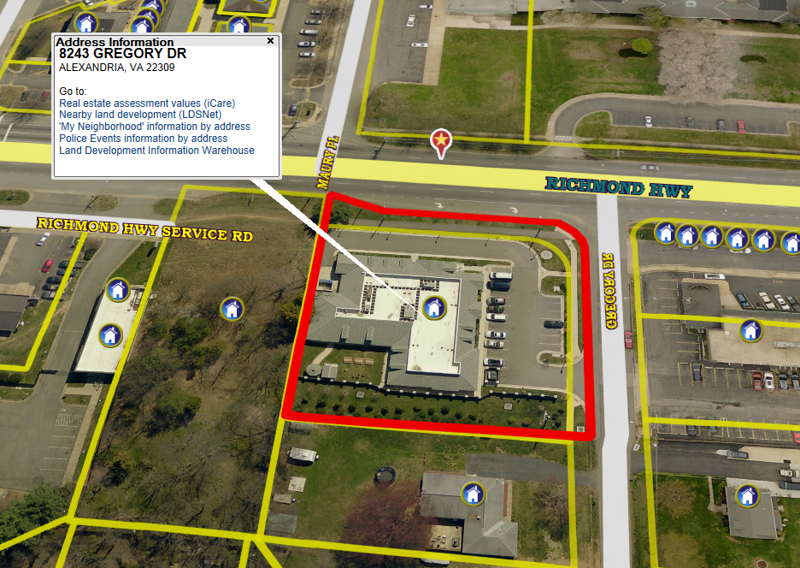
New Horizons (0.57) – 8243 Gregory Dr., Alexandria, VA 22309

Slide 21
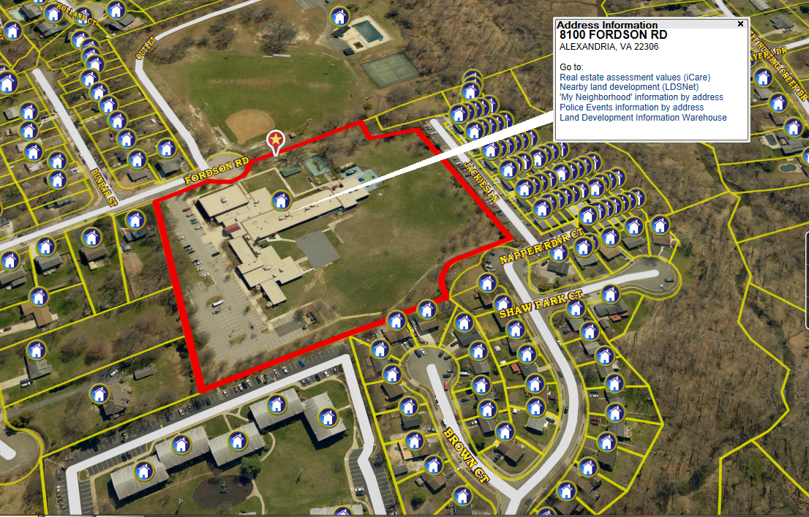
Gum Springs Community Ctr. (4.95) – 8100 Fordson Rd., Alexandria, VA 22306

Slide 22
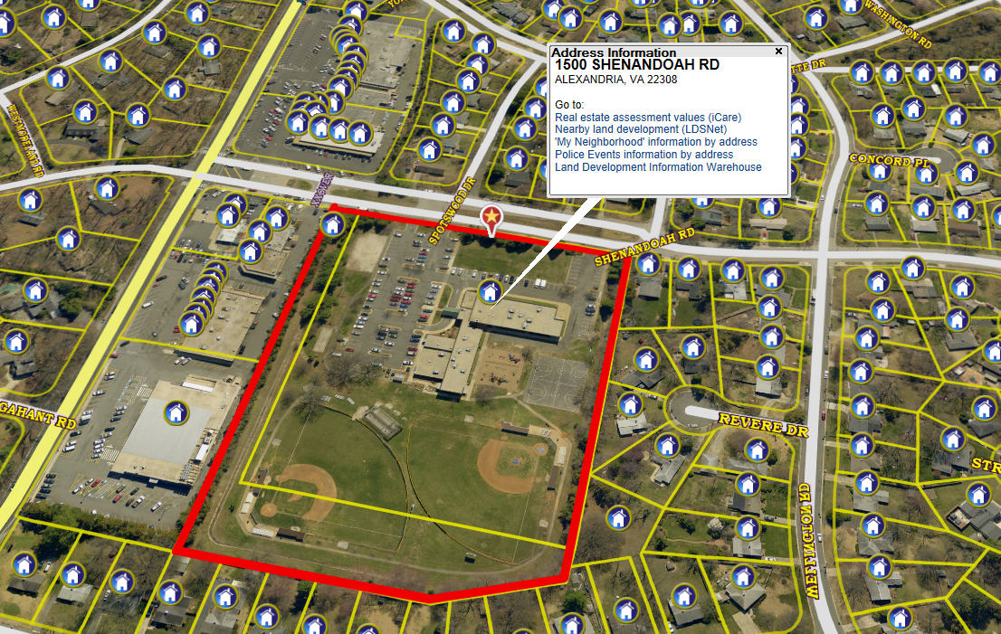
Hollin Hall Center (5.34) – 1500 Shenandoah Rd., Alexandria, VA 22308

Slide 23
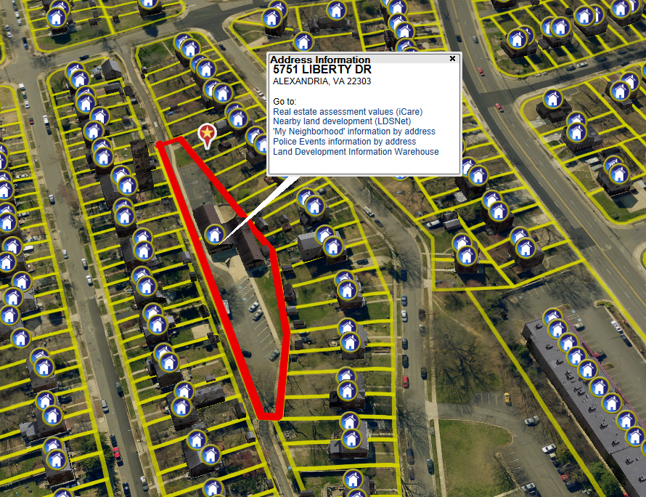
Huntington Community Center (0.25) – 5751 Liberty Dr., Alexandria, VA 22303

Slide 24
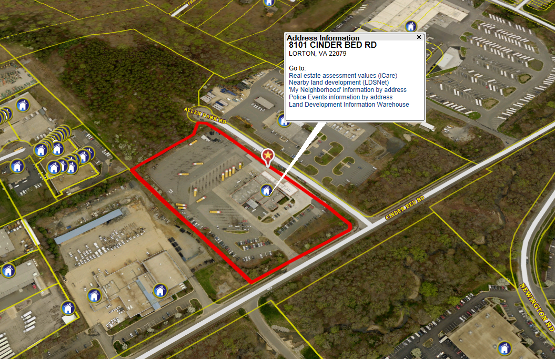
Huntington Feeder Bus (1.39) – 8101 Cinder Bed Rd., Lorton, VA 22079

Slide 25
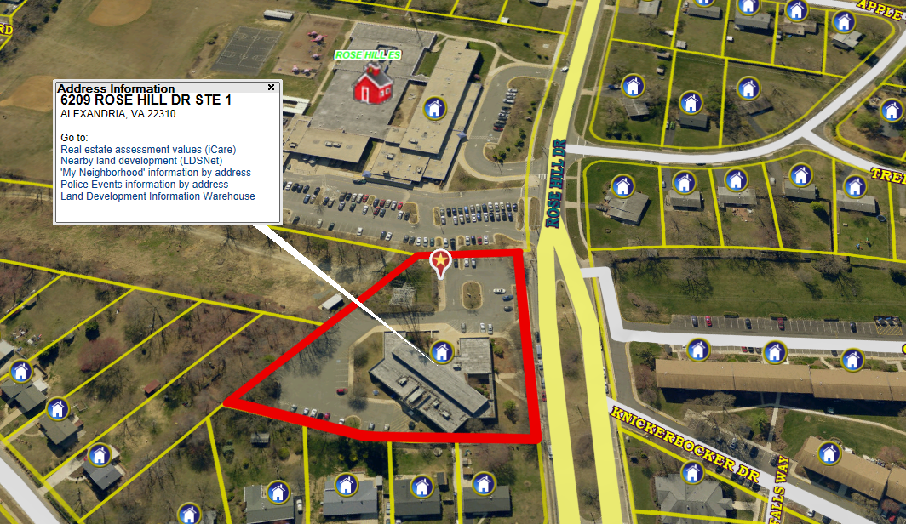
John Marshall Library (0.51) - 6209 Rose Hill Dr., Alexandria, VA 22310

Slide 26
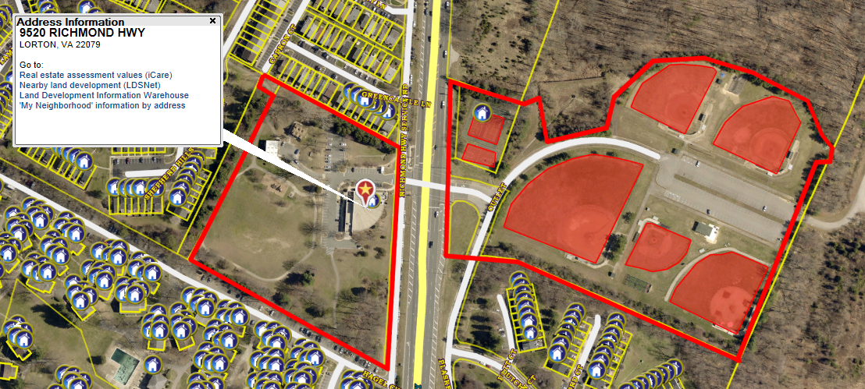
Lorton Library / Murphy Tract House (15.5) – 9520 Richmond HWY, Lorton, VA 22079

Slide 27
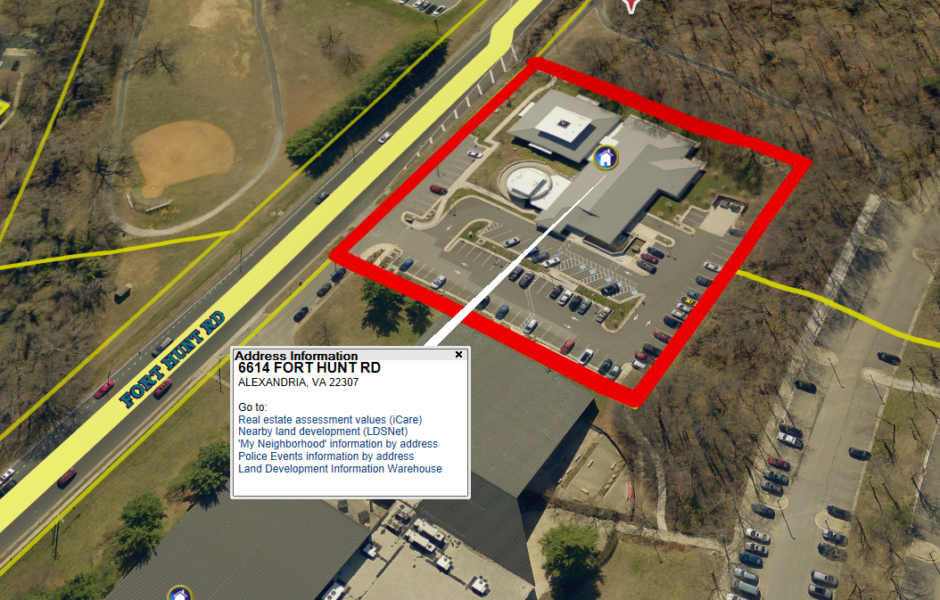
Martha Washington Library (0.64) – 6614 Fort Hunt Rd., Alexandria, VA 22307

Slide 28
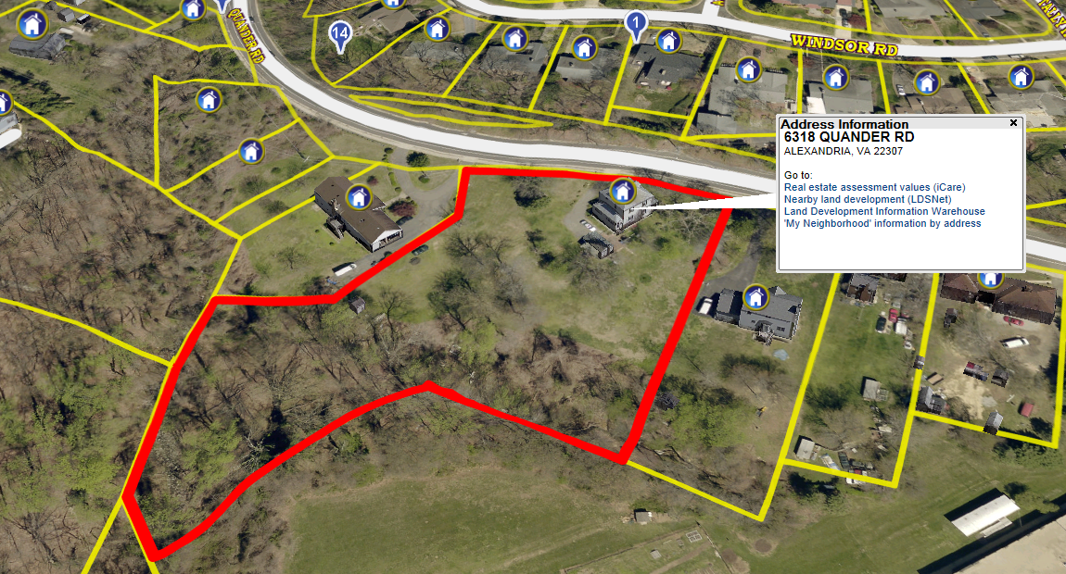
Quander Rd (2.01) –
6318 Quander Rd, Alexandria, VA 22307

Slide 29
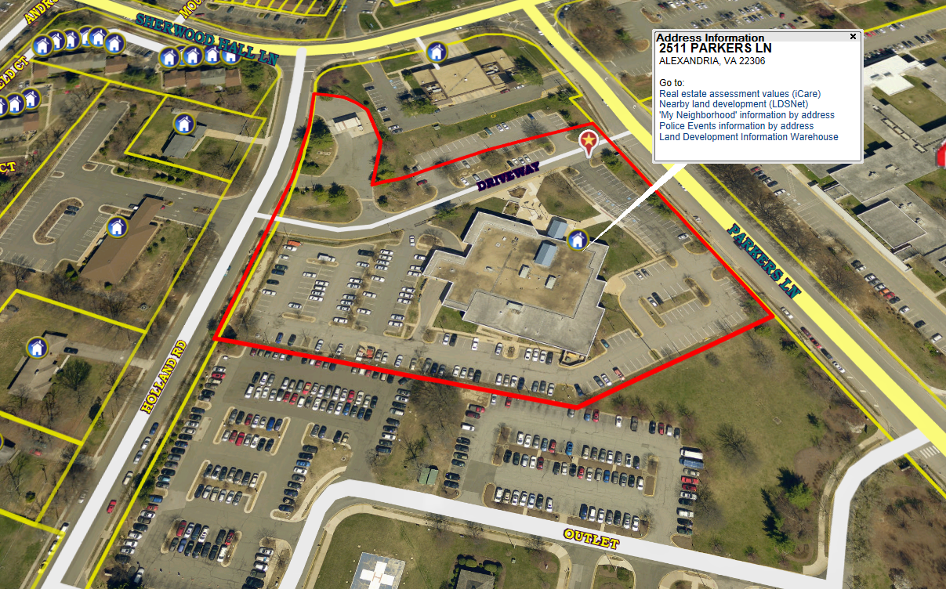
Mt Vernon Government Center (4.1) – 2511 Parkers Lane, Mt. Vernon, VA 22306

Slide 30
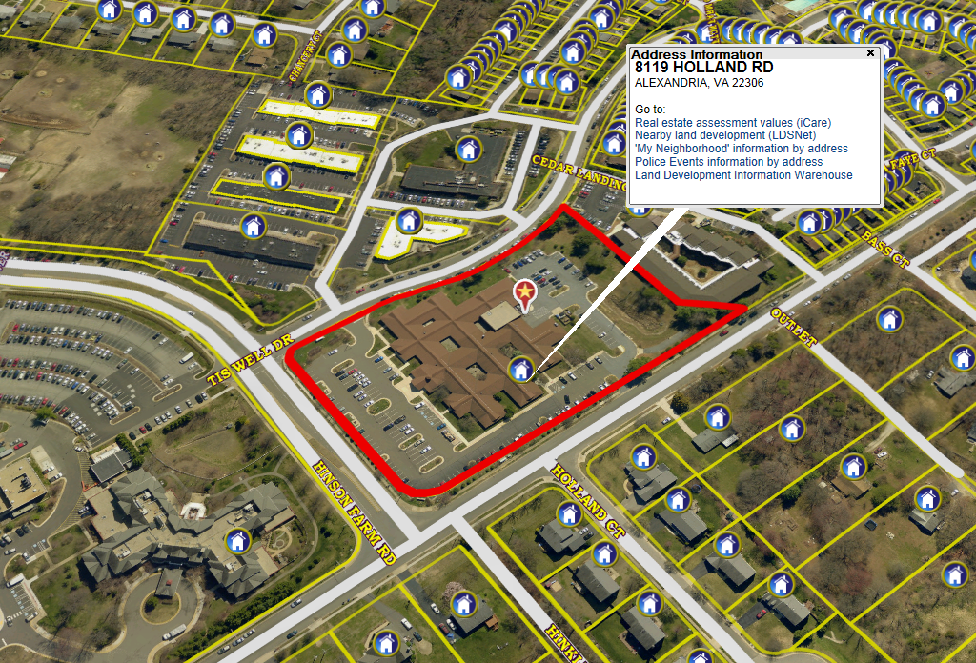
Mt. Vermon Mental Health (2.28) – 8119 Holland Rd., Alexandria, VA 22306

Slide 31
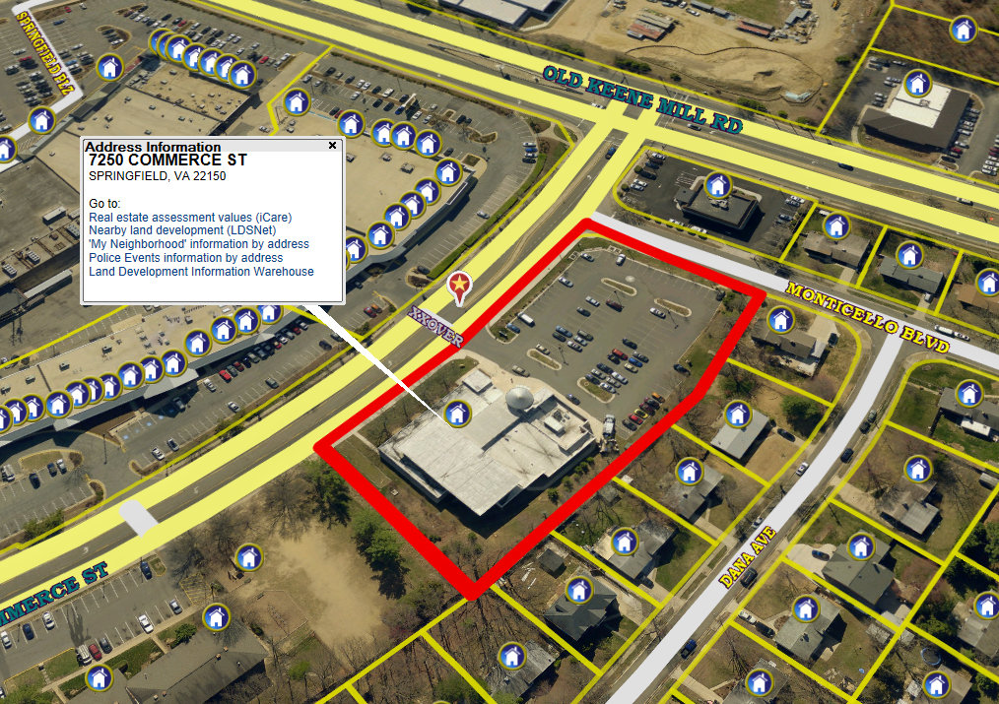
Richard Byrd Library (0.96) – 7250 Commerce St., Springfield, VA 22150

Slide 32
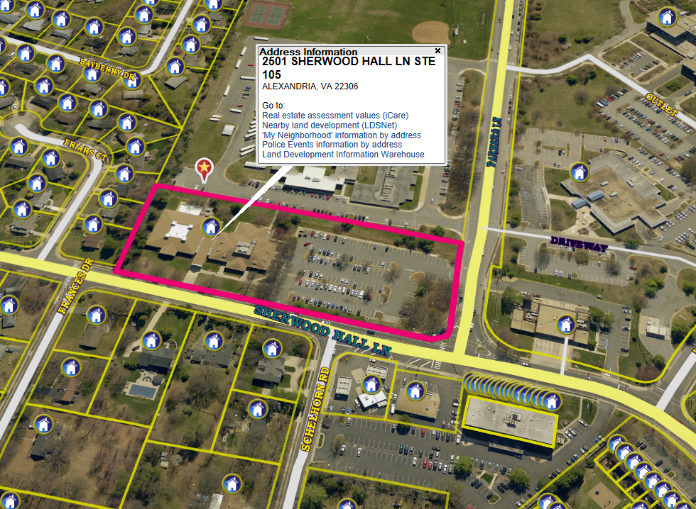
Sherwood Library (1.21) – 2501 Sherwood Hall Ln., Alexandria, VA 22306

Slide 33
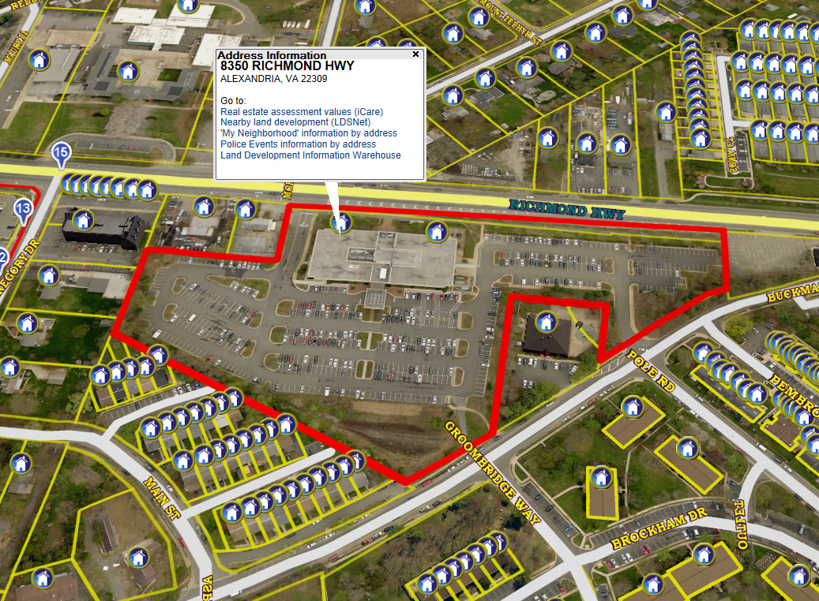
South County Center (2.13) – 8350 Richmond HWY, Alexandria, VA 22309

Slide 34
ZONE C - SOUTH (continued)
United Community Ministries (0.5) – 7511 Fordson Rd., Alexandria, VA 22306
Old Mount Vernon High School (5.83) – 4100 Mohawk Ln., Alexandria, VA 22309
Lincolnia Cemetery (0.67) – 6271 Lincolnia Rd., Alexandria, VA 22312

Slide 35
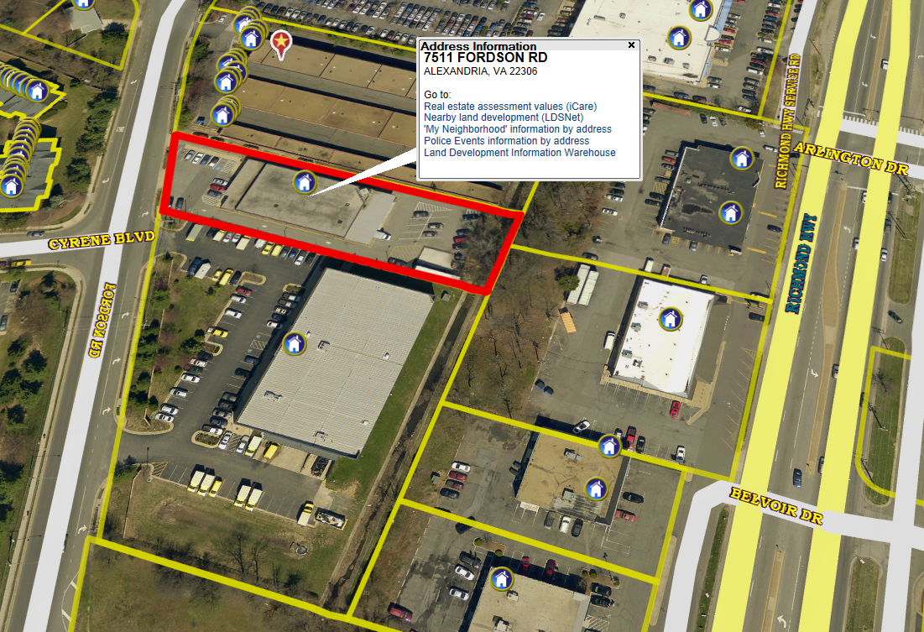
United Community Ministries (0.5) – 7511 Fordson Rd., Alexandria, VA 22306

Slide 36
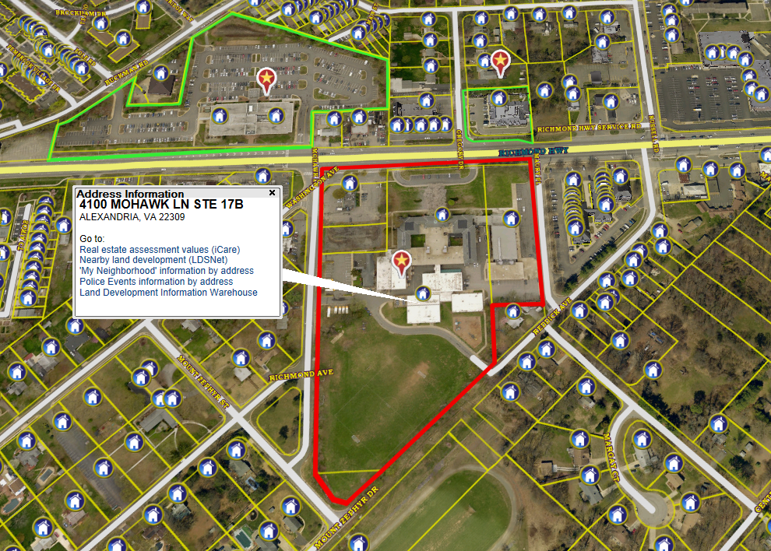
Old Mount Vernon High School (5.83) – 4100 Mohawk Ln., Alexandria, VA 22309

Slide 37
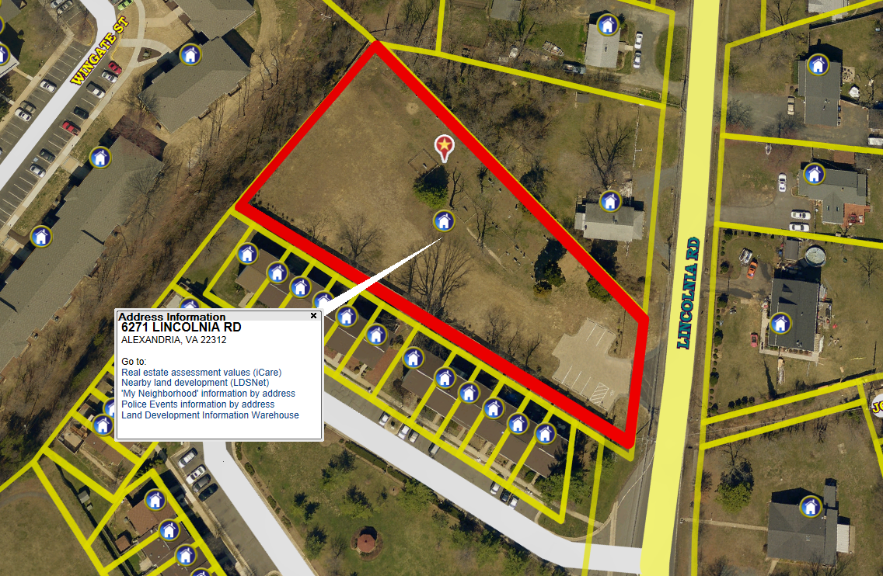
Lincolnia Cemetery (0.67) – 6271 Lincolnia Rd., Alexandria, VA 22312

