Slide 1
Area 1 DHCD RAD

Slide 2
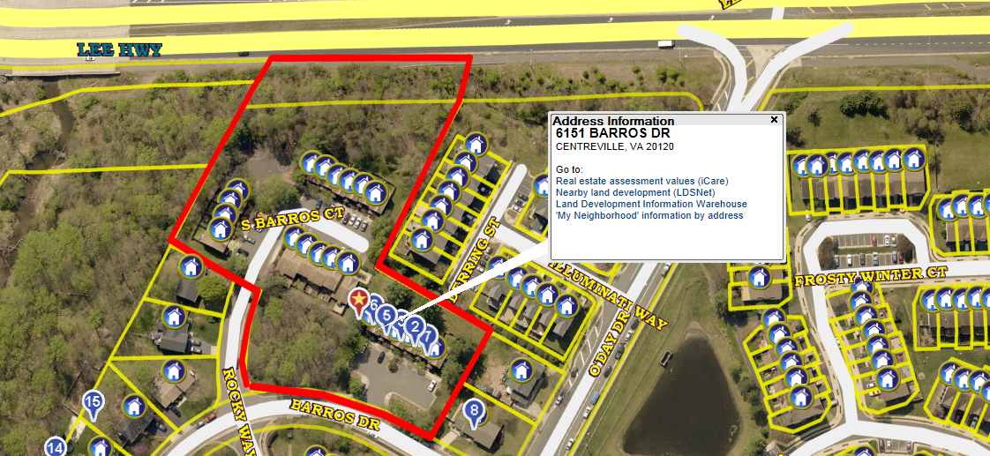
Barros Circle Townhouse (3.16) - 6151 – 6161 Barros Dr. 6107 – 6127 Barros Ct. 14516 – 14528 N. Barros Ct, Centreville, VA 22020

Slide 3
Barros Circle Townhouse (3.16) - 6151 – 6161 Barros Dr. 6107 – 6127 Barros Ct. 14516 – 14528 N. Barros Ct, Centreville, VA 22020

Slide 4
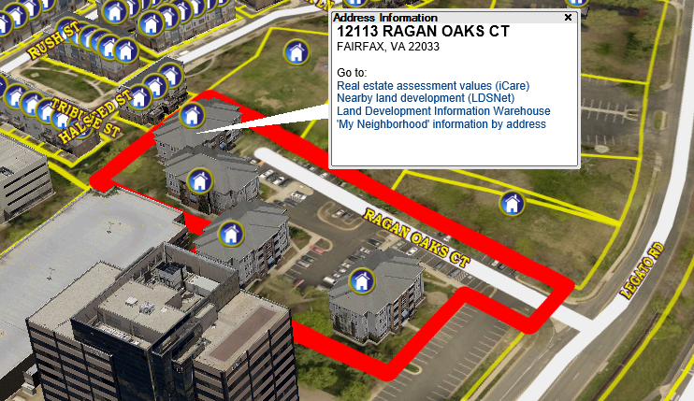
Ragan Oaks(1.89) 12101 -12113 Ragan Oaks Ct Fairfax, VA 22033

Slide 5
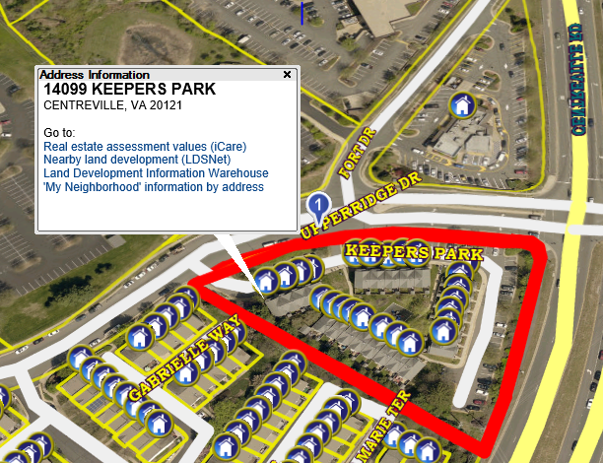
Castellani Meadows Townhouses(1.90) 14047 -14099 Keepers Park Centreville, VA 20121

Slide 6
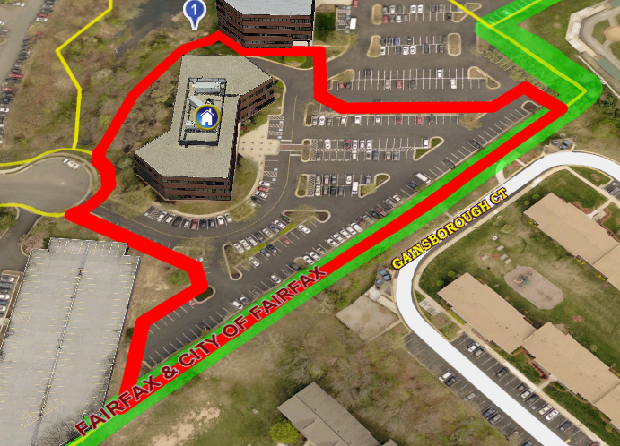
Housing Resource Center (3.39) 3700 Pender Drive Fairfax, VA 22030

Slide 7
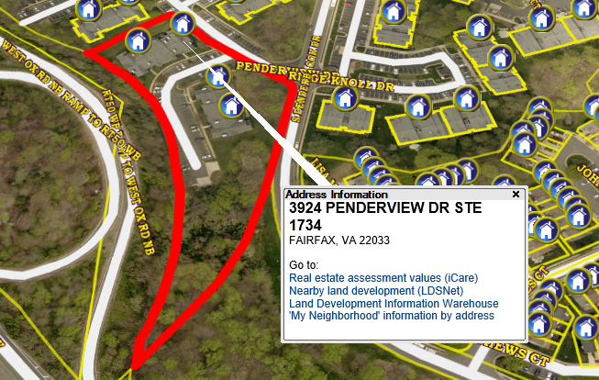
Penderbrook Apartments (2.63) 3924-3927 Penderview Fairfax, VA 22030

Slide 8
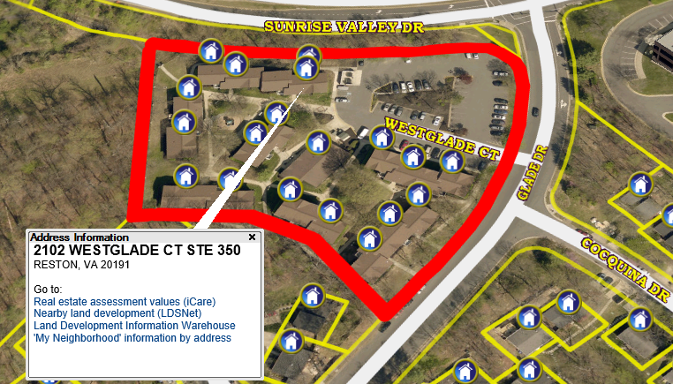
Westglade Apartments (2.95) 32102-2136 Westglade Ct Reston, VA 22091

Slide 9
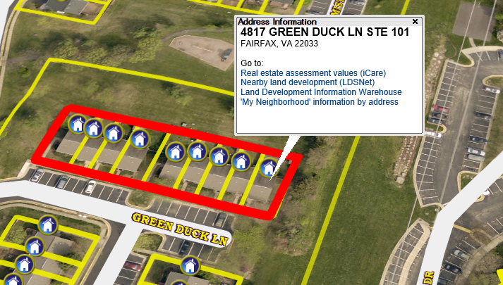
Water’s Edge (0.37) 4801-4817 Greenduck Lane Fairfax, VA 22033

