Slide 1
AREA 2 DHCD RAD

Slide 2
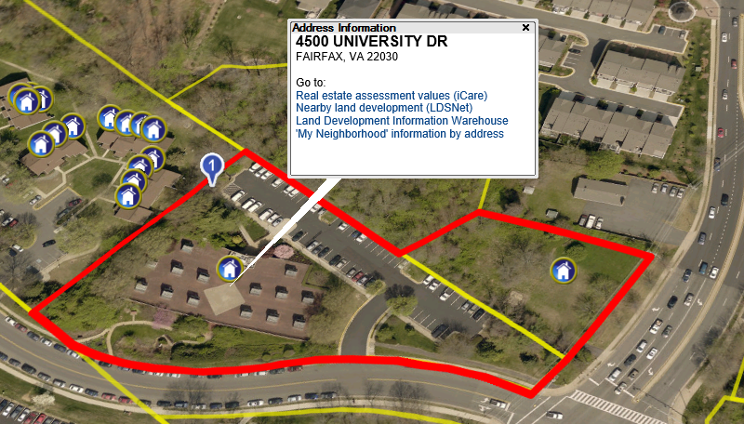
Division of Property Improvement/Maintenance & Adjacent Lot (2.37) 4500 University Drive Fairfax, VA 22030

Slide 3
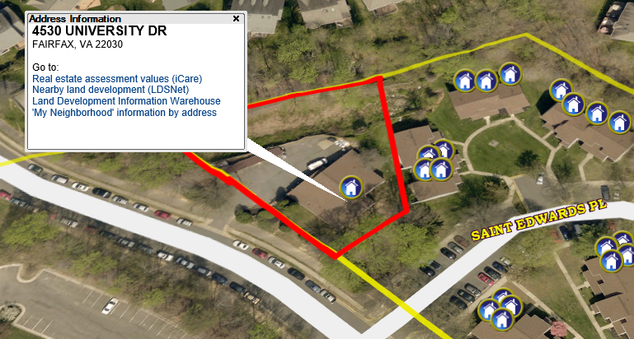
Maintenance Shop (0.05) 4530 University Drive Fairfax, VA 22030

Slide 4
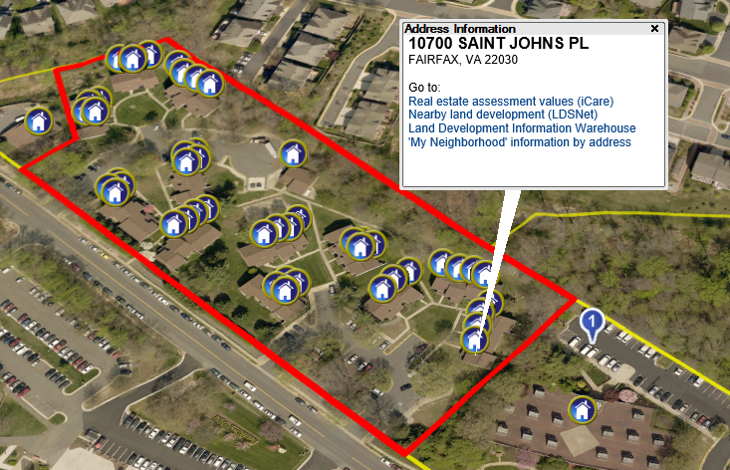
Robinson Square Townhouses (5.50) 4410-4433 St. Edwards Pl.; 10700-10744 St. Johns Pl. Fairfax, VA 22030

Slide 5
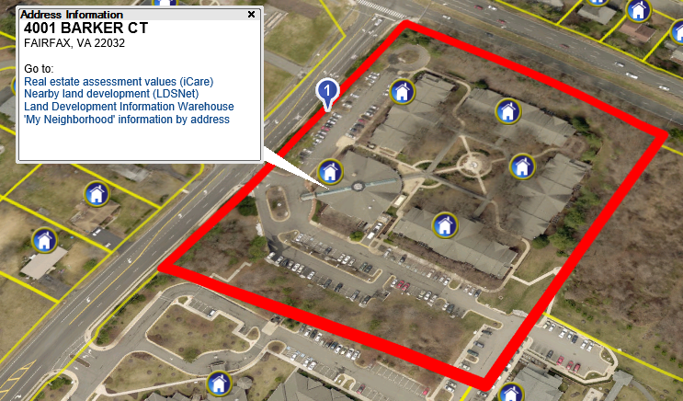
Little River Glen Senior Center (6.77) 4001-4009 Barker Court Fairfax, VA 22032

Slide 6
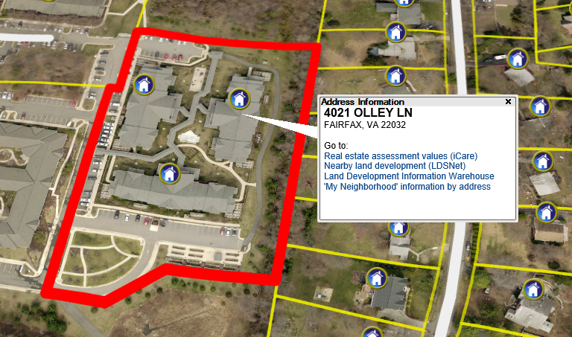
Olley Glen Senior Center (3.99) 4019-4023 Olley Ln. Fairfax, VA 22032

Slide 7
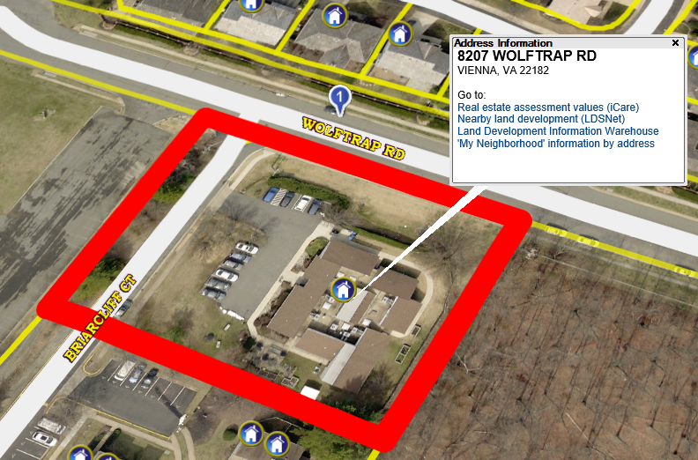
Minerva Fisher Hall Group Home (1.18) 8207 Wolf Trap Road Vienna, VA 22180

Slide 8
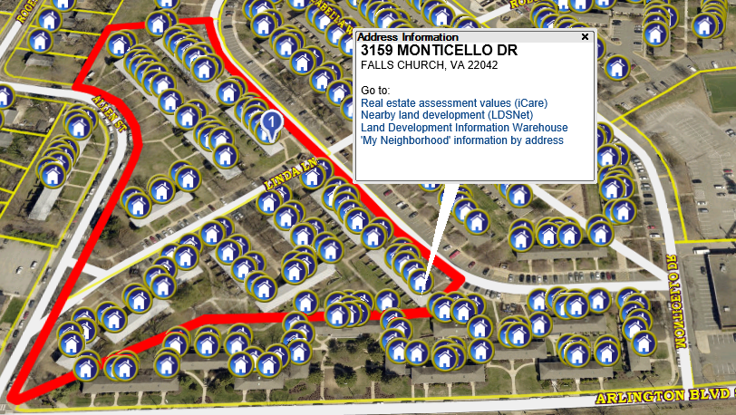
Kingsley Park Townhouses (6.42) 3069-3159 Monticello Dr.; 7401-7467 Linda Ln.; 3153-3182 Allen St Falls Church, VA 22042

Slide 9
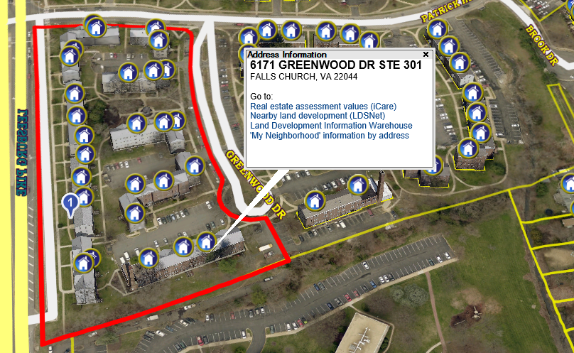
Greenwood Apartments (5.60) 6170-6188 Leesburg Pike; 3077-3081 Patrick Henry Dr.; 6171-6195 Greenwood Dr. Falls Church, VA 22044

Slide 10
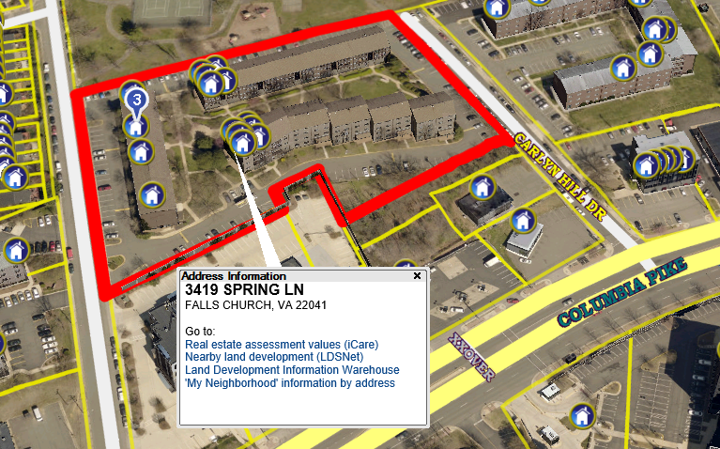
Rosedale Manor Apartments (3.79) 3401-3427 Spring Lane Falls Church, VA 22041

Slide 11
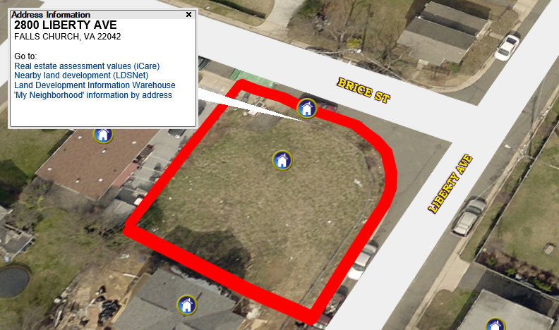
Vacant Lot (0.13) 2800-2802 Liberty Avenue Falls Church, VA 22041

