Slide 1
AREA 3 DHCD RAD

Slide 2
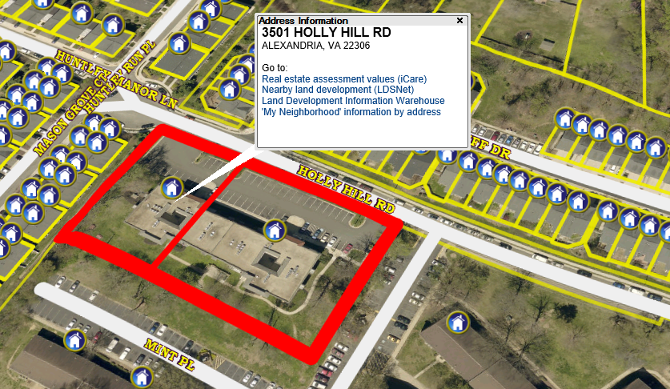
Atrium Apartments (1.30) 3429-3501 Holy Hill Road Alexandria, VA 22306

Slide 3
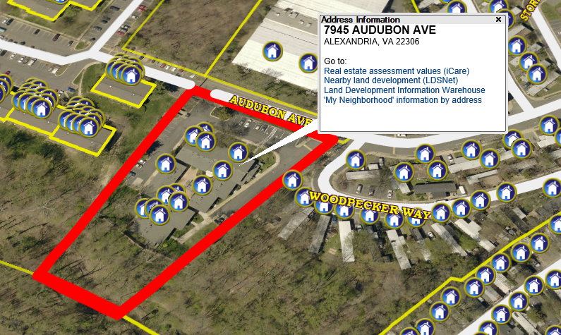
Audubon Apartments (1.70) 7945-7957 Audubon Ave. Alexandria, VA 22306

Slide 4
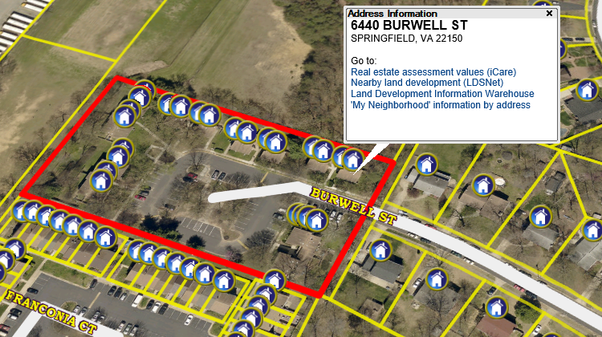
The Park Townhouses (2.50) 6440-6476 Burwell St. Springfield, VA 22150

Slide 5
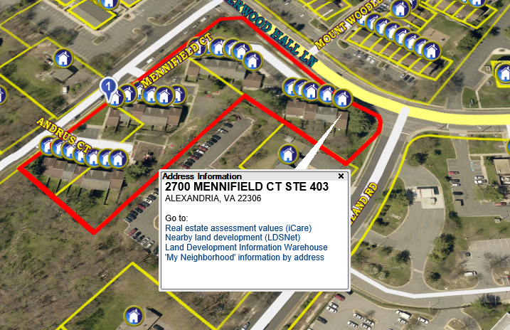
Westford I Townhouses (2.75) 7950-7962 Andrus Ct.; 2700-2732 Mennifield Ct. Alexandria, VA 22306

Slide 6
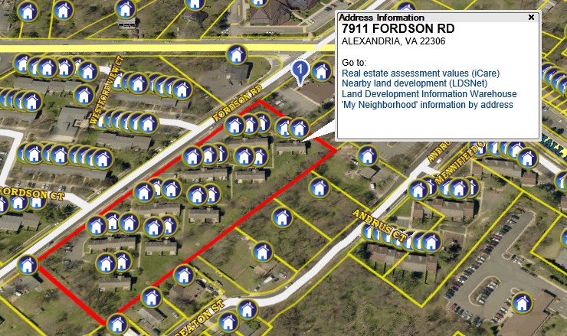
Westford II Townhouses (3.50) 7911-7953 Fordson Rd. Alexandria, VA 22306

Slide 7
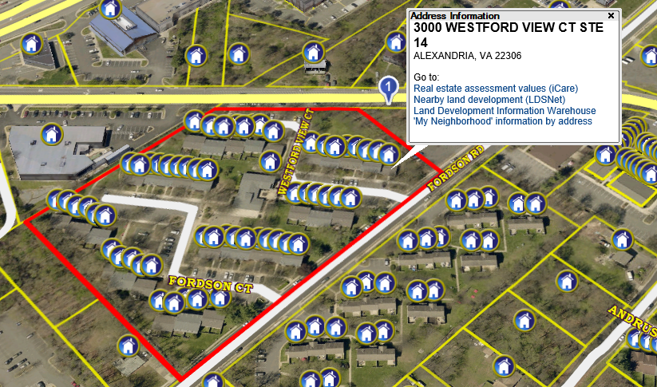
Westford III Townhouses (5.90) 3000-3031 Westford View: 3000-3021 Fordson Ct. Alexandria, VA 22306

Slide 8
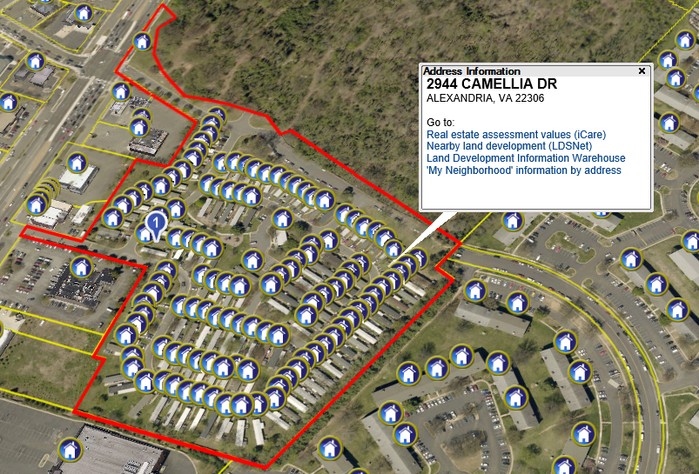
Woodley Hills Estates Mobile Home Park (18.10) 2800-3009 Camellia Dr.; 7400-7531 Poinsettia Dr.; 2801-2917 Daisy St.; 7401-7461 Mums Dr. Alexandria, VA 22306

Slide 9
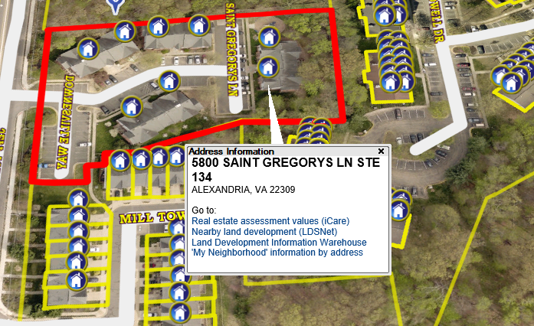
Old Mill Garden Apartments (1.80) 5800-5820 St. Gregory’s Lane Alexandria, VA 22309

Slide 10
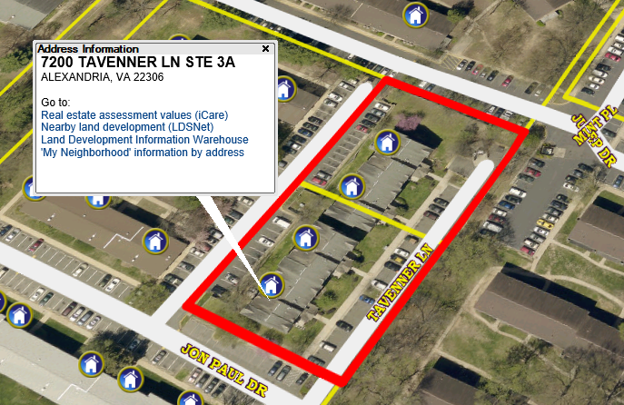
Tavenner Lane Apartments (1.60) 7200-7208 Tavenner Lane Alexandria, VA 22306

Slide 11
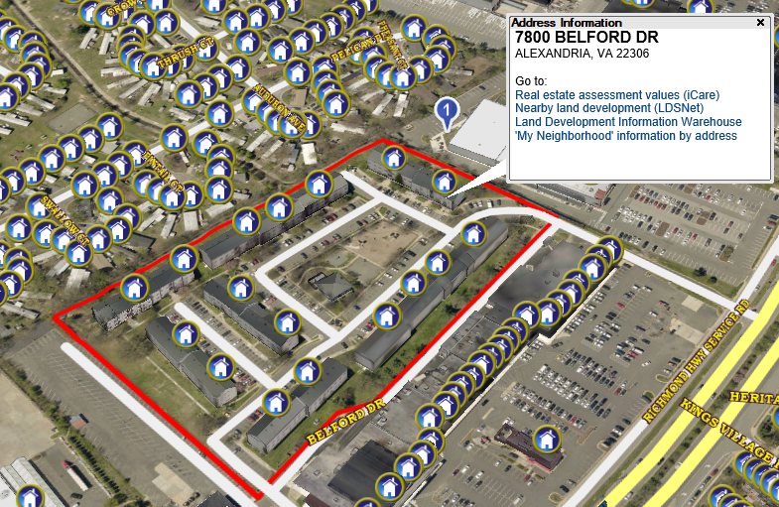
Murraygate Village (7.67) 7800 – 7820 Balford Drive Alexandria, VA 22306

