Slide 1
Solid Waste Management Program (78.8)
I-66 Transfer Station (151.7) - 4618 West Ox Rd, Fairfax, VA 22032
Lower Mordor Dr (10.2) - 10377 Mordor Dr, Lorton, VA 22079
(Cont.) Upper Mordor Dr./Furnace Rd/I-95 Transfer (13.8) 9898 Furnace Rd, Lorton, VA 22079
Newington (7) – 6901 Allen Park Rd, Lorton, VA 22079

Slide 2
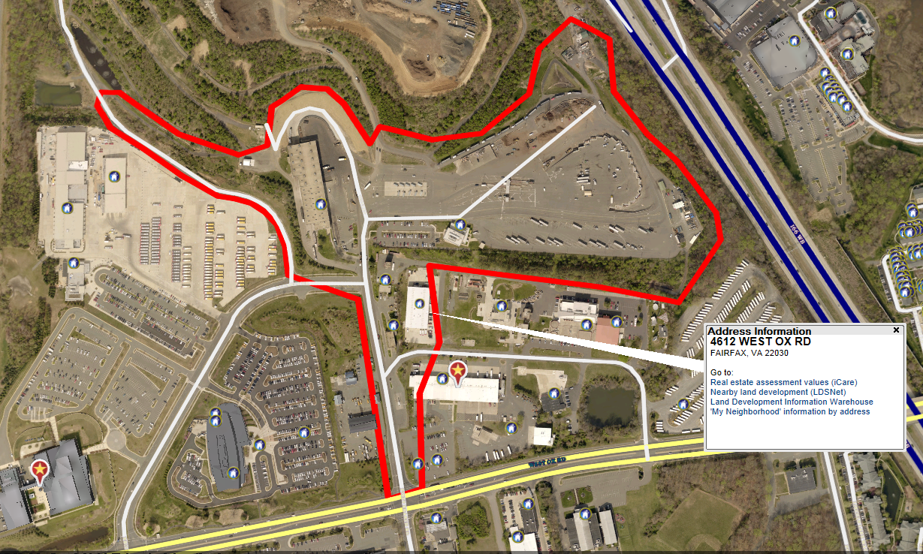
I-66 Transfer Station (47.8) – 4618 West Ox Rd, Fairfax, VA 22030

Slide 3
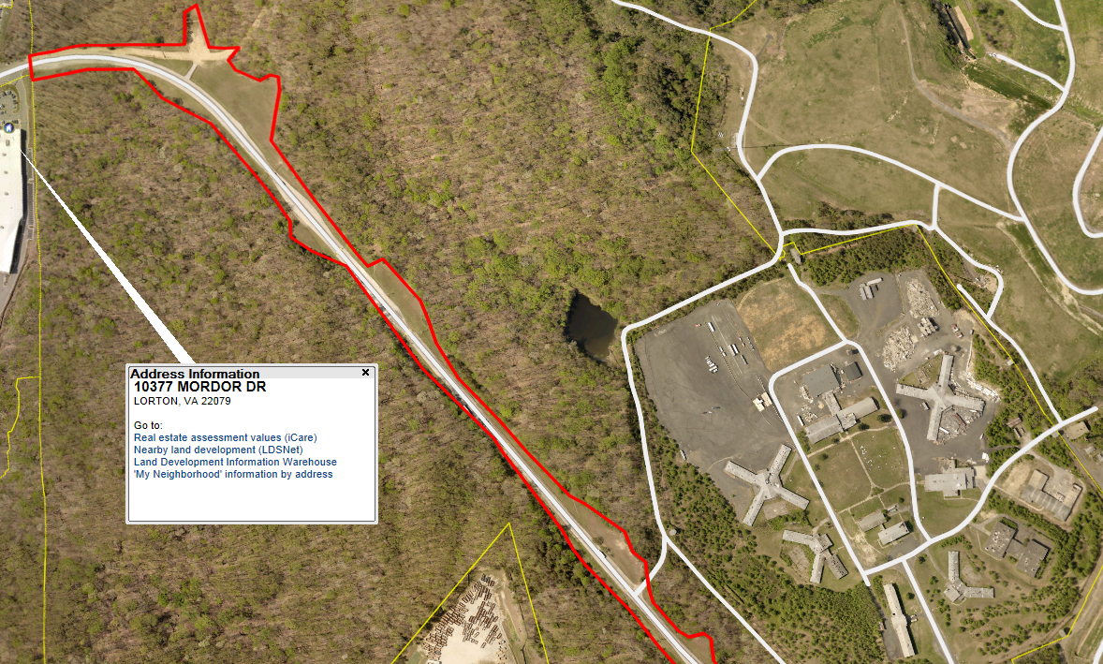
Lower Mordor Dr (10.2) -Leading to I-95 Transfer Station
10377 Mordor Dr, Lorton, VA 22079

Slide 4
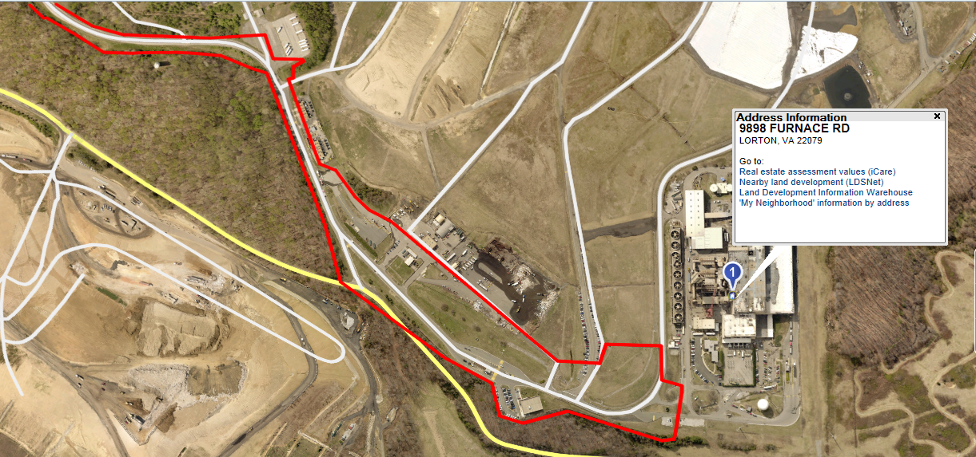
(Cont.) Upper Mordor Dr./Furnace Rd/I-95 Transfer (13.8) 9898 Furnace Rd, Lorton, VA 22079

Slide 5
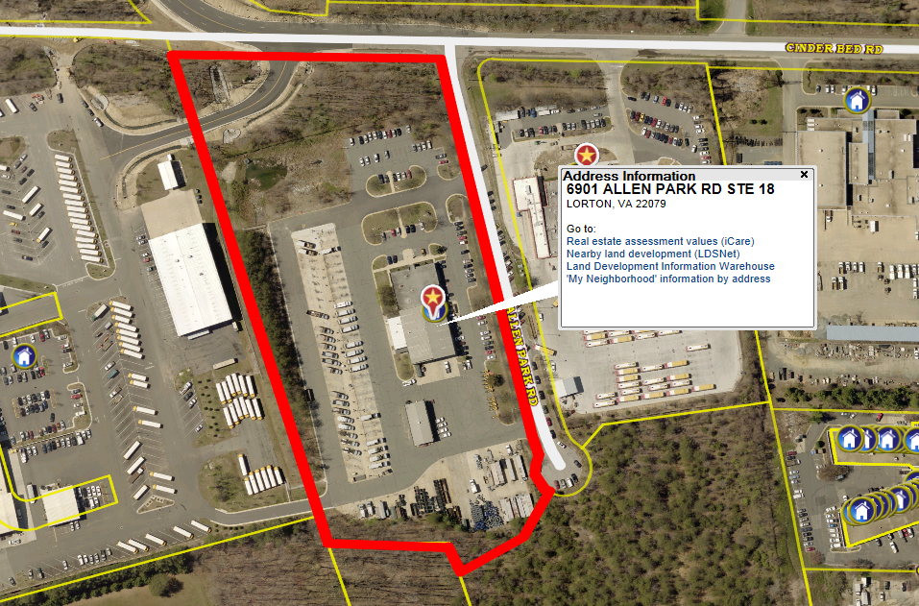
Newington (7) – 6901 Allen Park Rd, Lorton, VA 22079

