Slide 1
FAIRFAX-FALLS CHURCH COMMUNITY
Partnership to Prevent and End Homelessness
Bi-Annual CoC Meeting
July 7th, 2020 | 10:30 – 12:00 PM
Virtual Meeting
VIDEO
MICROPHONE
RAISE HAND
CHAT

Slide 2
AGENDA
1) Integration of Fairfax County’s Department of Housing & Community Development (HCD)
and the Office to Prevent and End Homelessness
2) Homeless Services System Updates
Summary of the Response to COVID-19
3) Virginia Department of Housing & Community Development
Homeless and Special Needs Housing (HSNH)
State-wide HMIS Data Integration Project
4) Homeless Services System Data
2020 Point in Time & Housing Inventory Counts
HUD System Performance Measures
5) Updates from Providers

Slide 3
INTEGRATION OF
Fairfax County’s Department of Housing & Community Development (HCD) and
Fairfax County’s Office to Prevent and End Homelessness

Slide 4
RESPONSE TO COVID-19
04.02.20: FEMA reimbursement funding secured for the payment of hotels
ESG-CV award of $1,699,586 announced by HUD
04.16.20: QPID Hotel Sites open in Falls Church, operated by Shelter House April 20th
215 Hotel Rooms
100 Hotel Rooms
05.02.20: ESF6 Workgroup, collaboration of 6 Fairfax County Departments was created
05.11.20: Decompression implemented at shelters to ensure ongoing social distancing
05.26.20: QPID Hotel Site opens in Herndon, operated by Cornerstones
87 Hotel Rooms
06.05.20: QPID Hotel Site opens in Alexandria, operated by New Hope Housing June 10th
QPID Hotel Site opens in Alexandria, operated by FACETS June 12th
06.09.20: ESG-CV award of $6,581,782 announced by HUD
06.17.20: Central Intake implemented, operated by Northern Virginia Family Service
57 Hotel Rooms
6 HOTELS | 459 Hotel Rooms | 50 DAYS

Slide 5
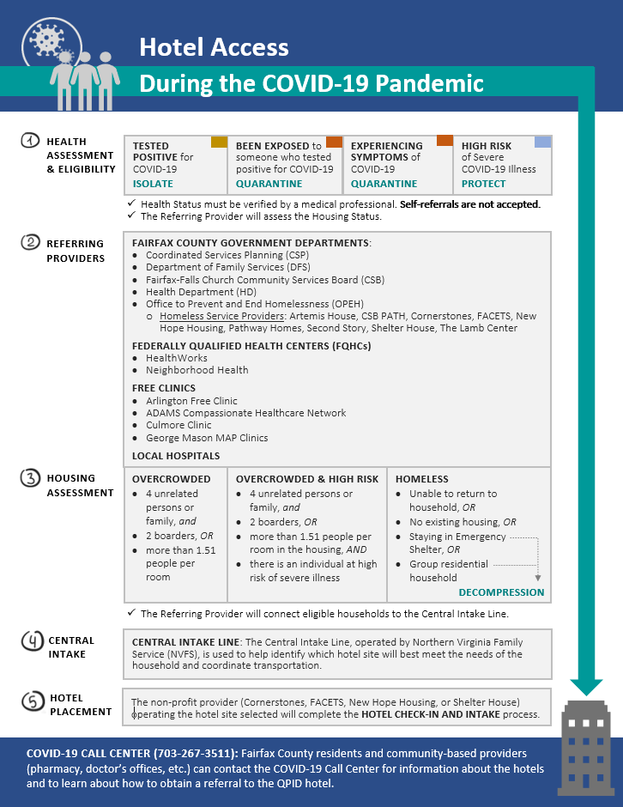
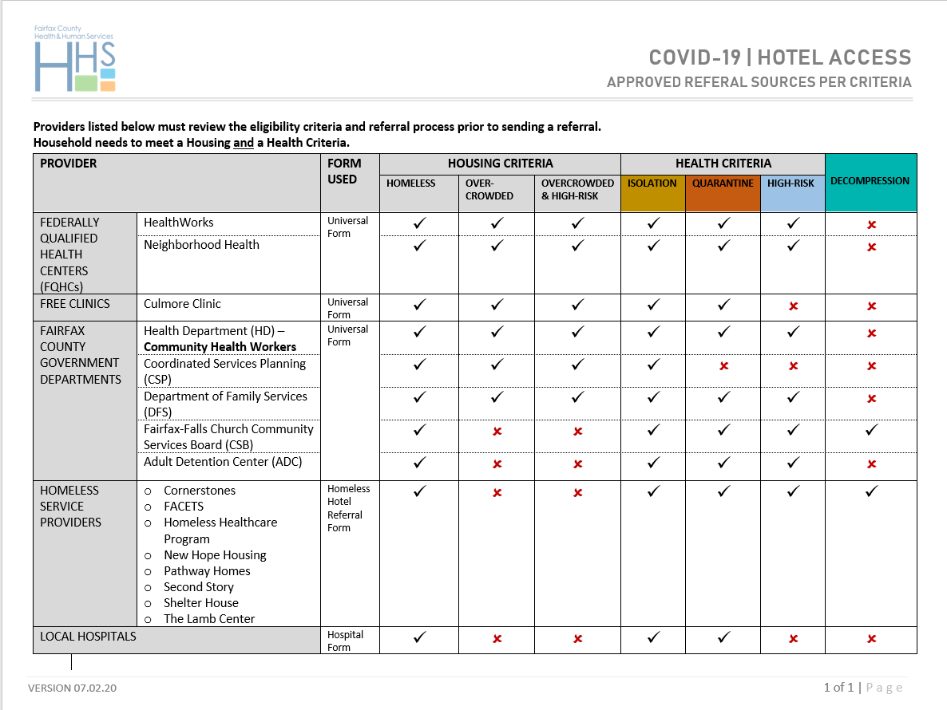
RESPONSE TO COVID-19
7 Fairfax County Health and Human Service Departments
Coordinated Services Planning (CSP)
Department of Family Services (DFS)
Fairfax-Falls Church Community Services Board (CSB)
Health Department (HD)
Office of Emergency Management (OEM)
Office to Prevent and End Homelessness (OPEH)
Office of Strategy Management (OSM)
5 Non-profit providers operating Hotels/Central Intake
Cornerstones
FACETS
New Hope Housing
Northern Virginia Family Service
Shelter House
2 Federally Qualified Health Care Centers (FQHCs)
HealthWorks
Neighborhood Health
4 Free Clinics
Culmore Clinic
Local Hospitals
25+ Partners

Slide 6
RESPONSE TO COVID-19
250+ Clients PLACED IN QUARANTINE, PROTECTION, ISOLATION, DECOMPRESSION (QPID) HOTELS

Slide 7
STATE-WIDE
HMIS DATA INTEGRATION PROJECT
ANDRIEA UKROP | Homeless Data Integration Coordinator

Slide 8
2020 POINT IN TIME COUNT
Point-in-Time Count (PIT): count of sheltered and unsheltered homeless persons
2020 PIT = January 22, 2020
Unsheltered
Emergency Shelter (DV Shelter, Overflow - Hotels & Winter Seasonal, Hypothermia Programs)
Transitional Housing
2019 PIT: 1,034 people experiencing homelessness
2020 PIT: 1,041 people experiencing homelessness (1% increase, 7 people)
21 Agencies (PIT & HIC) | 97 PROJECTS

Slide 9
2020 POINT IN TIME COUNT
43% reduction in the number of people experiencing homelessness since the 2008 PIT
Consistent decrease started in 2011
PIT Counts increased for the past four consecutive years (2017 – 2020)
964 people experiencing homelessness in the 2017 PIT Count
1,041 people experiencing homelessness in the 2020 PIT Count, an increase of 8%

Slide 10
2020 HOUSING INVENTORY COUNT
PROJECT TYPE |  | BEDS
 | ES | 833
 | TH | 247
 | RRH | 366
 | PSH | 627
 | OPH | 482
TOTAL BEDS |  | 2555
PROJECT TYPE | PEOPLE
Sheltered PIT Count | 953
Unsheltered PIT | 88
TOTAL PIT Count | 1041
TOTAL PIT Housed | 1430
TOTAL PEOPLE | 2471

Slide 11
SYSTEM PEFORMANCE MEASURES
Measure 1: Length of Time Persons Remain Homeless
Measure 2: The Extent to which Persons who Exit Homelessness to Permanent Housing
Destinations Return to Homelessness within 6, 12, and 24 Months
Measure 3: Number of Homeless Persons
Measure 4: Employment and Income Growth for Homeless Persons in
CoC Program-funded Projects
Measure 5: Number of Persons who Homeless for the First Time
Measure 6: Homelessness Prevention and Housing Placement of Persons Defined by
Category 3 of HUD’s Homeless Definition in CoC Program-funded Projects
Measure 7a: Successful Placement from Street Outreach
Measure 7b: Successful Placement in or Retention of PH

Slide 12
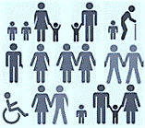
RARE
BRIEF
ONE TIME
System performance measure #3
Number of persons experiencing homelessness
METRIC 3.1 — CHANGE IN PIT COUNTS | METRIC 3.2 — CHANGE IN Annual Counts
PIT Count
7% INCREASE between
2017 & 2019
ANNUAL Count
6% INCREASE between
2018 & 2019
PIT & ANNUAL COUNTS
Point-in-Time Count
(Street Outreach, Emergency Shelter, & Transitional Housing)
Annual Count
(Emergency Shelter & Transitional Housing)
Federal fiscal year: 10/01 – 09/30

Slide 13
RARE
BRIEF
ONE TIME
System performance measure #5
First time homelessness
METRIC 5.1 — CHANGE IN THE # OF PERSONS IN ES+TH WITH NO PRIOR ENROLLMENTS IN HMIS
FIRST TIME HOMELESS
7% decrease between
2016 & 2018
2% INCREASE between
2018 & 2019
FIRST TIME HOMELESSS
Emergency Shelter & Transitional Housing
Federal fiscal year: 10/01 – 09/30

Slide 14
RARE
BRIEF
ONE TIME
System performance measure #7
Exits to permanent housing
METRIC 7b.1 — CHANGE IN PERSONS EXITING TO PERMANENT HOUSING
Percent exiting to permanent housinG
Permanent housing retention
1% increase between
2018 & 2019
ES + TH + RRH To Permanent
9% Increase between
2018 & 2019
Street Outreach To Permanent
64% Increase between
2018 & 2019
Exiting from Permanent Housing (excluding Rapid Rehousing) OR retaining permanent housing
Exiting from Emergency Shelter, Transitional Housing, & Rapid Rehousing
Exiting from Street Outreach
Federal fiscal year: 10/01 – 09/30

Slide 15
RARE
BRIEF
ONE TIME
System performance measure #1
Length of time persons remain homeless
METRIC 1.1 — Emergency Shelter
Average length of stay
34% increase between
2016 & 2019
Number of persons served
6% decrease between
2018 & 2019
Average length of stay
(days)
Number of Persons Served
Includes Hypothermia
Federal fiscal year: 10/01 – 09/30

Slide 16
QUESTIONS?

Slide 17
PARTNERSHIP UPDATES & INITIATIVES

Slide 18
FAIRFAX-FALLS CHURCH COMMUNITY
Partnership to Prevent and End Homelessness
Thoughts, questions, or ideas
about CoC meetings?
Jamie Ergas, LMSW
Continuum of Care Manager
Office to Prevent and End Homelessness
Department of Housing & Community Development
Direct: 703-324-3240
Cell: 703-223-2003
jamie.ergas@fairfaxcounty.gov

